Slide 1
Ucr ucpath transaction pilot
HANDOFF processes

Slide 2
TRAINER INTRODUCTION
Shannon Minter
Title: UCPath Business Support Analyst/Escalation Lead
Department: UCPath Campus Support Center
Year(s) @UC: 2 1/2
Previous Experience: 14 years of professional human resources analyst experience, focusing on classification & compensation, training development, position management, and recruitment.

Slide 3
TRAINER INTRODUCTION
LaKesha Welch
Title: UCPath Business Support Analyst/CSC Team Lead
Department: UCPath Campus Support Center
Year(s) @UC: 5 1/2
Previous Experience: 15 years Lead Business analyst/Functional Analyst support

Slide 4
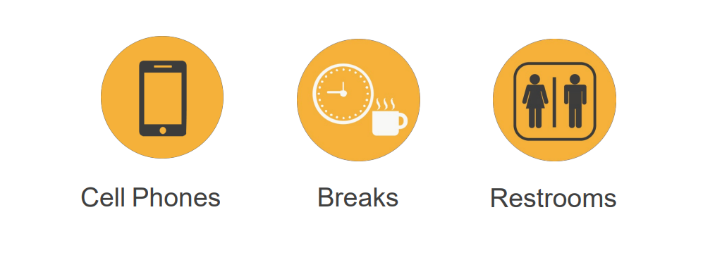
HOUSEKEEPING

Slide 5
LEARNING OBJECTIVES
Understand the roles and responsibilities for each process
Understand the handoff process within each process
Understand the Approval Workflow process, which leverages the Approval Workflow Engine

Slide 6
LEARNING TOPICS
ONE–TIME PAYMENTS
PERSONAL DATA CHANGES
VOLUNTARY TERMINATION
POSITION CONTROL
PERSON OF INTEREST
CONTINGENT WORKER
ON BEHALF OF CASE MANAGEMENT
THINGS TO REMEMBER
APPENDIX
FEEDBACK

Slide 7
One-Time Payment

Slide 8
PROCESS DEFINITION
The One Time Pay process is the method to add a flat dollar amount payment for staff and academic employees to be processed in a specific pay period.
The Transactional Units will have the opportunity to submit one-time payments for employees within their Accountability Structures.
The process begins when a department initiator in a Transactional Unit submits a one-time payment transaction for an employee in UCPath.
The process ends when all Payroll processes have been completed for the applicable pay period and the employee receives the payment on their paycheck.

Slide 9
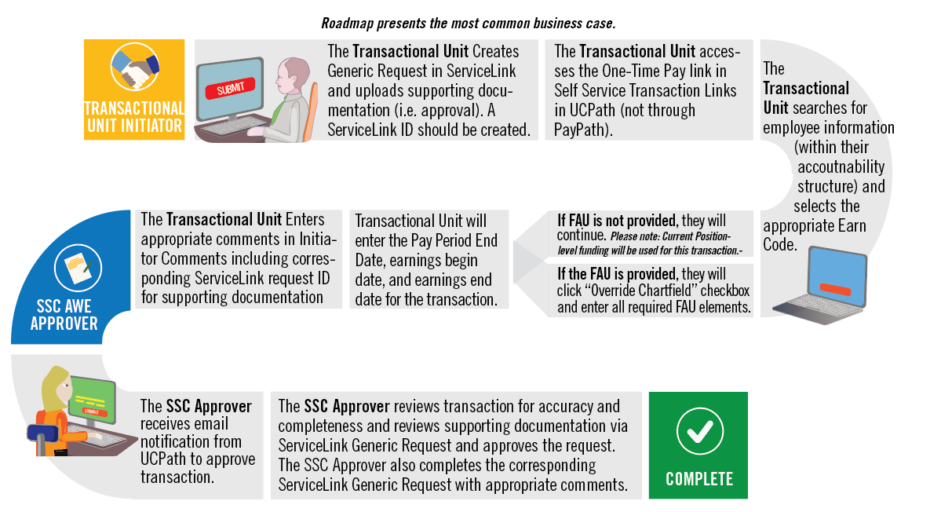
ONE-TIME PAYMENT ROADMAP

Slide 10
HANDOFF MATRIX
Scenarios | One Time Payment | Contact UCR Payroll | ServiceLink Request
STAR/SPOT award for one employee. | Transactional Unit
STAR/SPOT awards for entire department. |  |  | To SSC
By-agreement Payments/Earnings for UNEX faculty. |  |  | To SSC
Honoraria pay for UCR faculty on pay status. |  |  | To SSC
Regular payments for instructors in Transactional Unit Depts. (i.e. Rec Center Instructors) | Transactional Unit
Interlocation Honoraria Payment for Faculty. |  | UCR Payroll Team (Payroll Coordination & Analysis)
Staff Administrative Stipends Exceeding One Pay Period (Recurring Additional Pay). |  |  | To SSC
Other One-Time Additional Compensations (i.e. Staff Stipend for One Pay Period). | Transactional Unit
Summer Session Payments for Non-Faculty Academics |  |  | To SSC
Faculty Summer Salary Recurring Additional Payments (Non-research/Payroll Certification) |  |  | To SSC
This matrix walks through common use case scenarios involving non-regular/base payments, and which process they involve.
The scenarios marked under the One Time Payment column are in scope for this Pilot process.

Slide 11
AWE APPROVAL
Note: SSCs cannot clone denied one-time payments.
If they are denied, they always have to be re-entered.
Transactional Unit Initiator
Determine if person needs one time pay transaction
Shared Services Center
Review and approve, or deny Transactions
Deny
AWE

Slide 12
CHECK YOUR UNDERSTANDING

Slide 13
Personal Data Changes

Slide 14
PROCESS DEFINITION
Personal data is information the is unique to each employee. For example: your name, personal email address, education credentials, and contact information.

Slide 15
PERSONAL DATA CHANGES ROADMAP

Slide 16
HANDOFF MATRIX
Process | Employee Updates | Transactional Unit | SSC | UCPC
Personal Data Change | Employee Updates: Education Degree/Highest Degree Achieved, Licensure/Certification Legal Name (verified through SSNVS) | ------ | Validation and approval for Education Degree/Highest Degree Achieved, and Licensure/Certification | Legal Name change is verified through SSNVS
* The Central Offices have no responsibilities in this process

Slide 17
HANDOFF MATRIX
Process | Employee Updates | Transactional Unit | SSC | UCPath
Personal Data Change | Provides information to transactional unit | Transactional Updates Information: Email address (personal), Emergency contact, Home and mailing addresses, Disclosure of information, Phone number (personal) | SSCs review, approve, or deny via AWE | ------
Personal Data Change | Provides information to transactional unit | Transactional Updates Information: Education Degree/Highest Degree Achieved, Licensure/Certification, Legal Name (verified through SSNVS) | Validation and approval for Education Degree/Highest Degree Achieved, and Licensure/Certification | Legal Name change is verified through SSNVS
* The Central Offices have no responsibilities in this process

Slide 18
AWE APPROVAL (continued)
Transactional Unit Initiator
Initiator submits Template Transaction.
Shared Services AWE
Review and approve, or deny Template Transactions
Deny
AWE

Slide 19
CHECK YOUR UNDERSTANDING

Slide 20
Voluntary Termination

Slide 21
PROCESS DEFINITION
The process of Voluntary Termination starts with the employee’s decision to resign or retire, and ends with the final payment information being transferred to the UCPath Center Payroll Production team. Voluntary terminations are processed for both staff and academic employees.
There are benefits and payroll implications of voluntary terminations. These are dealt with in separate processes. The process ends with the confirmation that the employee has been separated, all access to systems and facilities has been updated or terminated, and all outstanding university and employee obligations related to compensation are settled.

Slide 22
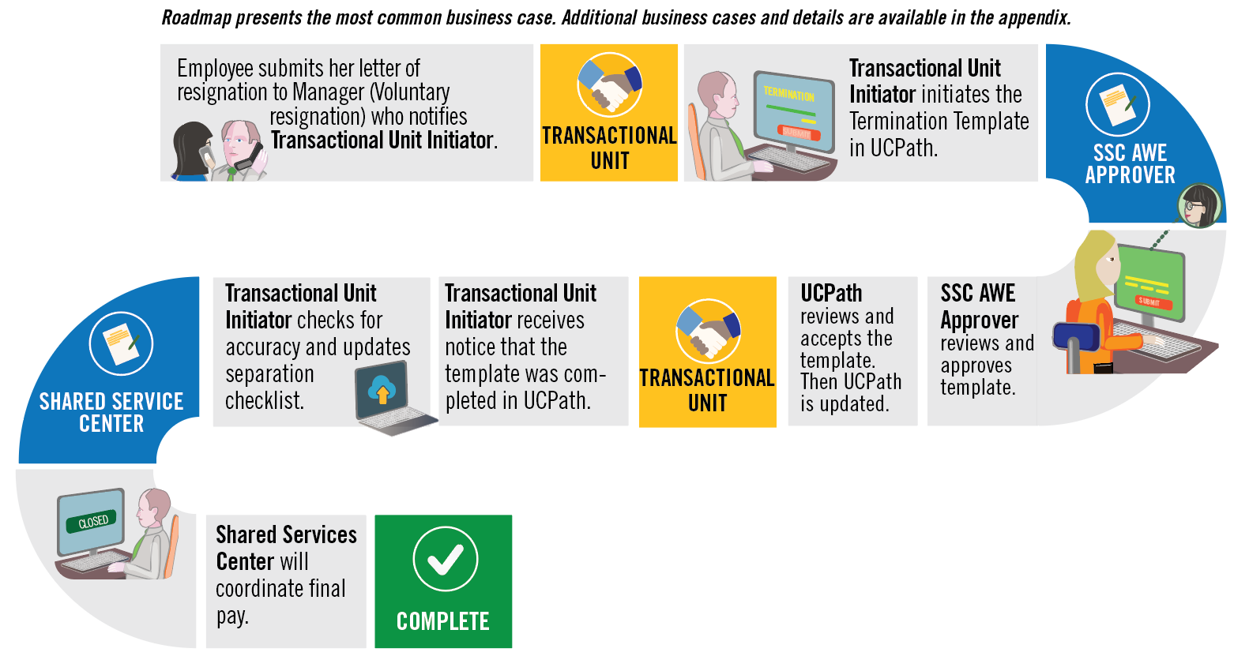
VOLUNTARY TERMINATION ROADMAP

Slide 23
HANDOFF MATRIX
Process | Employee | Transactional Unit | SSC | UCPC
Offboarding | Provides Resignation | Received Resignation
Offboarding |  | Process Termination Template including attachments, Needs to review Smart HR Template page and/or email to verify that it was approved or that it needs to be re-entered / cloned | Review Termination Template and attached documents in AWE
Offboarding |  | Needs to review Transaction Status page and/or email to verify that it was approved or that it needs to be re-entered / cloned. The Transactional Unit initiator contacts the SSC via Zoom, email, or phone, when UCPC cancels a transaction. |  | Reviews locally approved termination template
Offboarding |  | Verify that SSC has processed final pay | Processes Final Pay Automatically (once termination template is approved)

Slide 24
AWE APPROVAL
The Transactional Unit initiator contacts the SSC when UCPC cancels a transaction.
Transactional Unit Initiator
Initiate Voluntary Offboarding Transaction
Shared Services Center
UCPC
Receive, review, approve or cancel template transaction
Review and approve, or deny Transactions
Deny
Cancel
AWE
Approve
Note: Once transaction is approved, SSC will automatically complete final payment for Employee
Note: The Transactional Unit needs to monitor the Transactional Status page and/or email notification.

Slide 25
CHECK YOUR UNDERSTANDING

Slide 26
Position Control

Slide 27
PROCESS DEFINITION
UCPath Position Data Management refers to the process of creating and editing new and existing position data within PeopleSoft. Position data includes Business Unit, Department, Location, Establishment ID, Job Code, FLSA Status, Union Code, Reports To, Salary Plan, Salary Grade, FTE, and Standard Hours.

Slide 28
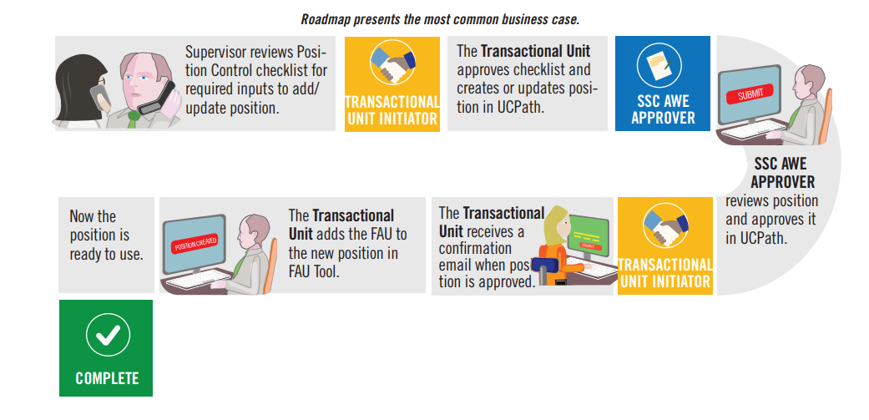
POSITION CONTROL ROADMAP

Slide 29
HANDOFF MATRIX
Process | Position/ Funding | Category | Transactional Unit Responsibility | SSC/Central Office Responsibility
Position Control | Position | New position request or updating vacant positon | Updating vacant or creating new position via POSITION CONTROL page | In Phase 1, SSCs review and approve or deny positions via AWE
Position Control | Funding | Updating Simple FAU | Update position FAU in FAU tool | none
Position Control | Funding | Funding for Positions with Complex FAUs, HCOMP, Salary Cap | Submit request for complex funding for positions via ServiceLink using the FAU Change request form or SnapShap (HARVEST/CHASS ONLY) Note: This is a temporary solution for the complex FAU | SSC fulfills the request
Position Control | Position | Updating a Multi-Headcount Position | Submit request to revise position via the ServiceLink Update Position form | SSC Position Control Administrator will update position Updates ServiceLink or SnapShot tool

Slide 30
AWE APPROVAL
Transactional Unit Initiator
Initiate Position Control request
Shared Services Center
Transactional Unit Initiator
Update Position Funding using FAU tool
Review and approve, or deny Transaction for Position Request
Deny
AWE
Approve

Slide 31
CHECK YOUR UNDERSTANDING

Slide 32
Person of Interest

Slide 33
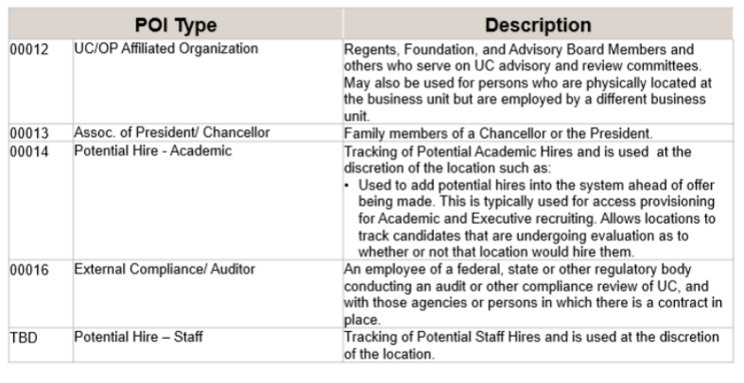
PROCESS DEFINITION
A Person of Interest (POI) is someone who is tracked by Locations for various reasons, such as a potential hire or potential external resource. Locations are responsible for adding and maintaining POI records in UCPath.

Slide 34
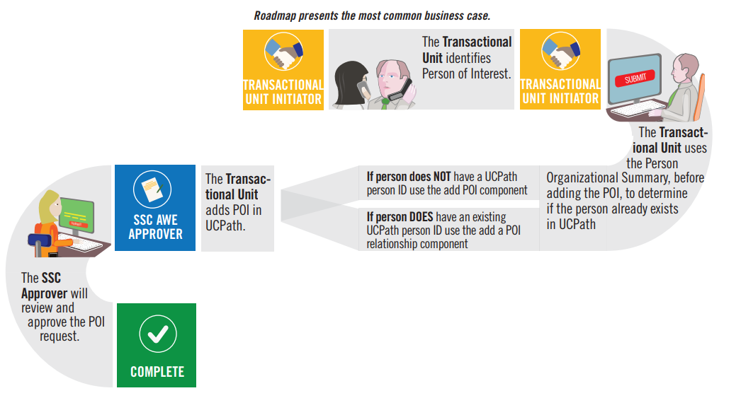
PERSON OF INTEREST ROADMAP

Slide 35
HANDOFF MATRIX
Process | Transactional Unit | SSC | Central Office
POI | Determine the need for Person of Interest
POI | Enter information on “Add POI” page Needs to review POI page and/or email to verify that it was approved/denied by SSC that it needs to be re-entered | Review and approve/deny POI page AWE
POI | Pilot Unit should reach out to central office for any questions regarding policy prior to processing POI transactions. | SSCs should reach out to central office for any questions regarding policy prior to approving POI transactions. | Respond to any policy questions

Slide 36
AWE APPROVAL
The approval workflow routing appears after the POI Initiator successfully submits the new person of interest.
UCPath assigns the Person ID and creates the POI record when the request is approved.
Transactional Unit Initiator
Determine if person is in UCPath, then enter/update POI or add new POI relationship
Shared Services Center
UCPC
Receive, review, approve or cancel Transaction
Review and approve, or deny Transactions
Deny
Cancel
AWE
Approve

Slide 37
CHECK YOUR UNDERSTANDING

Slide 38
Contingent Worker

Slide 39
PROCESS DEFINITION
Contingent Workers are defined as individuals engaged by the University of California on a non-permanent basis to complete a specific function or task who do NOT have an employee relationship with UCR and do NOT receive remuneration through UCPath.
An example of a contingent worker is a volunteer, since they are not paid, but also agency workers who perform work for UCR, but are paid through their agency. As such, all contingent workers, including temporary agency workers MUST be entered in UCPath for tracking purposes.

Slide 40
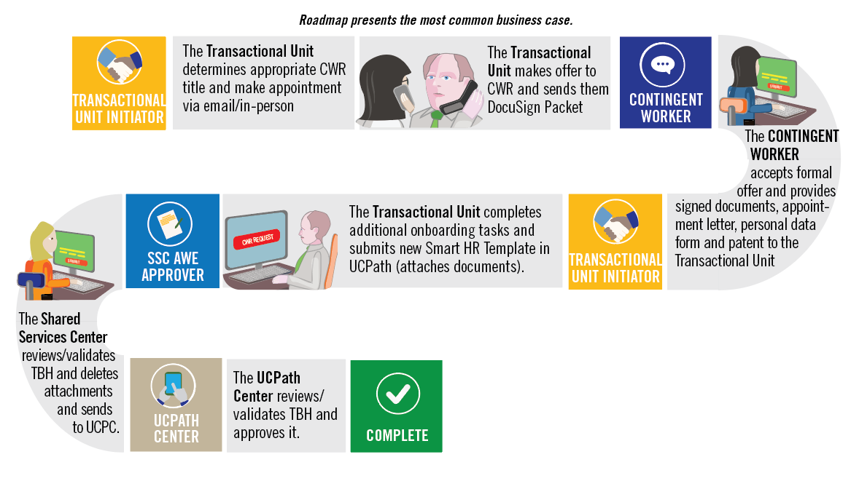
CONTINGENT WORKER ROADMAP
Note: CWR signs hard copy patent acknowledgement form during onboarding

Slide 41
HANDOFF MATRIX
Process | Employee | Transactional Unit | SSC | UCPC | Central Office
CWR | Provides signed appointment letter, personal data form and patent. | Receives employee paperwork
CWR |  | Process Smart HR Template for CWR, including attachments, Needs to review Smart HR Template page and/or email to verify that it was approved/denied by SSC that it needs to be re-entered / cloned. | Review and approve/deny Smart HR Template for CWR and attached documents in AWE
CWR |  | Needs to review Transaction Status page and/or email to verify that it was approved/denied by UCPC that it needs to be re-entered / cloned. The Transactional Unit initiator contacts the SSC via Zoom, email, or phone, when UCPC cancels a transaction. |  | Reviews locally approved CWR template
CWR |  | Pilot Unit should reach out to central office for any questions regarding policy prior to processing template | SSCs should reach out to central office for any questions regarding policy prior to approving template |  | Respond to any policy questions

Slide 42
HANDOFF MATRIX
Process | Category | CWR Responsibility | Transactional Unit Responsibility | SSC Responsibility | Central Office Responsibility
CWR | Background Check and Live Scan | Receives simplybookme. Link and completes requested background check | Book fingerprint appointments through simply book me. This may occur before the template is submitted. Receives background check results from SSC | The results are sent to Central HR and the SSC receive an email stating if the background check is successful or not. SSC then emails the department to let them know that the employee can start work | Receive background check results and sends email to SSC. Labor Relations notifies SSC and Transactional Unit if there is an issue with the background check

Slide 43
HANDOFF MATRIX
Process | Category | CWR Responsibility | Transactional Unit Responsibility | SSC Responsibility | Central Office Responsibility
CWR | Standard Case Management Issues | ------ | Transactional Unit Initiators are responsible for opening STANDARD cases directly in Saleforce for transactions that they are initiating per the case management matrix. ESCALATED cases are to be elevated to the SSC per the On Behalf of Case Management Matrix. | ------ | ------

Slide 44
AWE APPROVAL
The Transactional Unit initiator contacts the SSC when UCPC cancels a transaction.
Transactional Unit Initiator
Initiate all CWR Template Transactions
Shared Services Center
UCPC
Receive, review, approve or cancel template transaction
Review and approve, or deny Template Transactions
Deny
Cancel
AWE
Approve
Note: The Transactional Unit needs to monitor the Transactional Status page and/or email notification.

Slide 45
CHECK YOUR UNDERSTANDING

Slide 46
On Behalf of Case Management

Slide 47
ON BEHALF OF DEFINITION
On Behalf Of Case Management is the task of submitting an inquiry or an update on behalf of another employee or yourself to the UCPath Center via the UCPath website. This process is also used for the following common tasks (Not an exhaustive list):
Update, modify, edit, or change an employee/CWR information.
Open a Case for Transactions created on behalf of the employee, that did not process correctly, or were improperly cancelled by UCPath.
To make specific Personal Data Change updates as defined in the Future State Process Design (FSPD).

Slide 48
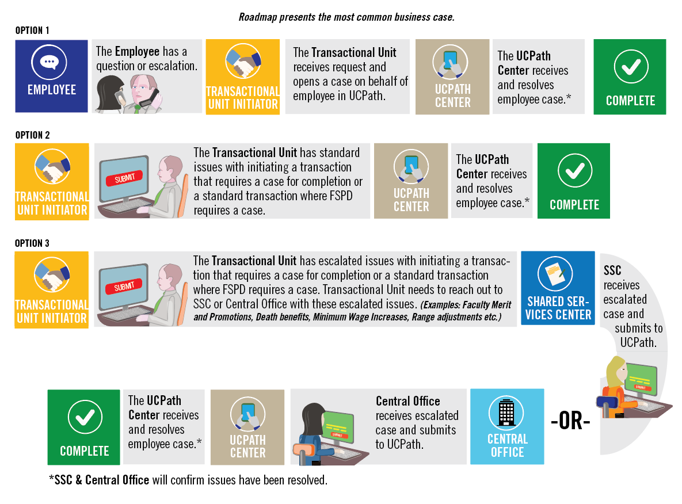
ON BEHALF CASE MANAGEMENT ROADMAP

Slide 49
HANDOFF MATRIX
Category | Purview | General Approach | Transactions Initiated by SSC only
Cases related to STANDARD transaction entry that requires UCPC entry | Transactional Unit | STANDARD corrections or updates initiated by the Transactional Unit for non-pay impacting, non-benefit related fields. For example correction of the following fields: Date of Birth Personal Data Name Address | ------

Slide 50
HANDOFF MATRIX
Category | Purview | General Approach | Transactions Initiated by SSC only
Cases related to ESCALATED transaction entry that requires UCPC entry | SSC | ESCALATED corrections or updates initiated by the SSC need to be opened by the SSC ONLY. Transactional units should NOT open cases for these escalated items but should send them to the SSC for handling: Any PAY related transactions that require a correction or a case that involves the following fields: Comp Rate Job Frequency Effective Date FTE Pay Group Additional Pay One-Time Pay | Retroactive Compensation Changes Overpayments Off Cycle Checks Final Pay Next Day Checks Missed Pay resolution Leave of Absence Issues Requests Sabbatical Credit Adjustments

Slide 51
HANDOFF MATRIX
Category | Purview | General Approach | Transactions Initiated by SSC only
Cases related to ESCALATED transaction entry that requires UCPC entry | SSC | Any ACCRUAL or BENEFITS related issues that require a correction or a case. DCP Retirement Cancellation of Benefits Issues with reinstatement Deductions A lapse in benefits coverage Damage Payments Service Credit Adjustments | Retroactive Compensation Changes Overpayments Off Cycle Checks Final Pay Next Day Checks Missed Pay resolution Leave of Absence Issues Requests Sabbatical Credit Adjustments

Slide 52
CHECK YOUR UNDERSTANDING

Slide 53
LEARNING OBJECTIVES REVIEW
Having completed this course, you should be able to:
Understand the roles and responsibilities for each process
Understand the handoff process within each process
Understand the Approval Workflow process, which leverages the Approval Workflow Engine

Slide 54
APPENDIX
On behalf case management Process Map
Position control Process Map
Contingent worker Process Map
Personal data changes Process Map
Person of interest Process Map
One–time payments Process Map
Voluntary termination Process Map

Slide 55
Your Feedback Please
http://bit.ly/ucpathpilottraining

