Slide 1

Ucr ucpath transaction pilot
payroll CALENDARS & AUTOMATED PROCESSES

Slide 2


TRAINER INTRODUCTION
NAME: Andrea Campos
Title: Business Systems Analyst
Department: Business & Financial Services
Years @UC: 3 Years

Slide 3
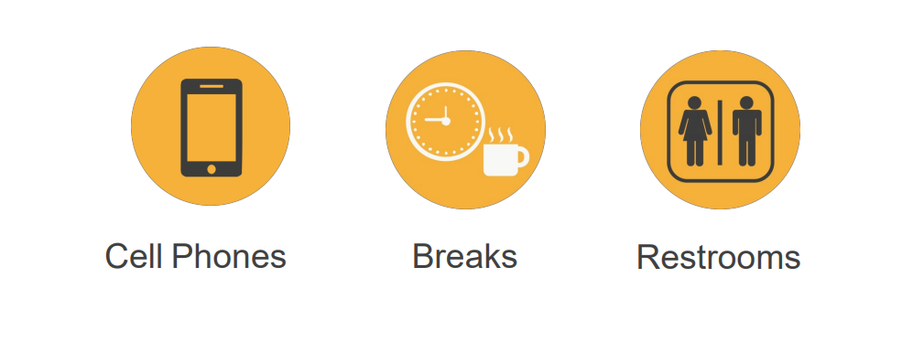
HOUSEKEEPING

Slide 4
LEARNING OBJECTIVES
Understand Milestones on UCPath Payroll Processing Schedule
Understand Criticality and Impact of Payroll Milestones
Recognize and define key UCPath terms and acronyms
Understand Payroll-impacting Inbound Files
Understand UCPath Automated Processes
Understand SSC Calendar Deadlines and SLA – forthcoming topic week of 7/15

Slide 5
LEARNING TOPICS
Payroll Calendar Definition
Understanding Critical Payroll Deadlines
  UCPC Payroll Processing Schedule
Inbound Files to UCPath
UCPath Center (UCPC) Deadlines
Automated Processes
  Pay Calendar Example
  Overnight Processes
  Monthly Processes
Payroll Calendars
  Monthly Payroll
  Biweekly Payroll
Learning Objectives Review
Things to Remember
Appendix
Questions and Answers

Slide 6


Slide 7

PAYROLL CALENDARS DEFINITION
The UCPath Payroll Process involves a series of actions and interfaces to process gross to net paychecks and finalize the payroll balances each pay cycle.
The process begins with calculating initial hours, taxes, and deductions. An iterative calculation routine will produce various validation edits for review, as well as data for subsequent processes and reports.
The process ends when payments are calculated and confirmed in UCPath, and employees receive both their paychecks and earnings statements correctly through direct deposit or paper check.
The UCPath Center enforces a strict timeline for payroll processing deadlines that all UC locations must adhere to.

Slide 8


Slide 9
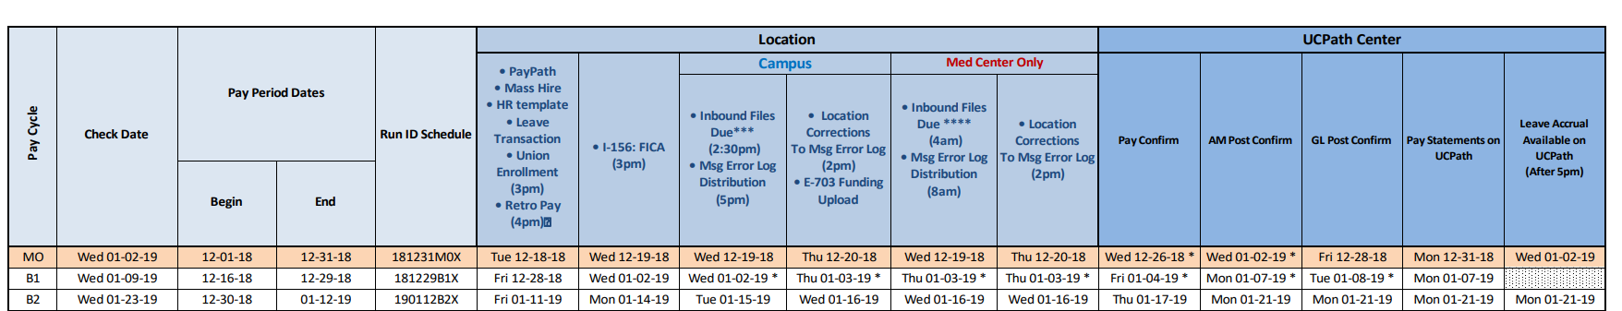
UCPC PAYROLL PROCESSING SCHEDULE MILESTONES
Pay Cycle
  MO – Payroll deadlines for Monthly-paid employee; these employees receive earnings once a month.
  B1 – Payroll deadlines for the first biweekly payroll period of the month for employees paid on a biweekly basis.
  B2 – Payroll deadlines for the second biweekly payroll period of the month for employees paid on a biweekly basis.
  B3 – Payroll deadlines for the third biweekly payroll period of the month for employees paid on a biweekly basis. (Note: third biweekly pay cycles only occur a few times per year).
Check Date
  Date that employees are expected to receive earnings for that particular pay period.

Slide 10
Pay Period Dates
  Period of time in which employees’ earnings are based on.
  Begin – Earnings Begin Date; first day of that earnings period.
  End – Earnings End Date; last day of that earnings period.
Run ID Schedule
  Pre-defined, unique identifier for the payroll processing for that period.
  Naming convention is YYMMDD, Pay Cycle, and “X” for On Cycle.

Slide 11
UCPC PAYROLL PROCESSING SCHEDULE MILESTONES (continued)
Location Milestones
  PayPath/Mass Hire/HR Template/Leave Transaction/etc.
    These types of transactions are payroll-impacting and must be submitted and approved in UCPath by this deadline in order to be processed with that particular pay cycle.
    For instance: Position Data Changes, Voluntary Termination, and One Time Payments must be entered by this deadline for that particular pay period.
    Retro Pay (4PM)
      This process pulls retroactive job data changes into the current payroll for that particular pay cycle.
  If this deadline is missed, transactions will need to be submitted against a future pay period.
  Best Practices: submit transactions 3 days prior to this deadline to ensure they
  are processed in the applicable payroll cycle.

Slide 12
Location Milestones – Continued
  I-156: FICA File (3PM)
    Interface file from Banner Student Information System (Banner SIS) to UCPath due on this date.
    This interface file applies rules for student employees who are potentially exempt from FICA taxes if enrolled in a minimum number of class credits.

Slide 13
Location Milestones – Continued
  Campus (These milestones apply to all UC campuses on UCPath)
    Inbound Files Due
      Payroll-impacting interface files (i.e. Parking Deductions Interface, Regular Time Entry Interface) are due on this date.
      Most interfaces are sent to UCPath on an automated job scheduler.
      Msg Error Log Distribution: Error logs are generated if there are any transaction errors discovered when the above interfaces were loaded in UCPath. These error logs are disseminated to the appropriate parties (i.e. Shared Services Centers).

Slide 14
Location Milestones – Continued
  Campus (These milestones apply to all UC campuses on UCPath)
    Location Correction to Msg Error Log
      Any corrections required to transactions that appeared on these error logs must be corrected by this date and time.

Slide 15
Location Milestones – Continued
  Med Center Only
    These milestones only apply to UC campus medical centers (i.e. UCLA and UCSD Med Centers).
    Deadlines not necessary for our campus.

Slide 16
Pay Confirm
  Delivered process that finalizes paycheck data.
AM Post Confirm
  A series of processes that update the Absence Management components of payroll transactions.
GL Post Confirm
  A series of processes that update the general ledger to reflect payroll transactions that have been processed.

Slide 17
Pay Statement on UCPath
  Date when earnings statements are accessible to employees in the UCPath Portal for that particular pay period.
Leave Accrual Available on UCPath
  Date on Payroll calendar when updated accrual balances are visible to employees in the UCPath portal; balance based on leave takes reporting in the payroll month.

Slide 18
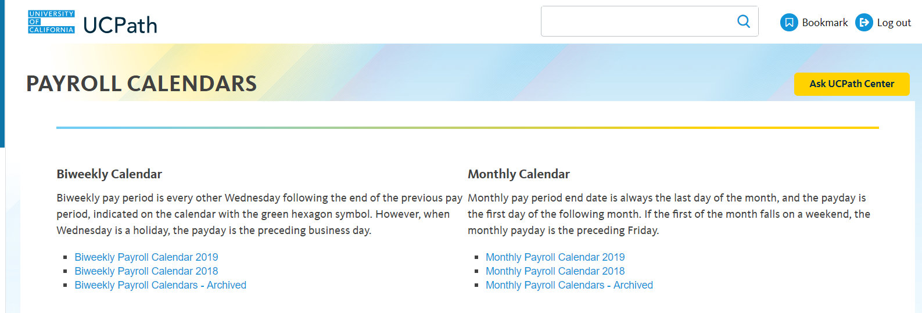
NAVIGATION TO SCHEDULES & CALENDARS IN UCPATH PORTAL
Navigation to Payroll Processing Schedules
UCPath Portal > Quicklinks > Payroll Calendars & Schedules > Payroll Processing Schedules
Navigation to Payroll Calendars
UCPath Portal > Quicklinks > Payroll Calendars & Schedules > Payroll Calendars

Slide 19
Inbound Files to UCPath

Slide 20
INBOUND FILES TO UCPATH
E-084: Manage Accruals
Custom component of UCPath for payouts, accruals, leave takes, and leave adjustments (Access to this page is highly limited).
E-330: Batch Load Additional Pay
Process that loads recurring additional pay transactions.
I-160:Tuition Reimbursement
File interface from Banner SIS to UCPath that provides a list of Employees receiving Tuition Remission benefits (with the associated Deduction Codes).
I-176: Parking Deductions
Interface file that loads parking deductions from Transportation and Parking Services (TAPS) to UCPath for payroll processing.
Note: this interface file will no longer be used as TAPS will begin using the I-378: One Time General Deductions interface file for parking deductions.
I-181: Regular Time Entry
Interface file that loads hours worked (i.e. regular/overtime) and leave taken (i.e. vacation, sick, leave no pay) from the Time and Attendance Reporting System (TARS) to UCPath.

Slide 21
INBOUND FILES TO UCPATH
E-353: Batch Load One-Time Payments
The process that submits one-time/flat dollar amount payment for staff and academic employees to be processed in a specific pay period.
This deadline is when Pilot One Time Pay transactions are processed.
I-171: Reoccurring General Deductions
Interface file that transfers payroll deduction data UCPath for deduction input and payroll processing.
I-378: One Time General Deductions
Interface file that transmits One-Time General Deductions, overrides, and adjustments to UCPath for processing. These one-time deductions will be flat amounts to either withhold or refund an additional amount specified on the file.
I-618: Flat Dollar Amount
A manually generated interface file that submits one-time/flat dollar amount payment, en masse, for staff and academic employees to be processed in a specific pay period
E-703 Funding Upload
Process that uploads daily position-level funding changes (made through FAU Change Request Tool) to UCPath for processing.

Slide 22
INBOUND FILES TO UCPATH
Error Log Distribution
If any of the interface files contain errors and transactions are rejected by UCPath, an error log is produced.
Corrections to Error Log Distribution
Locations have the opportunity to submit “correction files” to fix errors that occurred.
Correction files have a critical deadline on the payroll calendar.
Corrections will continue to be performed by Campus Shared Service Centers.

Slide 23
UCPath Center Deadline Definitions

Slide 24
UCPATH CENTER DEADLINES DEFINITIONS
Pay Calculation
Initial UCPath Payroll process that calculates paycheck data based on inputs (i.e. interface files, data changes, etc.) from upstream processes and configuration.
Pay Confirm
Delivered process that finalizes paycheck data.
AM Post Confirm
A series of processes that update the Absence Management components of payroll transactions.
GL Post Confirm
A series of processes that update the general ledger to reflect payroll transactions that have been processed.
Pay Statement on UCPath
Date on Payroll calendar when earnings statements are accessible to employees in the UCPath portal.
Leave Accrual Available on UCPath
Date on Payroll calendar when updated accrual balances are visible to employees in the UCPath portal.

Slide 25
Automated Processes

Slide 26
PAY CALENDAR EXAMPLE – MONTHLY PAYROLL
Notes:
E-703 is the funding upload

Slide 27
PAY CALENDAR EXAMPLE – MONTHLY PAYROLL

Slide 28
PAY CALENDAR EXAMPLE – MONTHLY PAYROLL

Slide 29
OVERNIGHT PROCESSES
Nightly ODS Data Burst
  UCPath Data is sent as files that are processed and loaded into a data store called the Operational Data Store (ODS).
  Data is scheduled for transfer to locations on a nightly basis.
  ODS data is used for downstream UCR applications such as TARS, HRDW, SuperDOPE, etc.
    (Note: in some circumstances, there may be a late data feed to the ODS, which results in a late feed of data to downstream UCR applications).
Nightly GL, Payroll, and HR UCPath Processes
  A series of batch jobs for UCPath run from 9:30PM to 4AM (the following day) on a nightly basis.
  Includes Budget Data Exports, Social Security Number Assignment, FICA Eligibility Determination, Chart of Accounts, Salary Cost Transfers, etc.

Slide 30
MONTHLY PROCESSES
The following UCPath processes are run on a monthly basis:
  E-042 Benefits Eligibility – this process reviews employee data attributes to determine if an employee currently meets eligibility requirements to receive benefits (i.e. medical, UCRP, etc.) with the university.
  I-243U – California Casualty Eligibility – UC employees have access to insurance (auto, enter, homeowners) through California Casualty. California Casualty requires an eligibility file in order to determine which employees meet eligibility requirements.
Notes:
Add the AM processing here too, that for MO it is once per month and for Biweekly twice a month but confirm with Maryann Eagan/Jessica Soto (and let Heidie know what she says).

Slide 31
Payroll Calendars for Employees

Slide 32
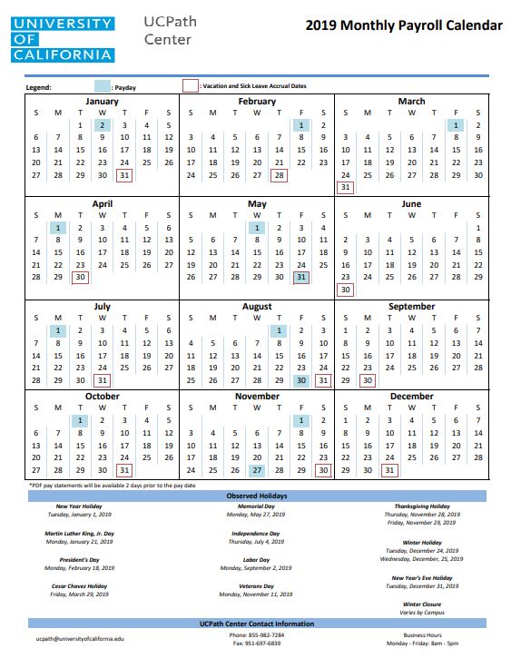
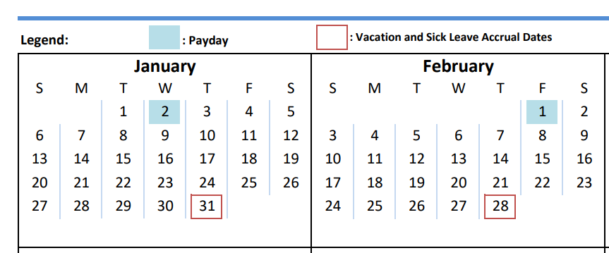
MONTHLY PAYROLL CALENDAR
The UCPath Center publishes a new Monthly Payroll Calendar every year.
This calendar is high-level and only contains pay days, leave accrual days, and holidays that apply to all campuses.
It does not provide details regarding critical deadlines related to the payroll process.
Paydays are highlighted in light blue.
Vacation and Sick Leave Accrual dates for Monthly employees occur on the last day of the month.
Notes:
Note: this page contains animations.
Need to explain what a Leave Accrual day actually means.
Also explain how these payroll calendars apply to the work they will be doing with the pilot. Maybe move it to the appendix and not so much in the beginning of the presentation. Just keep in the presentation so they are aware.
Also mention that this is more for the employees info.

Slide 33
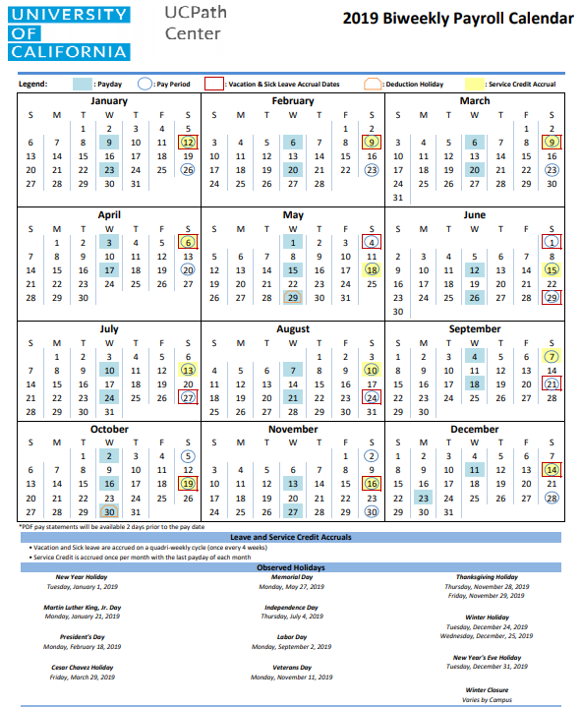
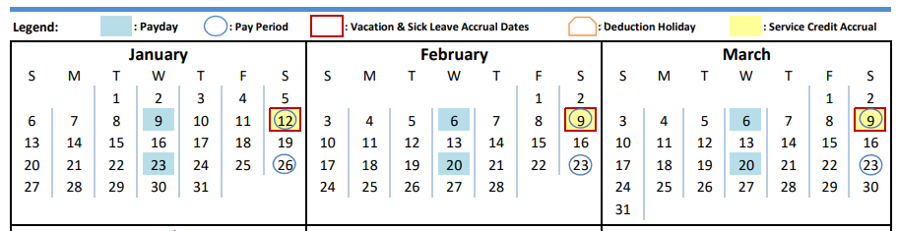
BIWEEKLY PAYROLL CALENDAR
The UCPath Center publishes a new Biweekly Payroll Calendar every year.
This calendar is high-level and contains pay days, leave accrual days, and holidays that apply to all campuses.
It does not provide details regarding critical deadlines related to the payroll process.
Leave and Service Credit Accruals
Vacation and Sick Leave are accrued on a quadri-weekly cycle (once every 4 weeks).
Service Credit is accrued once per month with the last payday of each month.
Paydays are highlighted in blue.
Pay Period End Dates are circled in Blue.
Vacation & Sick Leave Accrual Dates are boxed in red.
Deduction Holidays (3rd payroll) are boxed in orange.
Service Credit accruals are highlighted in yellow.
Notes:
Note: this page contains animations.

Slide 34
LEARNING OBJECTIVES REVIEW
Having completed this course, you should be able to:
Understand Milestones on UCPath Payroll Processing Schedule
Understand Criticality and Impact of Payroll Milestones
Recognize and define key UCPath terms and acronyms
Understand Payroll-impacting Inbound Files
Understand UCPath Automated Processes

Slide 35


THINGS TO REMEMBER
Payroll Deadlines are enforced by the UCPath Center for all UC Locations.
Payroll Deadlines cannot be moved or rescheduled by locations.
Monthly-paid and Biweekly-paid employee populations are processed in separate Payroll instances and adhere to different Payroll Processing deadlines.
The UCPath Center Publishes a new Payroll Schedule for the year in the UCPath Portal.
The UCPath Payroll Processing Schedule is subject to change throughout year.

Slide 36
APPENDIX
Link to 2019 UCPath Payroll Processing Schedule
Link to 2019 Biweekly Payroll Calendar
Link to 2019 Monthly Payroll Calendar
Link to UCR Payroll Calendars and Schedules
  Note: these calendars are based on UCPath Payroll Processing Schedule.

Slide 37

Your Feedback Please
http://bit.ly/ucpathpilottraining

Slide 38


Slide 39


