Slide 1

Ucr ucpath transaction pilot
INTRO to PEOPLESOFT AND ucpath

Slide 2

TRAINER INTRODUCTION
NAME: Antonette Toney, Robert Feinstein, Kameron Johnson, Lakesha Welch
Title: Varies ☺
Department: UCPath Campus Support Center
Year @UC: Varies ☺
Previous Experience: Varies ☺

Slide 3
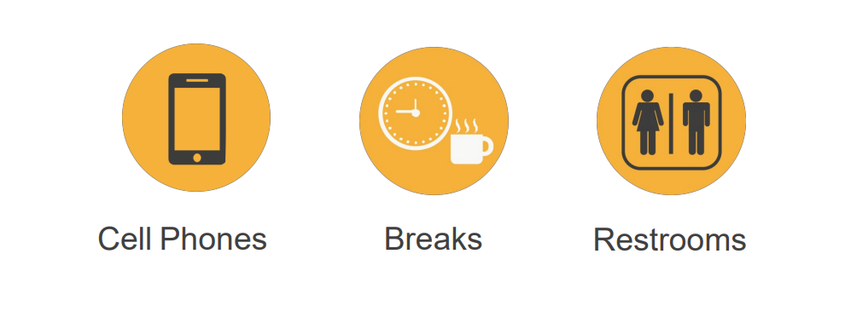
HOUSEKEEPING

Slide 4
Transaction Pilot & Training Overview

Slide 5
AGENDA
Welcome and Introductions
(Name, Dept, Role, PPS, Servicelink, UCPath Experience)
CSC and/vs Transaction Processing “Pilot” Initiative
Pilot Training Course Overview
Introduction to Peoplesoft and UCPath overview.

Slide 6
CSC AND/VS TRANSACTION PROCESSING “PILOT” INITIATIVE
In the Fall of 2018 UCPath Sponsors Vice Chancellor and CFO Gerry Bomotti & Vice Provost for Academic Personnel Ameae Walker expressed the need for the UCR campus to move from a UCPath Project Implementation Structure to an Operational Structure.
A new UCPath unit with a cross-functional focus, entitled the UCPath Campus Support Center (CSC) is established as of 7/1/2019. The CSC is accountable for providing central management and support services for UCPath operations working in collaboration with all functional areas AP, BFS, HR in addition to FPA & ITS.
The CSC provides UCPath services to the campus in the following functional areas:
    Campus Support Services
    Communications/Training and Organizational Change Management (OCM)
    UCPath Systems Management
    Reporting/ODS/Data Integrity
    Business Process Improvement
    Management of UCPath Initiatives*
The UCPath Transaction Processing Pilot Initiative is managed by the CSC.

Slide 7
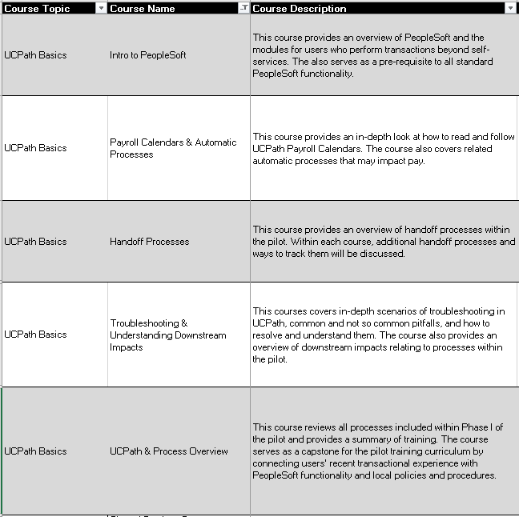
PILOT TRAINING OVERVIEW - FOUNDATIONAL COURSES

Slide 8
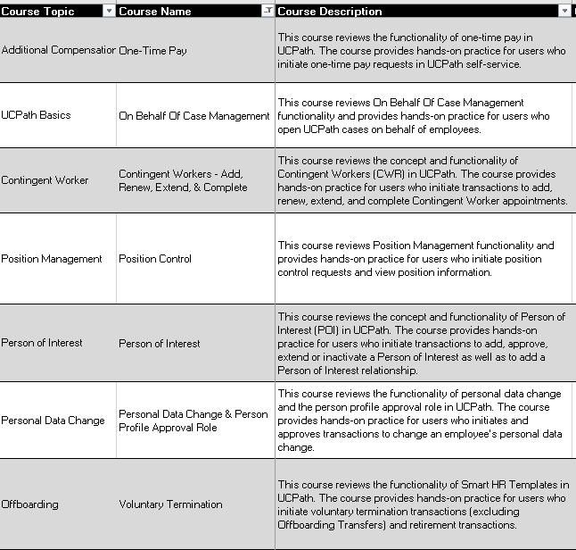
PILOT TRAINING OVERVIEW – TRANSACTION COURSES

Slide 9
Introduction to Peoplesoft (PS) and UCPath

Slide 10
LEARNING OBJECTIVES
Recognize and define key UCPath terms and acronyms
Describe High Level Transaction Process flows
View the functionalities of the UCPath Dashboard
Describe Approval Workflow Engine in UCPath
Learn how to view comments
Describe how the WFA Overview and Employee Lifecycle work

Slide 11
LEARNING TOPICS
HIGH LEVEL TRANSACTION PROCESS FLOW
UCPATH TERMS AND ACRONYMS
UCPATH NAVIGATION – Demo
UCPATH FUNCTIONALITY - Demo
AWE OVERVIEW AND APPROVALS - Demo
WFA OVERVIEW AND EMPLOYEE LIFECYCLE
LEARNING OBJECTIVES REVIEW
THINGS TO REMEMBER
APPENDIX

Slide 12
High Level Transaction Process Flow

Slide 13
HIGH LEVEL TRANSACTION PROCESS FLOW

Slide 14
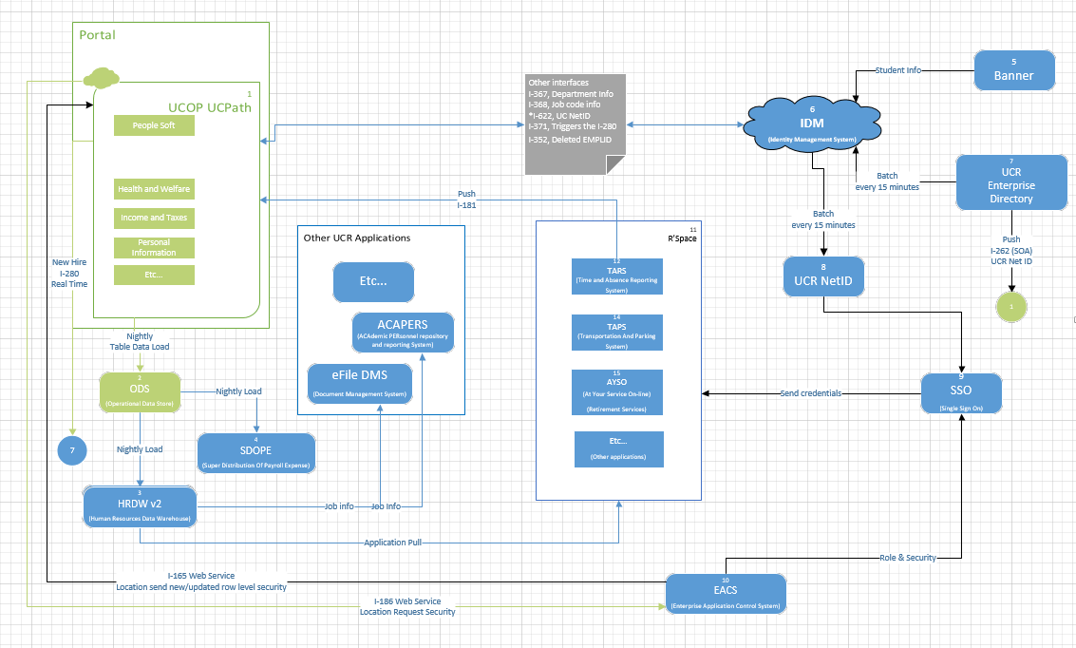

IDENTITY MANAGEMENT (IDM) PROCESS FLOW

Slide 15
UCPath Navigation

Slide 16
UCPATH DASHBOARD
At UCR, UCPath can be accessed through R’Space, see the tool section in the UCPath Portal.
Type ucpath.universityofcalifornia.edu in your browser’s address bar to access UCPath online.
Log in to UCPath using your current UC network user ID and password. UCPath times out after 60 minutes of inactivity; any unsaved data entry will be lost.
UCPath online gives employees greater access to view and update their own personal information, such as home and mailing address, direct deposit, and benefits enrollment.
Always use the buttons and links within the site to navigate. Do not use the Back and Next buttons in your web browser toolbar.
UCPath pages automatically resize to fit your computer, tablet, or smartphone screen.

Slide 17
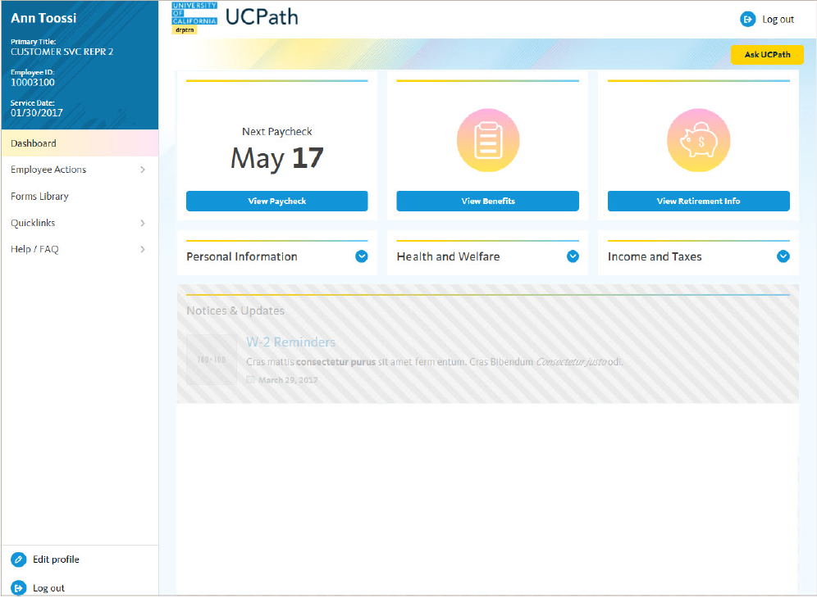
UCPATH DASHBOARD
Employee information appears in the upper left corner, including your name, title, employee ID, and service date.
Dashboard provides links to key information and activities for your role. The dashboard is based on your system role and differs for managers and super users. The example on this page represents an employee dashboard.
Notices & Updates provides key information for all employees, such as W-2 reminders at year end, or planned system outages.

Slide 18
UCPATH DASHBOARD (continued)
Navigation menu provides access to all UCPath activities. The menu options are based on your system role and may differ from the options available to your colleagues.
  Employee Actions provides access to all self-service activities, such as updating your address, updating your emergency contacts, or setting up direct deposit.
  Forms Library provides access to frequently used documents, such as the Dependent Information Update form.
  Quicklinks provides access to frequently used tools and sites, such as the payroll calendar, holiday schedule, campus websites, and more.
  Help / FAQ provides access to training materials, the Ask UCPath tool, and other support links.

Slide 19
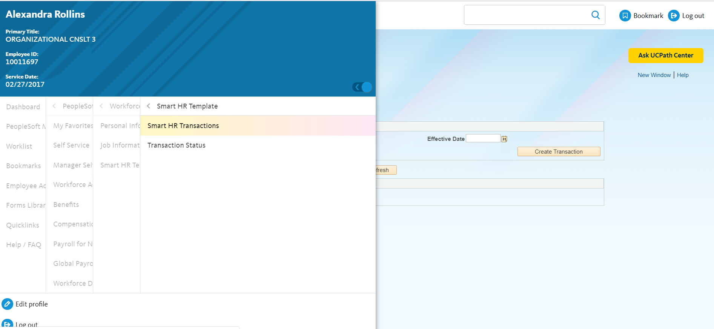
UCPATH ADDING FAVORITES
Navigation: PeopleSoft Menu > Workforce Administration > Smart HR Template > Smart HR Transactions
Click the New Window link at the upper right corner of the page.
Choose the component you would like to add to your favorites. In this example we will be adding the Smart HR Transactions to our favorites.

Slide 20
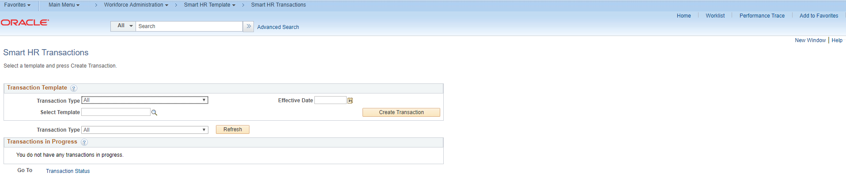
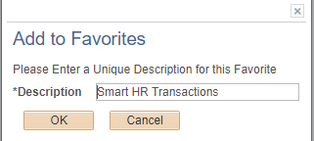

UCPATH ADDING FAVORITES
A new window will appear.
Click the Add Favorites link at the top right of the page.
The Add to Favorites message will appear.
Click the OK button. You can also change the description name for something that is easier for you.
Click the OK button to save favorite.

Slide 21
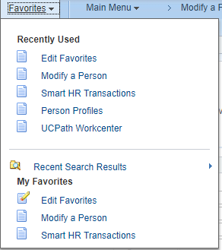
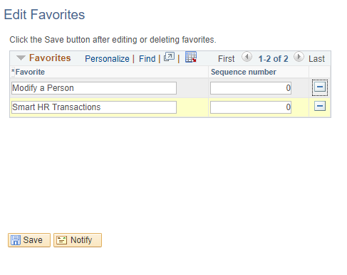
UCPATH ADDING FAVORITES
Click the Favorites tab at the top left of the page to view favorites. In this example there are two favorites added: one for Modify a Person, and one for Smart HR Transactions.
Click the on the Edit Favorite link to edit any favorites.
Click the on the to delete any favorites you have previously added.

Slide 22
UCPATH ADDING BOOKMARKS
Navigation: PeopleSoft Menu > Workforce Administration > Smart HR Template > Smart HR Transactions
If you find yourself navigating to the same pages and/or components, you may want to bookmark them to avoid having to constantly navigate through many menus.
Click the Bookmark icon at the upper right corner of the page. This action will bookmark the entire component.
To bookmark a page or component, navigate to the page or component you want to bookmark.

Slide 23
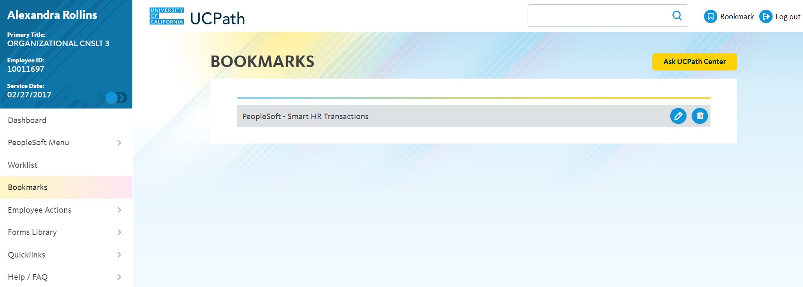
UCPATH ADDING BOOKMARKS
To view bookmarks, click on the Bookmarks hyperlink located in the top level menu.
Bookmarks are displayed in the order they were bookmarked.

Slide 24
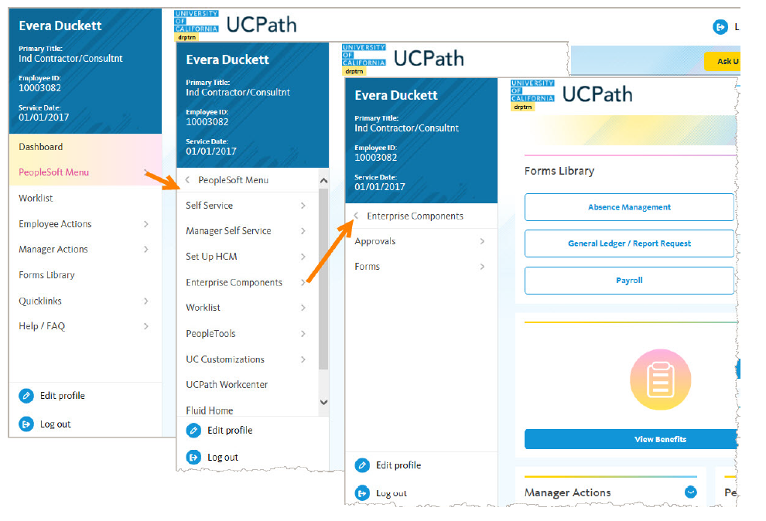
UCPATH CASCADING MENUS
UCPath uses cascading menus to display a hierarchy of submenus you use to navigate to various application pages and components (page groups).
The top-level menu (far left example in the images at right) includes PeopleSoft Menu, Employee Actions, Help / FAQ, and other standard options.
When you expand the PeopleSoft Menu (middle example), you see all functional areas relevant to your job/system role.
Continue to drill down to find pages and components for the tasks you perform in UCPath (far right example).
Note: You have access only to menu items and pages you need to perform your job. The menu in this example may show more options than your user account.

Slide 25
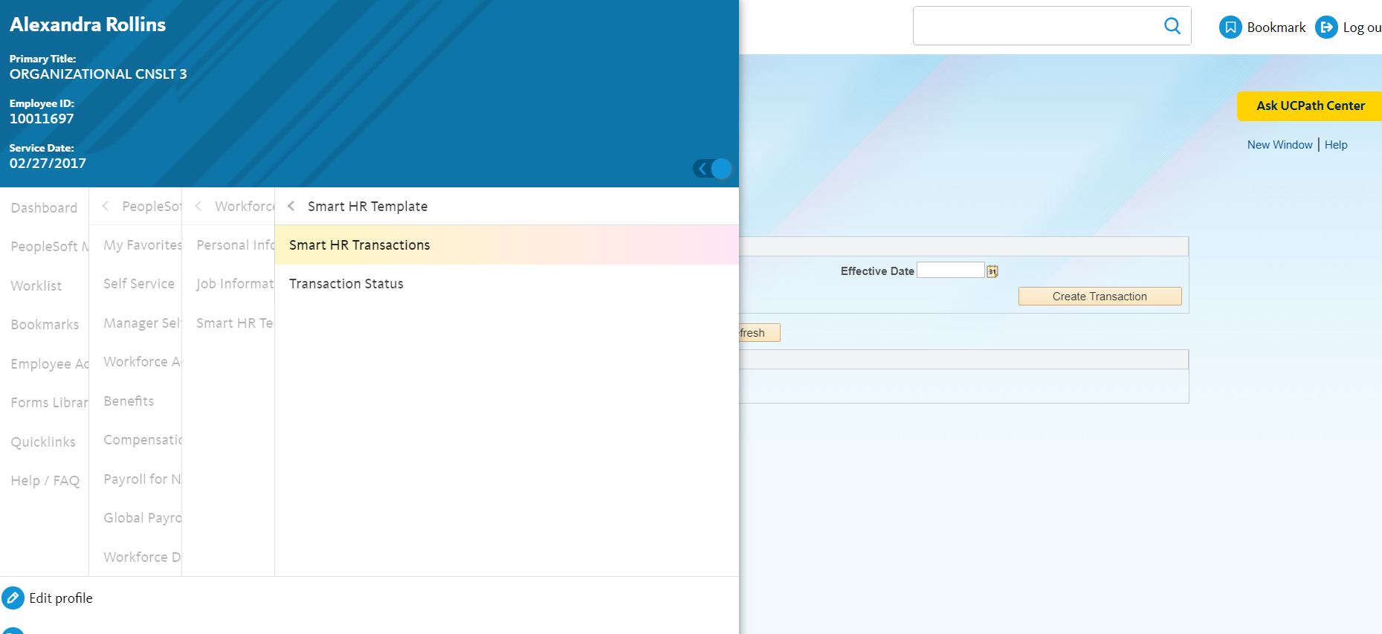
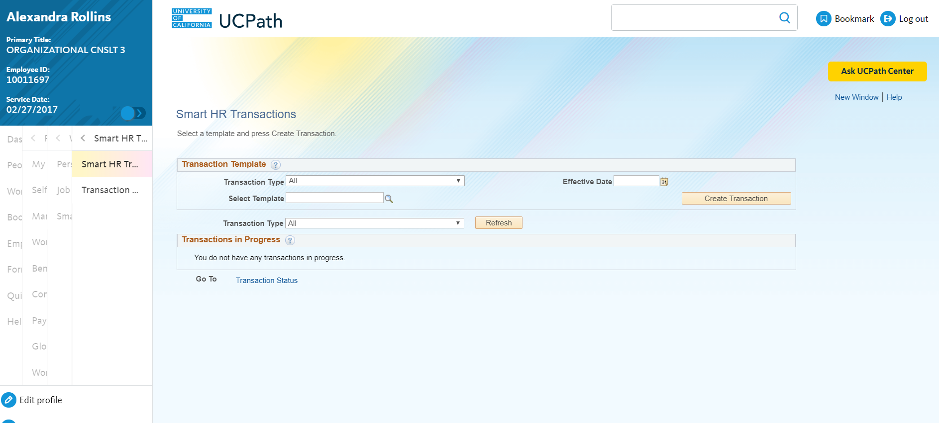
UCPATH CASCADING MENUS

Slide 26
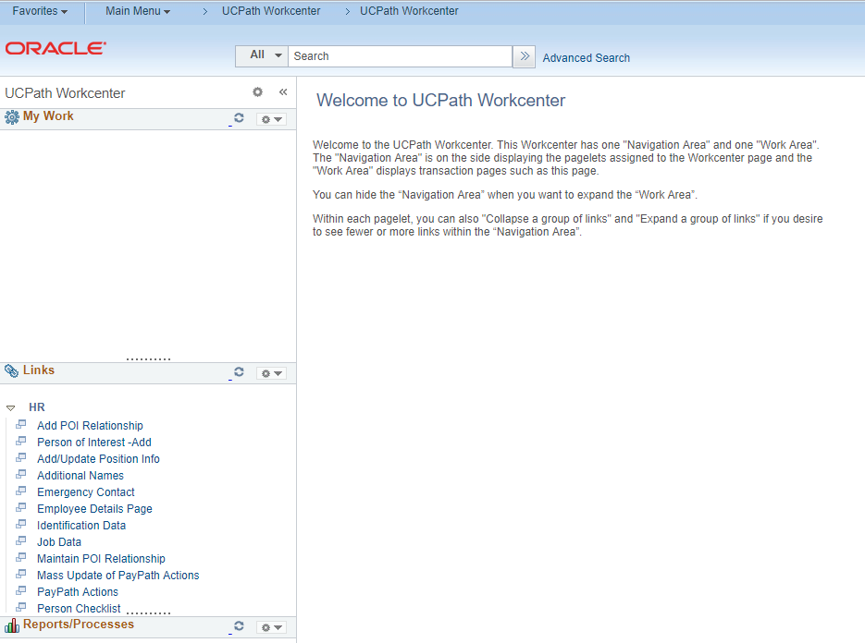
UCPATH WORKCENTER
Navigation: PeopleSoft Menu > UCPath Workcenter
The UCPath Workcenter provides a central location where day-to-day tasks are accomplished without leaving the UCPath Workcenter. This reduces the time spent navigating menus.
Your security access to key pages and components in the UCPath Workcenter is the same as your access to those pages and components from the PeopleSoft Menu.
Click for UCPC Workcenter Job Aid

Slide 27
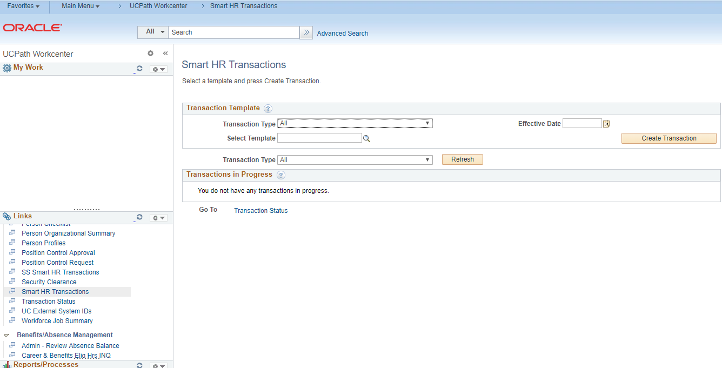
UCPATH WORKCENTER
Navigation: PeopleSoft Menu > UCPath Workcenter
Navigation Area
Work Area
When you click a task in the Navigation Area on the left side of the page, content appears in the Work Area on the right side of the page.
UCPC Workcenter Job Aid

Slide 28
UCPATH SELF-SERVICE EMPLOYEE ACTIONS
The Self-Service Employee Actions allows employees to be able to directly update some of their own personal data. Self-Service includes:
  Add a preferred name to personal information or update legal name
  Enter disability status
  Enter Veteran status
  Generate Employment summary, including dates of employment and earnings
  Update address or Phone number
  Update Educational Information
  Update honors, awards, licenses, or certifications
  Enroll to Receive W-2 online in UCPath
  Review leave balances
  Review online paystub
  Update Direct Deposit Information
  Enroll in benefits
Click for UCPC Job Aid

Slide 29
UCPATH SELF-SERVICE EMPLOYEE ACTIONS
The Self-Service Employee Actions allows employees to be able to directly update some of their own personal data. Self-Service includes:
  Review patent acknowledgment
  Review status of an existing case that you submitted
  Submit a case to the UCPath Center
  Set up security questions and answers
  Update California tax withholding (DE-4)
Click for UCPC Job Aid

Slide 30
UCPath Terms and Acronyms

Slide 31
UCPATH KEY TERMS AND ACRONYMS
Approval Workflow Engine
Effective Date
Effective Dating
Current Effective Date - Date that is less than or equal to the current system date.’
Historic Effective Date – Dates that are less than the current information
Future Effective Date – Effective dates that are greater than the current information
Retro Effective Date – Date prior to the current pay period begin date
Effective Sequencing
(AWE) systematically routes transactions in UCPath to designated roles (example Initiator) for approval at UCR. Once these UCR approvals are complete, transactions are either routed to the UCPath Center for finalization or committed to the database
Date on which the associated information takes effect. The information is in effect until a new entry is made with a more current effective date. We do not have “stop dates” on effective dated data. The Effective Date usually defaults to the system's current date so you need to be careful to change it as appropriate.
It is uses to maintain and view a complete chronological record of historic, current and future data.
Effective sequence indicated in what order the data was input or changes on a particular date.

Slide 32
UCPATH TERMS AND ACRONYMS
Employee Record
Production (PROD)
UCPath
Workflow
Worklist
A numeric value indicating a unique instance of a job for an employee with multiple concurrent jobs.
The instance of UCPath with all Locations currently implemented on the system.
UC Payroll, Academic Personnel, Timekeeping and HR: A UC-Wide Initiative, coordinated by UC Office of the President
The sequential flow of tasks and information in a business process.
The automated to‐do list that PeopleSoft Workflow creates. From the worklist, you can directly access the pages you need to perform the next action, and then return to the worklist for another item.

Slide 33
UCPATH TERMS AND ACRONYMS
Component
Page
Module
A collection of PeopleSoft pages that are logically grouped by functionality.
A screen in PeopleSoft or UCPath that allows users to view information, input new data, submit updates or view reports.
A collection of functionality in the software, for example the Absence Management module is the part of the application that manages leaves and time off.

Slide 34
UCPath Functionality

Slide 35
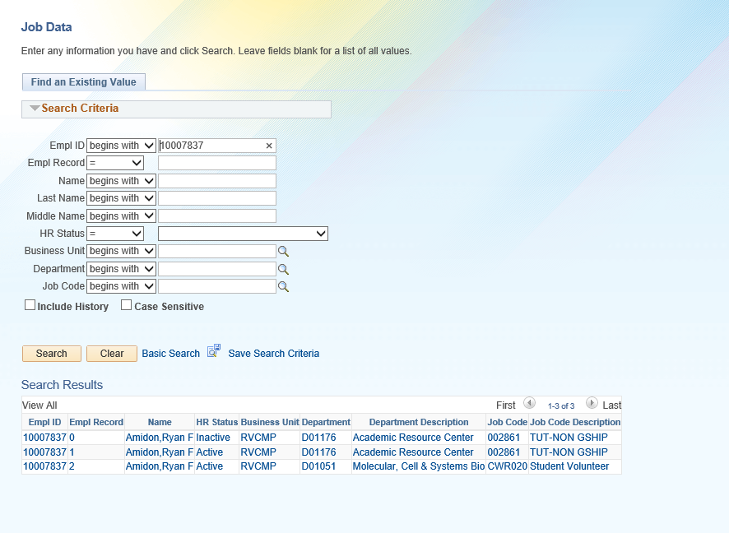
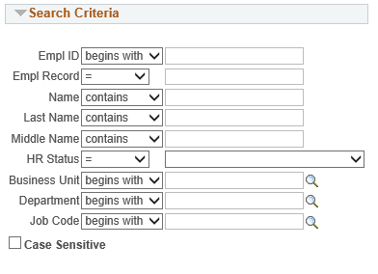
USING SEARCH PAGES
When you select most pages or components in UCPath, the system displays a Find an Existing Value tab where you can search for the records you want to display.
TIP: If you aren’t searching by the EMPL ID, always change the operator from “Begins with” which is always the default, to “Contains”, by clicking on the arrows.
Notes:
The Basic Search page enables you to search by only one field at a time, and then only using the begins with operator. To designate the search field, if more than one is available, select the desired field from the Search by list of values, enter your search criteria and then click the Search button to display the results. On the Advanced Search page you can search using multiple fields and using a variety of search operators.

Slide 36
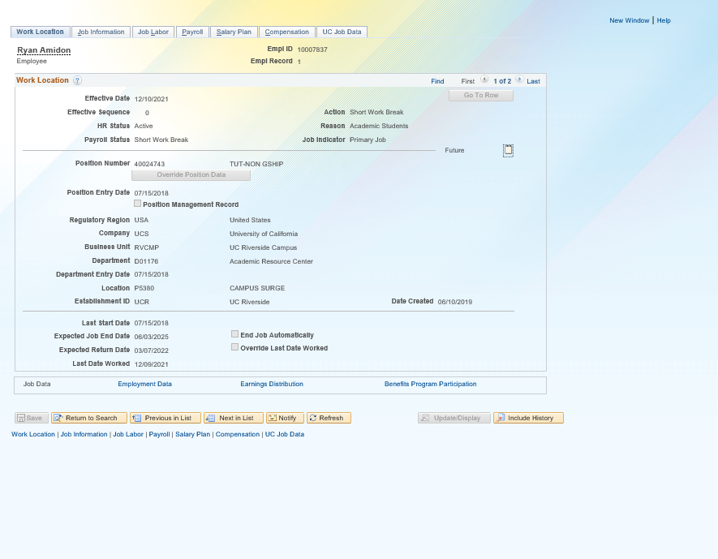
FUTURE DATING
This example shows a Future Dating example. This employee will be put on a Short Work Break (SWB) with an effective date of 12/10/2021.
The future dating date shows on the first screen after you have selected which employee you have wanted to view.

Slide 37
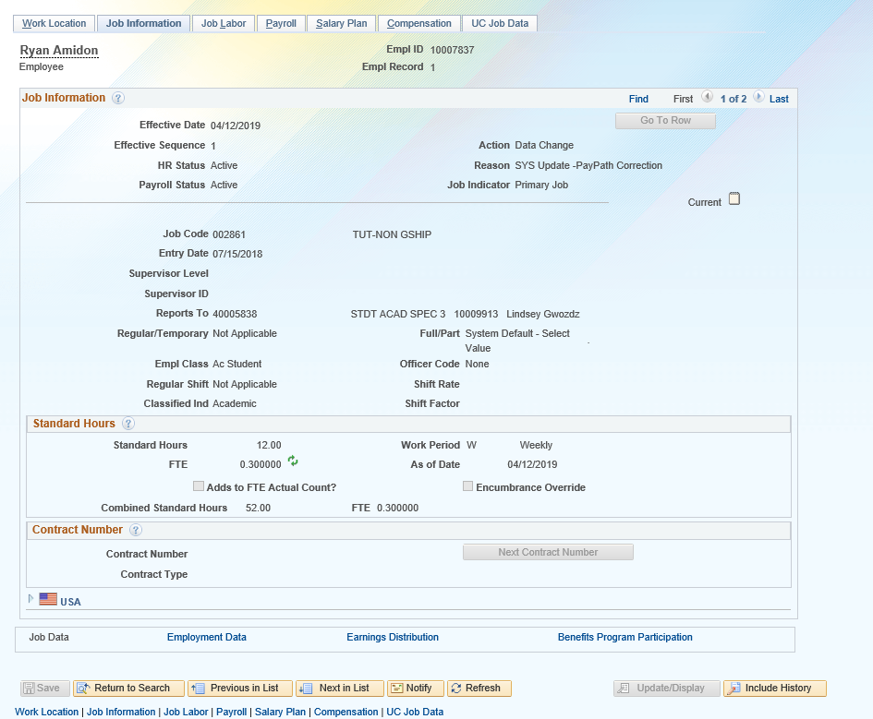
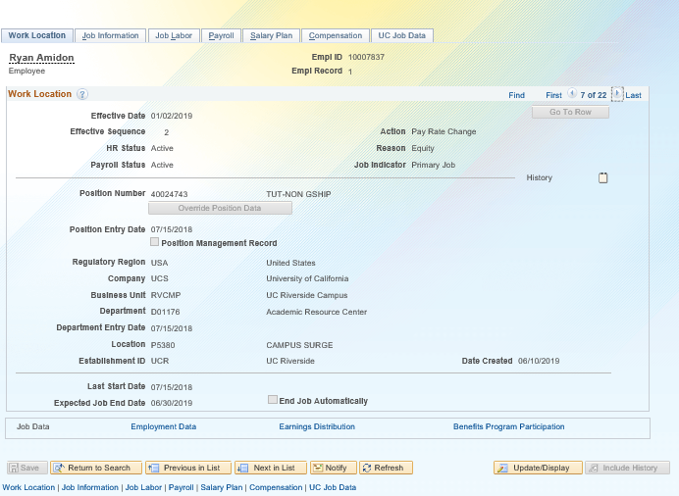
RETRO-DATING
Click on the arrows at the top until you get to the appropriate Effective Date, which is 01/02/2019.
This example shows a processed Retro-Dating Transaction with an Effective Date of 01/02/2019.
Click on the Include History to see changes in your data over time. The system is able to maintain an accurate history of information in the database due to effective-dating logic.
Notice that the Include History button is greyed out after you clicked on it.

Slide 38
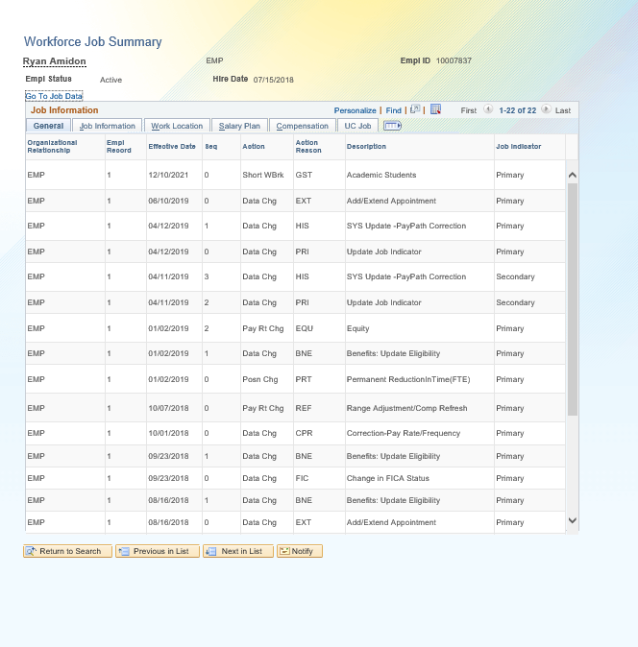
WORKFORCE JOB SUMMARY
Navigation: PeopleSoft Menu > Workforce Administration > Job Information > Review Job Information > Workforce Job Summary
Effective Dating is the date that the transaction needs to be effective in UCPath.
Effective Sequencing is auto- generated by the system.
This screen shot shows the employees Workforce Job Summary, most often known as the employees job stack, effective sequencing, and the effective date of each transaction.
Future-Dating Transaction
Retro-Dating Transaction
Notes:
In the Workforce Job Summary page you can view all job data actions (historical, current, and future-dated rows) for this employee.

Slide 39
USING CORRECT HISTORY vs CORRECTION VIA EFFECTIVE SEQUENCING
Correct History Definition: The action of correcting an existing effective dated row
  Downstream Impacts: Once a row is corrected you won’t be able to view what was previously listed in the row.
  There is no effective sequencing on POSITION; therefore, when a correction is needed with an effective date that already exists on the position, UCPC will have to make the correction. This is done through an on behalf of case management case.
Correction via Effective Sequencing: The action of correcting an existing effective dated row by stacking another row on top using effective sequencing.
  Downstream Impacts: Only the changed fields will move forward when using effective sequence. All other fields will remain the same.
  Effective Sequencing is available in PAYPATH (Phase 2); therefore if an effective sequence row is added that row becomes top of stack and will be used as of that effective date instead of any previous rows with that same effective date.
Notes:
Define correct history, how it gets done. Downstream impacts (you won’t be able to see the changes)
How effective sequencing is related (position doesn’t have it)

Slide 40
AWE Overview and Approvals

Slide 41
INTRO TO AWE
AWE is the UCPath functionality that routes transactions for review and approval. This process ensures the appropriate users review and approve the transactions.
Location Approver options include:
Approve
Deny

Slide 42
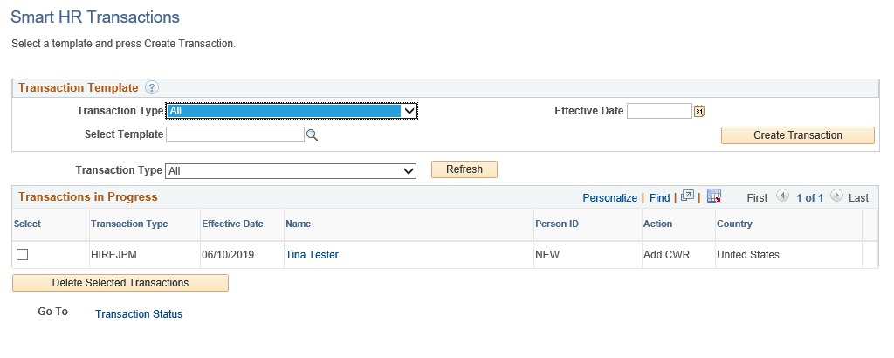
SS SMART HR TRANSACTIONS PAGE
Navigation: PeopleSoft Menu > Workforce Administration > Smart HR Template > Smart HR Transactions
Use the SS Smart HR Transactions page to:
  View the status of a template transaction within Approval Workflow Engine (AWE).
  View comments entered by a Location Initiator or Approver.
  View transactions you have submitted, along with all transactions submitted within your business unit. This page is not restricted by department security.
  Review the template entry details (the fields are view-only).
Click for UCPC Job Aid

Slide 43
TRANSACTION STATUS PAGE
Navigation: PeopleSoft Menu > Workforce Administration > Smart HR Template > Transaction Status
Use the Transaction Status page to view the status of templates after they have completed AWE.
This page tracks the status of templates after they have been routed and approved at the Locations.
View transactions you have submitted, along with all transactions for departments for which you have security access.
This page is also used to clone a transaction that was cancelled or denied.
If you clone a transaction denied at the location, both the original and the clone appear in the list.
  Tip: The cloned (new) transaction appears below the original denied transaction in the default sorting of the list.
The Clone button appears when:
  1) A template transaction was denied by a Location Approver. Refer to the SS Smart HR Transactions page to view comments from the Approver about the denied transaction.
  2) A template transaction was cancelled by UCPC WFA Production. Refer to the Reason for Cancellation column on this page to view comments from WFA Production about the cancelled transaction.

Slide 44
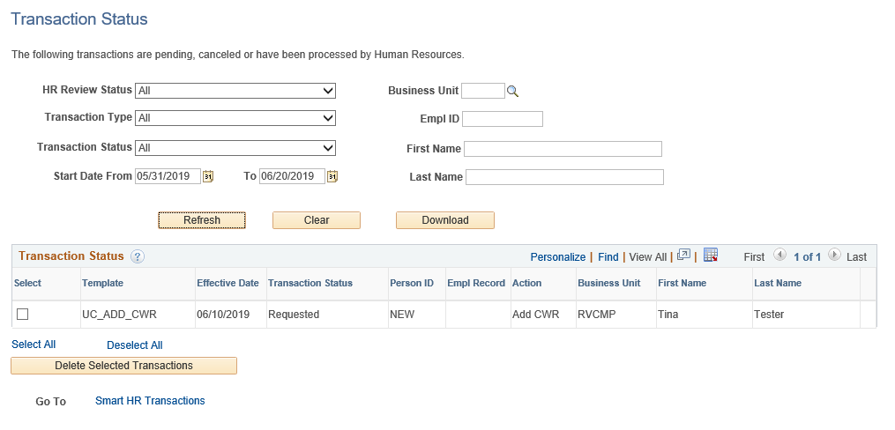
TRANSACTION STATUS PAGE (continued)
Navigation: PeopleSoft Menu > Workforce Administration > Smart HR Template > Transaction Status
Adjust the selection criteria as needed to filter the displayed transactions.
Transaction Status values are:
Requested, Completed, Hired/Added,
Denied, and Cancel.
If a transaction is cancelled or denied, you can View Comments to see why it was cancelled / denied on this page, then Clone the existing template information into a new template, correct, and resubmit.

Slide 45
Approving a Transaction

Slide 46
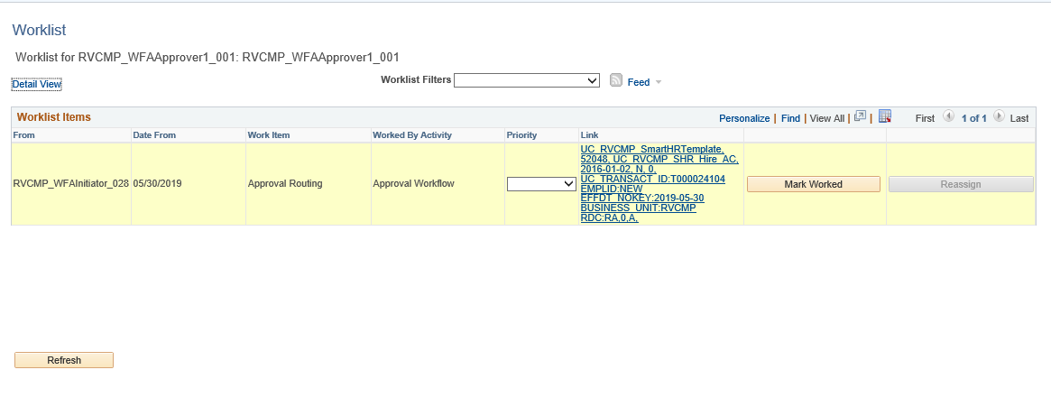
AWE APPROVAL ROLE
The template transaction has been routed for approval and appears in the Worklist.
Click on the appropriate template to Approve or Deny the transaction.
Click the link to review, approve, or deny.

Slide 47
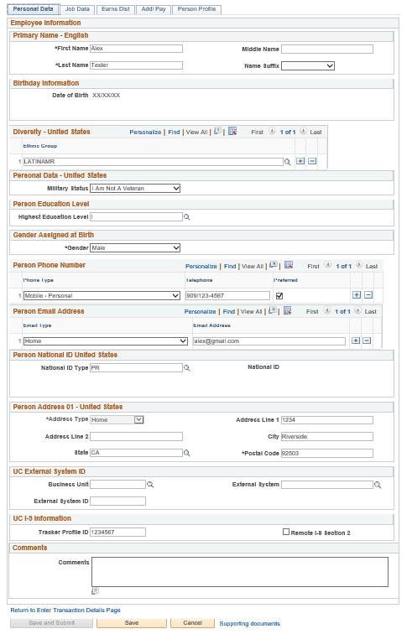
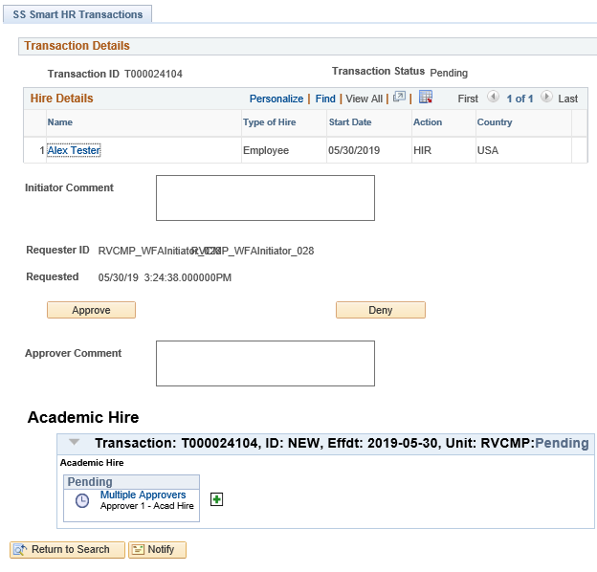
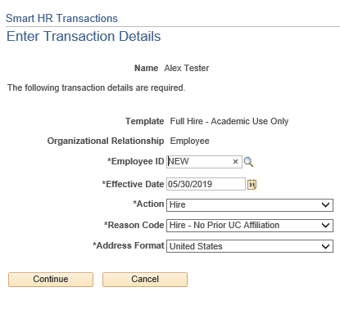
AWE APPROVAL ROLE (continued)
Click on the Person’s Name to review the template transaction details.
Click Continue.
When the review is complete, click the Cancel button to return to the approval page.
The Save and Submit button is greyed out because this is the original transaction.

Slide 48
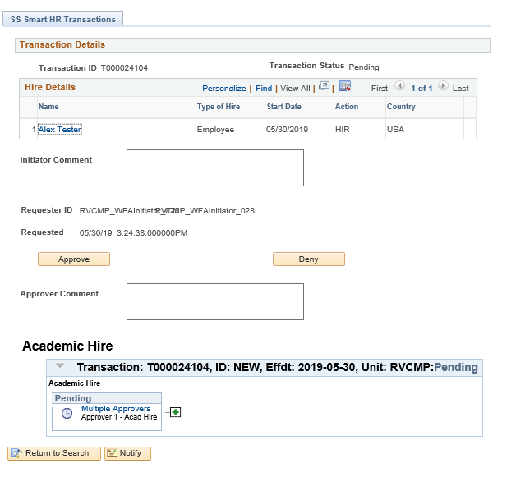
AWE APPROVAL ROLE (continued)
In this example, we will be approving the Academic Full Hire transaction. Click Approve.

Slide 49
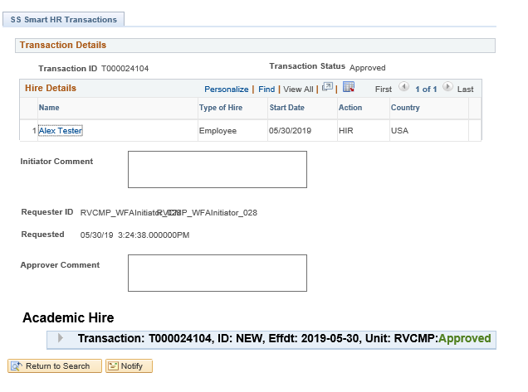
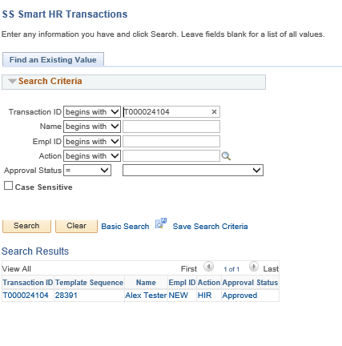
AWE APPROVAL ROLE (continued)
This example shows an approved Academic Full Hire request.
Below you can see that the template was Approved.

Slide 50
View Comments

Slide 51
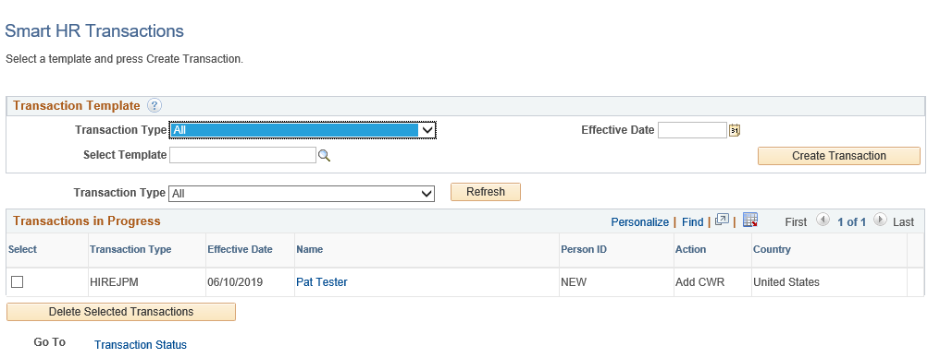
SS SMART HR TRANSACTIONS PAGE
Navigation: PeopleSoft Menu > Workforce Administration > Smart HR Template > Smart HR Transactions
To view the denial comments on the original transaction, click on the person’s name.
TIP: To clone the transaction, you would click on the Transaction Status link.

Slide 52
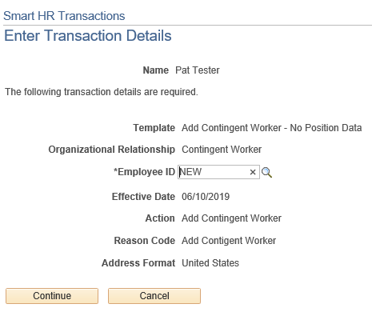
TRANSACTIONS DETAILS PAGE
The Transaction Details will appear. Click the continue button.
Initiator views comments from the Smart HR Transactions page.
Initiator Clones in the Transaction Status page.
In this example, we are viewing the comments from the Smart HR Transactions page.

Slide 53
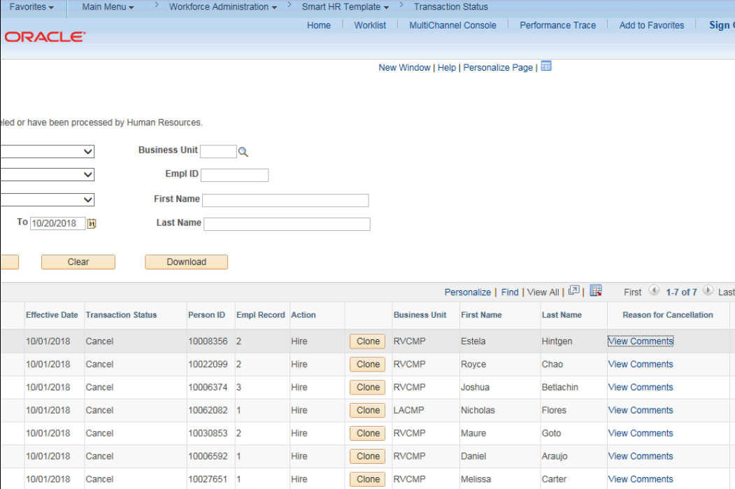
VIEW COMMENTS FROM UCPC
Navigation: PeopleSoft Menu > Workforce Administration > Smart HR Template > Transaction Status
When a transaction is cancelled by UCPC WFA Production, comments are entered to explain why the transaction was cancelled.
Template Initiators can View Comments under Reason for Cancellation and, if needed, Clone the transaction to resubmit it with necessary corrections.
Note: To view comments about a transaction that was denied by a Location AWE Approver, you must navigate to the SS Smart HR Transactions page and review the Approver Comments field.
Click to view the UCPC How to Clone Job Aid

Slide 54
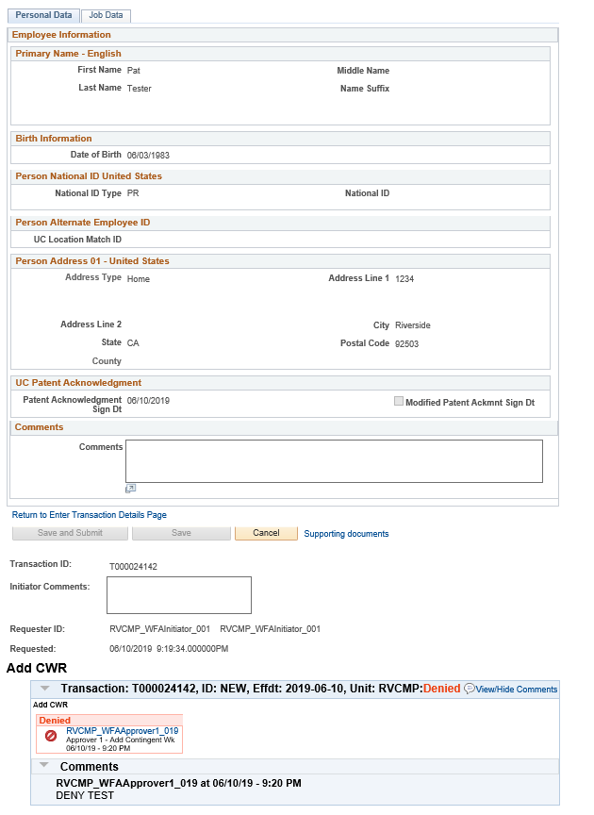
VIEW COMMENTS FROM AWE LOCATION APPROVER
The original submitted transaction appears. Notice that the Save and Submit button on the bottom is greyed out.
To view comments from the AWE Approver who denied the transaction, click on the arrow.

Slide 55
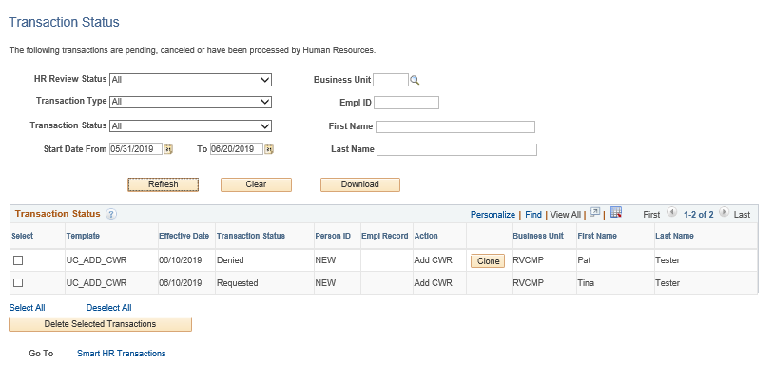
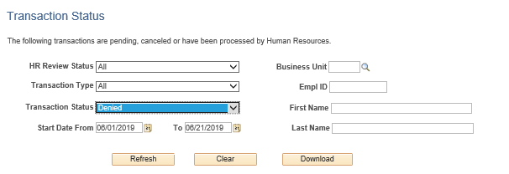
CLONING A TRANSACTION
Navigation: PeopleSoft Menu > Workforce Administration > Smart HR Template > Smart HR Transactions
The cloning function is available when:
  A template transaction is denied by a location Approver.
  A template transaction is cancelled by UCPC WFA Productions
Search for your transaction and click the Refresh button.

Slide 56
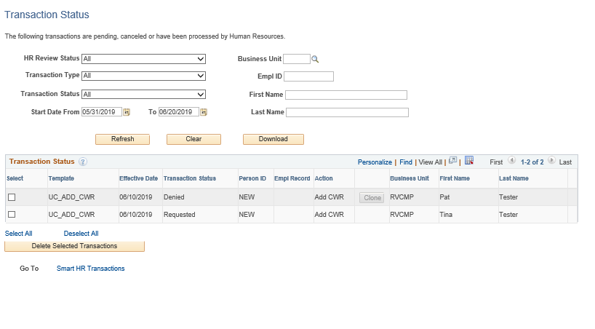
CLONING A TRANSACTION
You can Clone transaction, by clicking on the Clone button.
Once you click the Clone button, the button will grey out.
Go to Smart HR Transactions at the bottom of the page to access the cloned template.
1
2

Slide 57
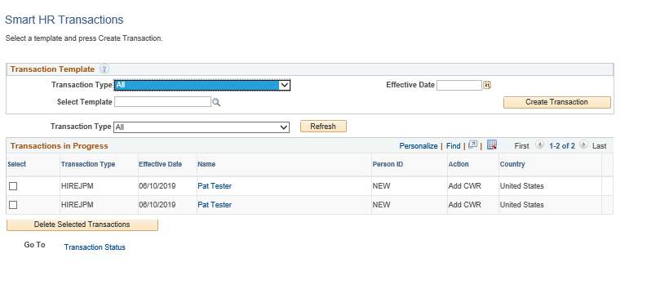
CLONING A TRANSACTION
If you clone a transaction denied at the location, both the original and the clone appear in the list.
Original Transaction
Cloned Transaction
TIP: the cloned (new) transaction appears below the original denied transaction in the default sorting of the list.
To resubmit the transaction, click on the cloned transactions person’s name.

Slide 58
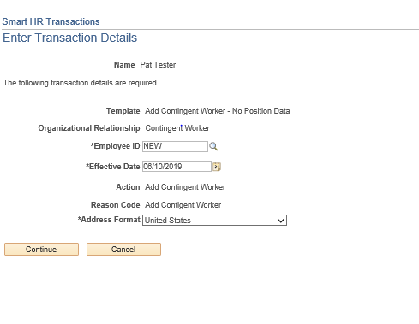
RESUBMITTING A CLONED TRANSACTION
Click the continue button once the Transaction details appear.

Slide 59
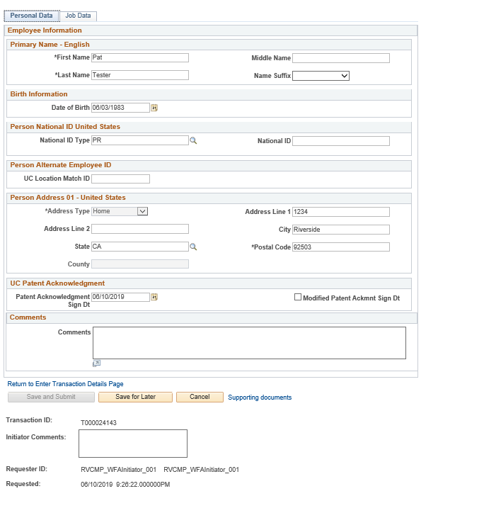
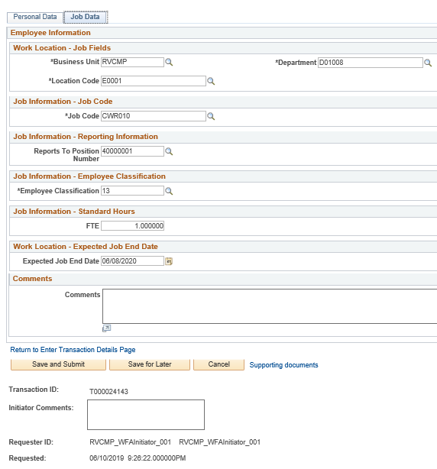
RESUBMITTING A CLONED TRANSACTION (continued)
The template transaction appears, and you can resubmit the transaction with necessary corrections on the Personal Data tab or Job Data tab.
Notice that you can now Save and Submit the cloned transaction.

Slide 60
WFA Overview and Employee Lifecycle

Slide 61
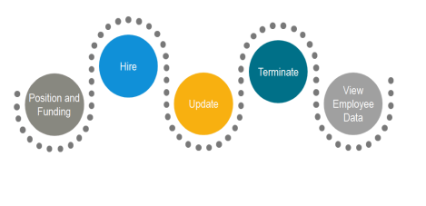
ADD POSITION AND FUNDING
Navigation: PeopleSoft Menu > UC Customizations > UC Extensions > Position Control Request
Position Control Initiators use the Position Control Request to request that a position be added (or to update a position) in UCPath.
After the position is entered and approved, the funding can be entered for the position. The next task demonstrates how a Location Funding Initiator enters the funding.
Location Funding Initiators use the Funding Entry page to enter funding for new positions. The funding entry can be completed prior to or after hiring the employee.
After the position is entered and approved, the funding can be entered for the position.
Location Funding Initiators use the Funding Entry page to enter funding for new positions. The funding entry can be completed prior to or after hiring the employee.
Position Control Initiators use the Position Control Request to request that a position be added (or to update a position) in UCPath.
Click for UCPC Job Aid

Slide 62
INITIATE, APPROVE, AND PROCESS NEW HIRE TEMPLATE TRANSACTION
Navigation: PeopleSoft Menu > Workforce Administration > Smart HR Template > Smart HR Transactions
The new hire template has Five tabs: Personal Data, Job Data, Earns Dist, Addl Pay and (Person Profile) Academic (Employee Experience) Staff
The completed template is routed to the SSC AWE Approver. If the hire template is completed accurately , the template is approved and routed to UCPC WFA Production.
Location Template Initiators use the Smart HR Transactions page to initiate a new hire template in UCPath
Once the new hire has been processed into UCPath. The system automatically generates the next sequential UC Employee ID.

Slide 63
INITIATE AND APPROVE PAY CHANGE PAYPATH TRANSACTION
Navigation: PeopleSoft Menu > UC Customizations > UC Extensions > PayPath Actions
The PayPath Action provides access to three pages where employee updates can be entered: - Position Data - Job Data - Additional Pay Data
The Location PayPath Approver reviews and approves the PayPath Transaction.
Location PayPath Initiators use the PayPath Action page to initiate various position, job data and additional pay changes that occur throughout an employees career at UC.
Note: PayPath transactions are not reviewed by UCPC WFA Production. After the Location approval process is complete, the change is saved in UCPath.

Slide 64
INITIATE, APPROVE, AND PROCESS TERMINATION TEMPLATE TRANSACTION
Navigation: PeopleSoft Menu > Workforce Administration > Smart HR Template > Smart HR Transactions
The termination template appears with the employee's Position Number, Business Unit, Department, Location Code and Last Date Worked.
The Location Template Approver reviews and approves the Termination Template Transaction.
Location Template Initiators use the Smart HR Transactions page to initiate a termination template in UCPath.
The employee termination has been processed in UCPath.
Note: The Last Date Worked field is automatically populated with a date that is one day prior to the Effective Date that was entered. This field can be updated if necessary. Changing the Last Date Worked does not change the Effective Date; however, the Last Date Worked must be prior to the Effective Date.

Slide 65
VIEW WORKFORCE JOB SUMMARY
Navigation: PeopleSoft Menu > Workforce Administration > Job Information > Review Job Information > Workforce Job Summary
The Workforce Job Summary page includes 6 tabs. General, Job Information, Work Location, Salary Plan, Compensation, and UC Job.
The Workforce Job Summary page includes all the actions completed for the employee during their career at UC.

Slide 66
LEARNING OBJECTIVES REVIEW
Having completed this course, you should be able to:
Recognize and define key UCPath terms and acronyms
Understand High Level Transaction Process flows
Understand the functionalities of the UCPath Dashboard
Describe Approval Workflow Engine (AWE) in UCPath
View comments and clone a transaction
Understand the WFA Overview and Employee Lifecycle

Slide 67


THINGS TO REMEMBER
Effective Date is the date the transaction will take place. Remember to pay attention to this date when doing Retro and Future dating transactions.
If you find yourself navigating to the same pages and/or components, you may want to bookmark them to avoid having to constantly navigate through many menus.
View comments entered by a Location Initiator or Approver in the Smart HR Transaction Page.
Clone a transaction that was cancelled or denied in the Transaction Status Page. If you clone a transaction denied at the location, both the original and the clone appear in the list.
  Tip: The cloned (new) transaction appears below the original denied transaction in the default sorting of the list.

Slide 68
THINGS TO REMEMBER
If you aren’t searching by the EMPL ID, always change the operator from “Begins with” which is always the default, to “Contains”, by clicking on the arrows.
When navigating in UCPath always use the buttons and links within the site to navigate. Do not use the Back and Next buttons in your web browser toolbar.
Your security access to key pages and components in the UCPath Workcenter is the same as your access to those pages and components from the PeopleSoft Menu.
There is no effective sequencing on position; therefore, when a correction is needed with an effective date that already exists on the position, UCPC will have to make the correction. This is done through an on behalf of case management case.

Slide 69
APPENDIX

Slide 70
APPENDIX
On behalf case management Process Map
Position control Process Map
Contingent worker Process Map
Personal data changes Process Map
Person of interest Process Map
One–time payments Process Map
Voluntary termination Process Map

Slide 71
APPENDIX
Navigation: PeopleSoft Menu > Workforce Administration > Smart HR Template > Smart HR Transactions
Navigation: PeopleSoft Menu > UCPath Workcenter
Navigation: PeopleSoft Menu > Workforce Administration > Job Information > Review Job Information > Workforce Job Summary
Navigation: PeopleSoft Menu > Workforce Administration > Smart HR Template > Transaction Status
Navigation: PeopleSoft Menu > UC Customizations > UC Extensions > Position Control Request
Navigation: PeopleSoft Menu > UC Customizations > UC Extensions > PayPath Actions

Slide 72
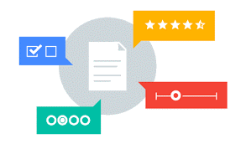
Your Feedback Please
http://bit.ly/ucpathpilottraining

Slide 73


Slide 74


