Slide 1

Ucr ucpath transaction pilot
HANDOFF processes
PHASE II

Slide 2

TRAINER INTRODUCTION
LaKesha Welch, Antonette Toney
Department: UCPath Campus Support Center

Slide 3
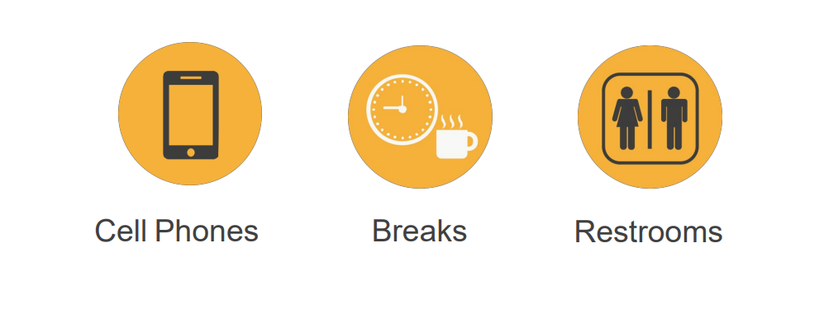
HOUSEKEEPING

Slide 4
LEARNING OBJECTIVES
Understand the roles and responsibilities for each process
Understand the handoff processes within each process
Understand the Approval Workflow process, and which transactions will be approved by pilot unit vs. SSC

Slide 5
LEARNING TOPICS
INVOLUNTARY TERMINATION
ONBOARDING
PAYPATH
ON BEHALF OF CASE MANAGEMENT
APO UPDATE
PHASE I: NEW HAND OFFS FOR APPROVALS
SSC/UNIT BEAK OUT
FEEDBACK
THINGS TO REMEMBER
LEARNING OBJECTIVES REVIEW

Slide 6
PILOT PHASE II – UNIT INITIATION & APPROVAL
Persons of Interest Onboarding/
Off-boarding SSC AWE
Personal Data & Personal Profile Changes
Pilot Unit AWE
Position Control
SSC AWE
On Behalf of Case Management
No AWE
Voluntary Termination – Staff & Academic
Pilot Unit AWE
Contingent Workers Onboarding &
Off-boarding Pilot Unit AWE
One-Time
Pilot Unit AWE
Onboarding (excluding transfers) –
Empl class 5, 9, 10
SSC AWE
Involuntary Termination – Empl class 5, 9, 10
SSC AWE
PayPath/Additional Pay – Empl class 5, 9, 10
SSC AWE
New for Phase II: New transaction types
New for Phase II: Phase I transaction pilot unit approvals

Slide 7
OFFBOARDING
INVOLUNTARY TERMINATION

Slide 8


INVOLUNTARY TERMINATION DEFINITION & PROCESS OVERVIEW
An involuntary termination is a separation action initiated by the campus or is as result of the death of an employee.
The Involuntary Termination process starts when the Department/Org. decides to terminate or layoff an employee, or learns of the death of an employee.
Involuntary Terminations are processed for both staff and academic employees. There are benefits and payroll implications for Involuntary Terminations, these are dealt with in separate processes.
The process ends with the confirmation that the employee has been separated, all access to systems and facilities has been updated or terminated and all outstanding university and employee obligations related to compensation are settled. Lastly, the final payment information is transferred to the UCPath Center Payroll Production team.

Slide 9
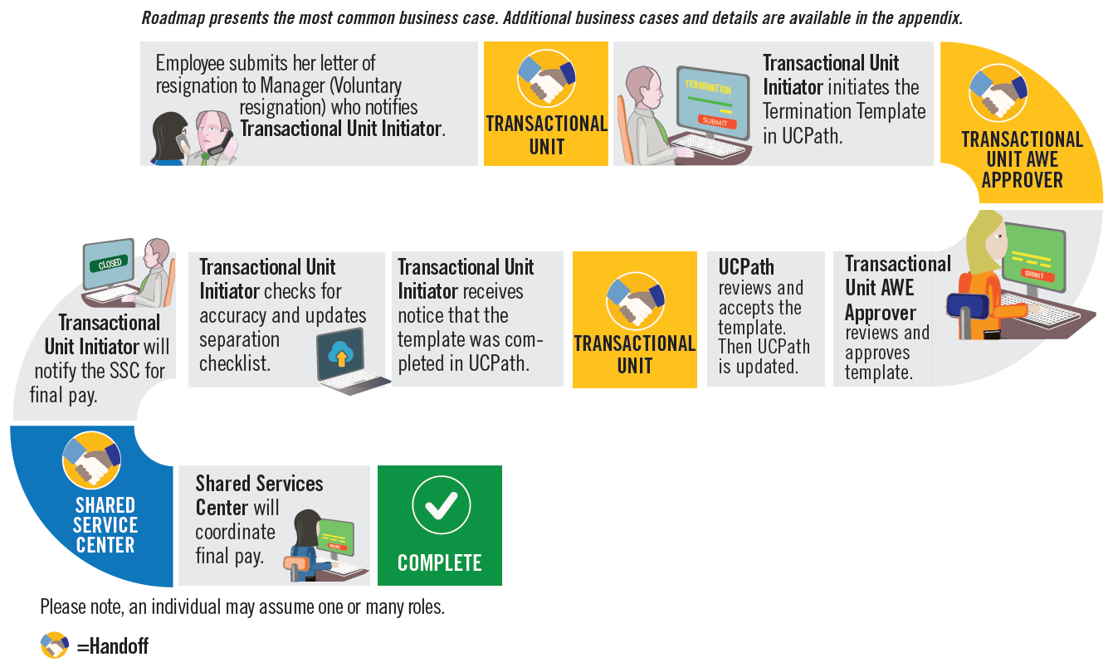
INVOLUNTARY TERMINATION HIGH LEVEL PROCESS OVERVIEW

Slide 10
INVOLUNTARY TERMINATION HANDOFF MATRIX
Process | Employee | DEPT/ORG | Transactional Unit | SSC | UCPC | Central Office
Offboarding | Submits letter of resignation | Determines need for termination and has reached out to HR/ELR per policy and provides transactional unit with termination request |  |  |  | Respond to any policy questions
Offboarding |  |  | Process Termination Template including attachments, Needs to review Smart HR Template page and/or email to verify that it was approved or that it needs to be re-entered / cloned | Review, approves/denies Involuntary Termination Template | Reviews and processes termination template
Offboarding |  |  | Needs to review Transaction Status page and/or email to verify that it was approved or that it needs to be re-entered / cloned. The Transactional Unit initiator contacts the SSC via Zoom, email, or phone, when UCPC cancels a transaction.
Offboarding |  |  | Request final pay via ServiceLink/Snap Shot | Coordinates and initiates Final Pay (once termination template is approved and notification is received from Pilot Unit) | Reviews and processes final pay | Respond to any policy questions
Offboarding |  |  | Verify that final pay has been processed
8
Hands
offs

Slide 11


QUESTIONS
PILOT UNITS/SSC’s:
Are you prepared to follow the new processes?
Do you understand the processes and your role in the hand offs?
Do you understand each others role in the process?
Do you have any open questions not answered?
Is there anything more you need?
Are there any gaps that would stop you from being successful?

Slide 12
ONBOARDING

Slide 13

ONBOARDING DEFINITION & OVERVIEW
Onboarding is the action or process of integrating a new employee into an organization or familiarizing a new customer or client with one's products or services.
Available Phase II Onboarding Templates
The process begins when the New Hire accepts a contingent offer of employment from UCR
The process uses Approval Workflow Engine (AWE) to allow routing of the request from the transactional unit through the Shared Services Centers and to UCPath for approval
Once approved, the new hire is ready to work
Template | Description
UC_ADD_CWR | Add Contingent Worker - No Position Data
UC_ADD_CWR_POSN | Add Contingent Worker With Position
UC_CONC_HIRE | Staff Concurrent Hire/Inter Location Transfer
UC_CONC_HIRE_AC | Academic Concurrent Hire/Inter Location Transfer
UC_FULL_HIRE | Full Hire - Staff Only
UC_FULL_HIRE_AC | Full Hire - Academic Use Only
UC_REHIRE | UC Rehire - Staff Only
UC_REHIRE_AC | Rehire - Academic
UC_REHIRE_REI | Rehire Reinstatement - For Staff Appointments
UC_REHIRE_REI_AC | Rehire Reinstatement - For Academic Appointments

Slide 14
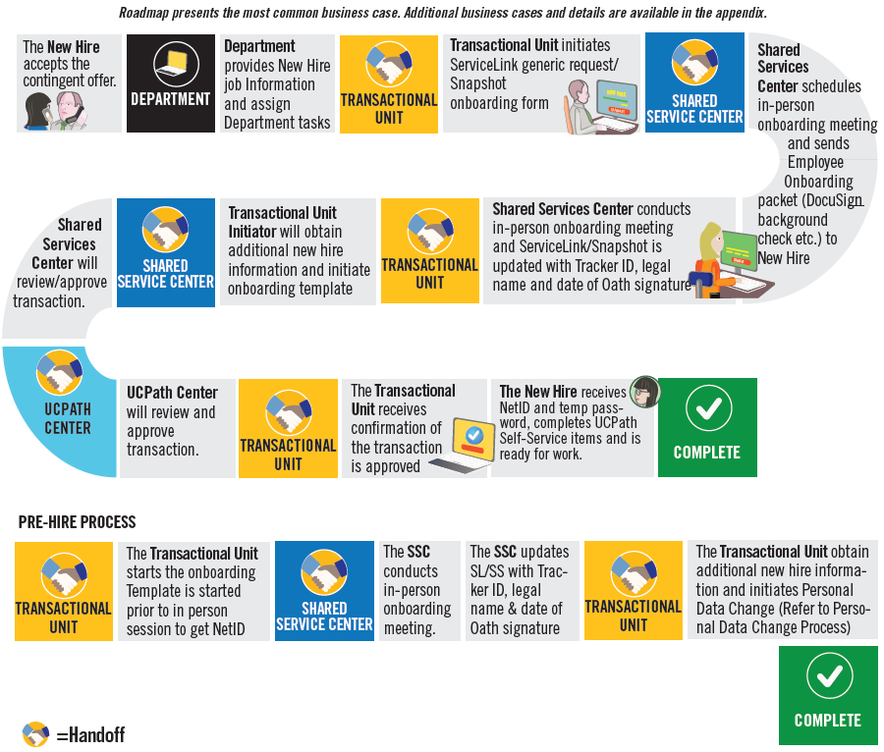
ONBOARDING HIGH LEVEL PROCESS OVERVIEW

Slide 15
ONBOARDING HAND OFF MATRIX
6
Hand
offs
Process | Employee | DEPT/ORG | Transactional Unit | SSC | UCPC | Central Office
ONBOARDING | Provides signed appointment letter | Provides New hire job information and assign department task | Receives employee paperwork and initiate ServiceLink generic request/snap shot onboarding form | Send DocuSign packet to employee. Performs in person session, and updates ServiceLink/Snap shot once complete to notify the unit to initiate Hire template
ONBOARDING |  |  | Process Smart HR Template, including attachments if required. Needs to review Smart HR Template page and/or email to verify that it was approved/denied by SSC that it needs to be re-entered / cloned. | Review and approve/deny Smart HR Template | Reviews and processes Smart HR Template
ONBOARDING |  |  | Needs to review Transaction Status page and/or email to verify that it was approved/denied by UCPC that it needs to be re-entered / cloned. The Transactional Unit initiator contacts the SSC via Zoom, email, or phone, when UCPC cancels a transaction.
ONBOARDING |  |  | Pilot Unit should reach out to central office for any questions regarding policy and FLSA mismatch prior to processing template | SSCs should reach out to central office for any questions regarding policy prior to approving template |  | Respond to any policy questions

Slide 16
PRE-HIRE ONBOARDING HAND OFF MATRIX
Process | Employee | DEPT/ORG | Transactional Unit | SSC | UCPC | Central Office
ONBOARDING | Provides signed appointment letter | Provides New hire job information and assign department task | Process Smart HR Template for pre-hire, including attachments if required. Needs to review Smart HR Template page and/or email to verify that it was approved/denied by SSC that it needs to be re-entered / cloned.
ONBOARDING |  |  | Needs to review Transaction Status page and/or email to verify that it was approved/denied by UCPC that it needs to be re-entered / cloned. The Transactional Unit initiator contacts the SSC via Zoom, email, or phone, when UCPC cancels a transaction. | Review and approve/deny Smart HR Template | Reviews and processes Smart HR Template
ONBOARDING |  |  | Receives employee paperwork and initiate ServiceLink generic request/snap shot onboarding form | Send DocuSign packet to employee. Performs in person session, and updates ServiceLink/Snap shot once complete to notify the unit to initiate Hire template
ONBOARDING |  |  | Process Smart HR Template to update personal data and Tracker to update tracker ID. Needs to review Smart HR Template page and/or email to verify that it was approved/denied by SSC that it needs to be re-entered / cloned. | Review and approve/deny Smart HR Template, Personal Data | Reviews and processes Smart HR Template, Personal Data
ONBOARDING |  |  | Pilot Unit should reach out to central office for any questions regarding policy and FLSA mismatch prior to processing template | SSCs should reach out to central office for any questions regarding policy prior to approving template |  | Respond to any policy questions
9
Hand
offs

Slide 17
QUESTIONS
PILOT UNITS/SSC’s:
Are you prepared to follow the new processes?
Do you understand the processes and your role in the hand offs?
Do you understand each others role in the process?
Do you have any open questions not answered?
Is there anything more you need?
Are there any gaps that would stop you from being successful?

Slide 18
PAYPATH

Slide 19
PAYPATH ACTIONS OVERVIEW
The PayPath Actions page is a customized component (CEMLI E-102) designed just for UC that offers a one-stop shop for processing various types of transactions, and the flexibility to submit multiple actions in a single transaction.
PayPath Actions is a component that contains a subset of the Fields on POSITION and JOBDATA. And, is a clone of the “Recurring” ADDITIONAL PAY PAGE.
There are two PayPath Actions components;
  One for ACADEMIC
  One for STAFF
  The appropriate component displays based on the type of employee selected.
The following types of transactions are processed for staff and academic employees using PayPath Actions:
PayPath Actions Transactions
Position Data Changes
Job Data Changes
Additional Pay

Slide 20
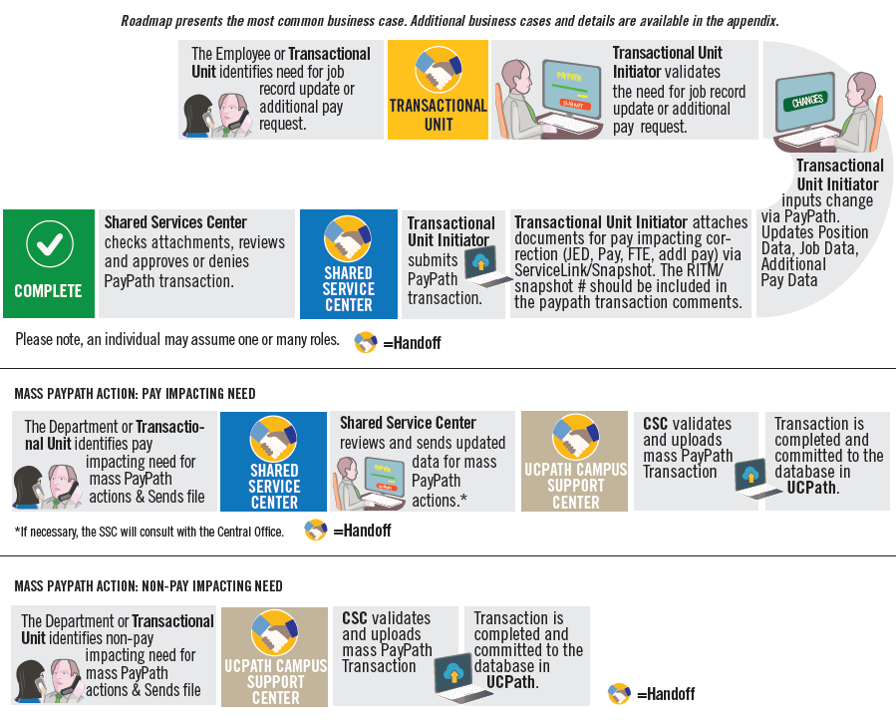
PAYPATH HIGH LEVEL PROCESS OVERVIEW

Slide 21
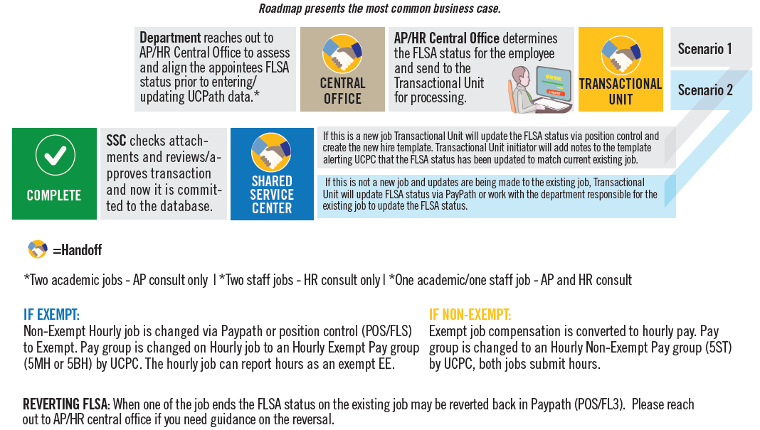
FLSA MISMATCH HIGH LEVEL PROCESS OVERVIEW

Slide 22
PAYPATH HANDOFF MATRIX
2
Hand
offs
Process | Employee | Transactional Unit | SSC | Central Office
PAYPATH | Identify need for a change in their job record or compensation | Identify’ s and validates need for PayPath change and updates to Position, Job and/or recurring additional pay
PAYPATH |  | Process position, job, and/or recurring update in paypath Needs to review email to verify that it was approved/denied by SSC that it needs to be re-entered. | Review and approve/deny PayPath change (review attachments for PAY, JED or FTE changes)
PAYPATH |  | Pilot Unit should reach out to central office for any questions regarding policy prior to processing PayPath changes | SSCs should reach out to central office for any questions regarding policy prior to approving paypath transaction | Respond to any policy questions

Slide 23
QUESTIONS
PILOT UNITS/SSC’s:
Are you prepared to follow the new processes?
Do you understand the processes and your role in the hand offs?
Do you understand each others role in the process?
Do you have any open questions not answered?
Is there anything more you need?
Are there any gaps that would stop you from being successful?

Slide 24
ON BEHALF OF CASE MANAGEMENT

Slide 25

ON BEHALF OF DEFINITION
On Behalf Of Case Management is the task of submitting an inquiry or an update on behalf of another employee or yourself to the UCPath Center via the UCPath website. This process is also used for the following common tasks (Not an exhaustive list):
Update, modify, edit, or change an employee/CWR information.
Open a Case for Transactions created on behalf of the employee, that did not process correctly, or were improperly cancelled by UCPath.
To make specific Personal Data Change updates as defined in the Future State Process Design (FSPD).

Slide 26
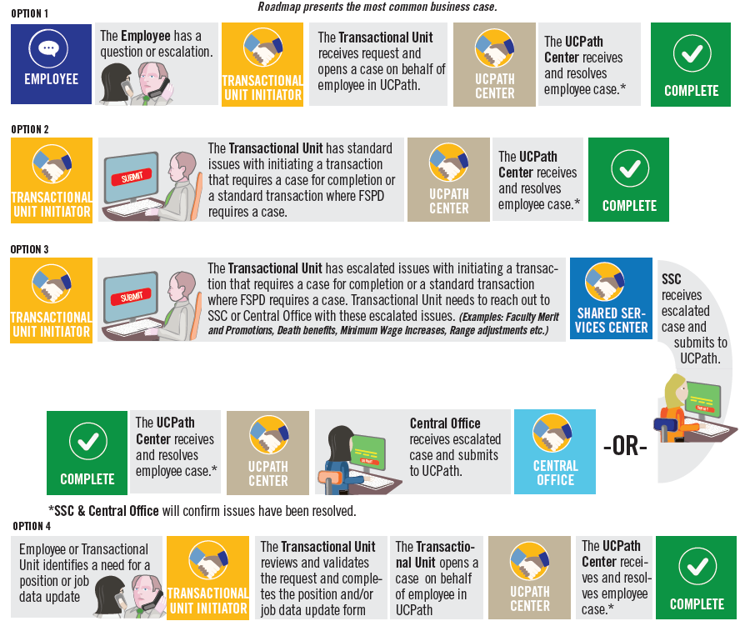
ON BEHALF CASE MANAGEMENT HIGH LEVEL PROCESS OVERVIEW

Slide 27
ON BEHALF OF CASE MANAGEMENT HANDOFF MATRIX
1
Hand
off
Category | Purview | General Approach | Transactions Initiated by SSC only
Cases related to ESCALATED transaction entry that requires UCPC entry | Transactional Unit | ESCALATED corrections or updates initiated by the Transactional Unit need to be opened by the Transactional Unit. Any PAY related transactions that require a *correction or a case requires a Job and/or Position data update form to submit the request to UCPath Center via case for any of the fields below: Comp Rate Job Frequency Effective Date FTE Pay Group Additional Pay One-Time Pay *Phase II position/job data update form are in scope | Retroactive Compensation Changes Overpayments Off Cycle Checks Final Pay Next Day Checks Missed Pay Leave of Absence Sabbatical Credit Adjustments

Slide 28
ON BEHALF OF CASE MANAGEMENT HANDOFF MATRIX
Category | Purview | General Approach | Transactions Initiated by SSC only
Cases related to STANDARD transaction entry that requires UCPC entry | Transactional Unit | STANDARD corrections or updates initiated by the Transactional Unit for non-pay impacting, non-benefit related fields. For example correction of the following fields: Date of Birth Personal Data Name Address | ------
1
Hand
off

Slide 29
ON BEHALF OF CASE MANAGEMENT HANDOFF MATRIX
1
Hand
off
Category | Purview | General Approach | Transactions Initiated by SSC only
Cases related to ESCALATED transaction entry that requires UCPC entry | SSC | Any ACCRUAL or BENEFITS related issues that require a correction or a case. DCP Retirement Cancellation of Benefits Issues with reinstatement Deductions A lapse in benefits coverage Damage Payments Service Credit Adjustments | Retroactive Compensation Changes Overpayments Off Cycle Checks Final Pay Next Day Checks Missed Pay Leave of Absence Sabbatical Credit Adjustments

Slide 30
APO – FACULTY ADMINISTRATIVE APPOINTMENTS
Starting Nov 5, 2019, APO will begin transacting for all Faculty Administrative appointments and titles across all EMPL classes and all transaction types.
APO held an initiation meeting with all Shared Service Centers to review and discuss the upcoming changes with faculty administrative appointments.
Communication will be sent out to all Dean staff and departments informing of the new process.

Slide 31
APO – FACULTY ADMINISTRATIVE APPOINTMENTS JOB CODES
EMPL Class | Job Code | CTO | CTO Name
9 | 000803 | 928 | Associate Vice Chancellor and Chief Diversity Officer
9 | 000803 | 928 | Senior Associate Vice Chancellor
9 | 000803 | 928 | Associate Vice Chancellor of Research and Facilities
9 | 000804 | 928 | Interim Associate Vice Chancellor – Strategic Initiatives and International Recruitment
9 | 000900 | S31 | Director
9 | 000907 | S34 | ACT/Interim Director
9 | 000910 | S31 | Assoc Director
9 | 000917 | S34 | ACT/ Interim Assoc Director
9 | 000920 | S31 | Asst Director
9 | 000927 | S34 | ACT/Interim Asst Director
9 | 001047 | S24 | ACT/Interim College Provost
9 | 001051 | S27 | Asst College Provost
9 | 001052 | S27 | Assoc College Provost
9 | 001060 | S27 | College Provost
9 | 001068 | S27 | Vice Provost
9 | 001069 | S27 | Assoc Vice Provost
9 | 001077 | S24 | ACT/Interim Vice Provost
9 | 001087 | S24 | ACT/Interim Assoc Vice Provost
9 | 001094 | S61 | Department Vice Chair
9 | 001096 | S61 | Department Chair
9 | 001099 | 999 | Admin Stipend
9 | 001097 | S64 | Acting Department Chair
EMPL Class | Job Code | CTO | CTO Name
22 | 001000 | S21 | Dean
22 | 001007 | S24 | ACT/Interim Dean
22 | 001010 | S21 | Assoc Dean
22 | 001017 | S24 | ACT/Interim Associate Dean
22 | 001020 | S21 | Asst Dean
22 | 001027 | S24 | ACT/Interim Assistant Dean
22 | 001030 | S26 | Divisional Dean
22 | 001032 | S26 | Assoc Divisional Dean
22 | 001037 | S24 | ACT/Interim Divisional Dean
22 | 001040 | S21 | Dean- Extended Learning
22 | 001042 | 928 | Faculty Asst to Vice Chancellor
22 | 001044 | 928 | Faculty Asst to Chancellor
22 | 001055 | 928 | Faculty Asst. to Provost/Dean

Slide 32
QUESTIONS
PILOT UNITS/SSC’s:
Are you prepared to follow the new processes?
Do you understand the processes and your role in the hand offs?
Do you understand each others role in the process?
Do you have any open questions not answered?
Is there anything more you need?
Are there any gaps that would stop you from being successful?

Slide 33
PHASE I
Notes:
#1 – Voluntary Termination
#2 - Coordinate with other SSC/Depts.
#3 - SSC

Slide 34
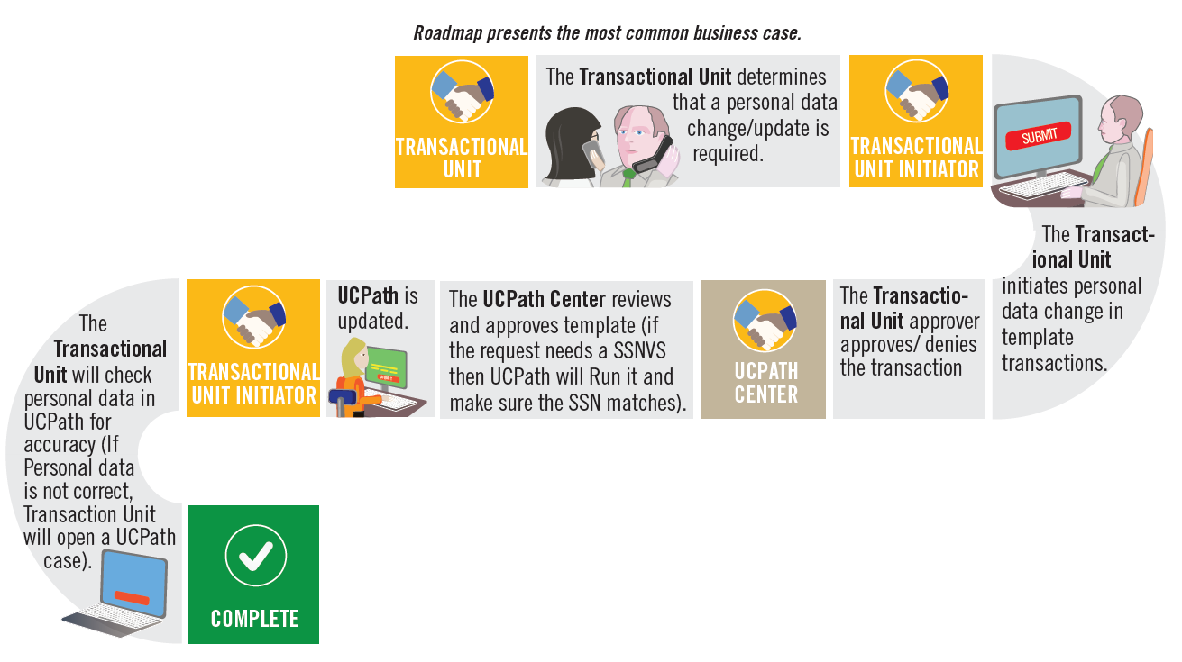
PERSONAL DATA CHANGE HIGH LEVEL PROCESS OVERVIEW
Notes:
#1 – Voluntary Termination
#2 - Coordinate with other SSC/Depts.
#3 - SSC

Slide 35
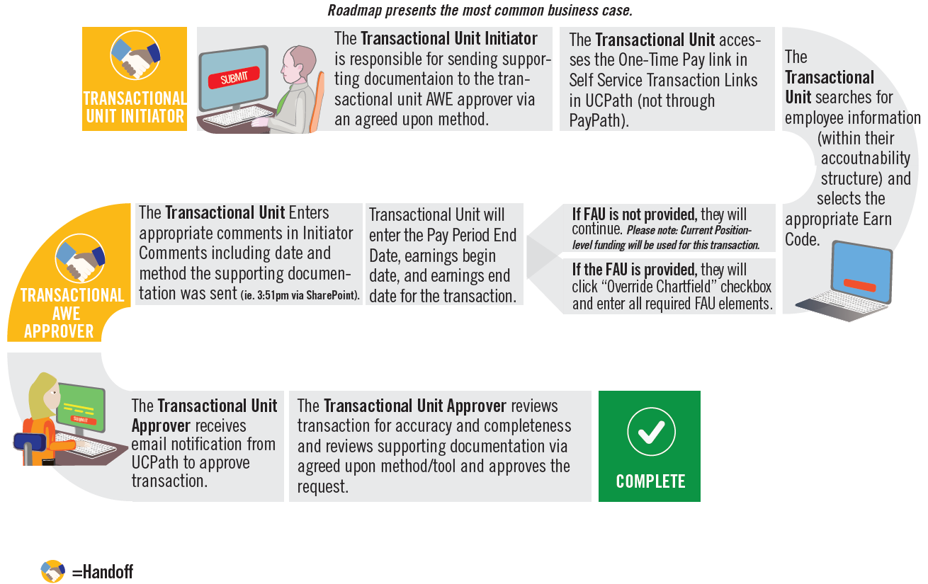
ONE TIME PAYMENT HIGH LEVEL PROCESS OVERVIEW
Notes:
#1 – Voluntary Termination
#2 - Coordinate with other SSC/Depts.
#3 - SSC

Slide 36
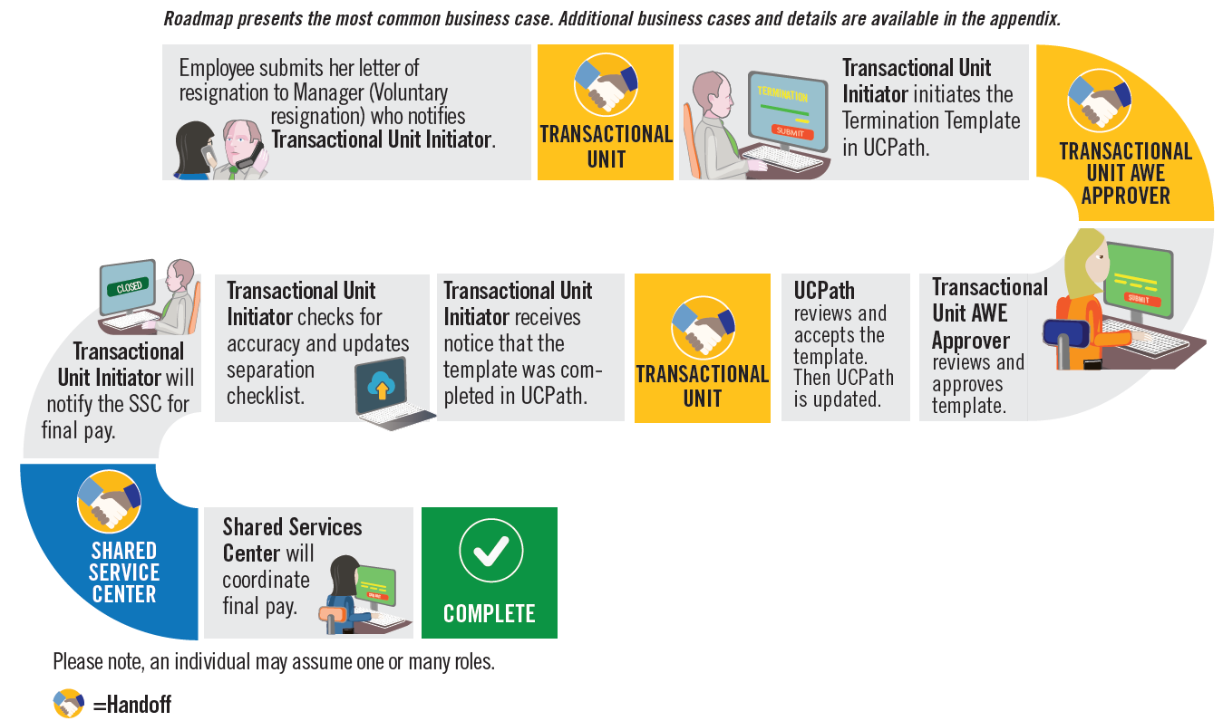
VOLUNTARY TERMINATION HIGH LEVEL PROCESS OVERVIEW
Notes:
#1 – Voluntary Termination
#2 - Coordinate with other SSC/Depts.
#3 - SSC

Slide 37
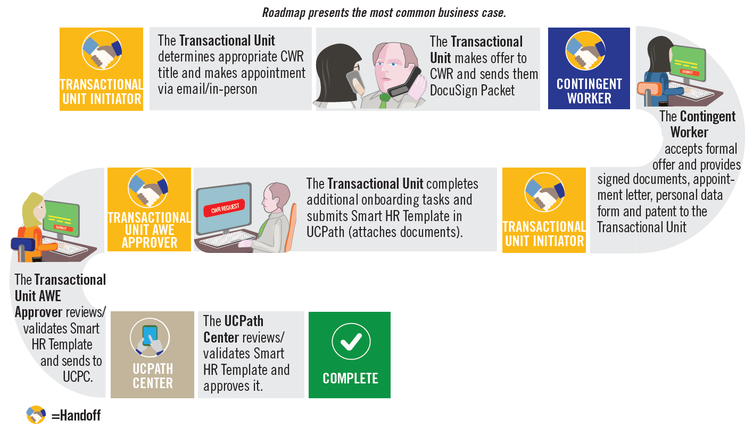
CONTINGENT WORKER HIGH LEVEL PROCESS OVERVIEW
Notes:
#1 – Voluntary Termination
#2 - Coordinate with other SSC/Depts.
#3 - SSC

Slide 38

PROCESSES AWE WILL REMAIN IN SSC
POSITION CONTROL
PERSON
OF
INTEREST
AWE
Notes:
#1 – Voluntary Termination
#2 - Coordinate with other SSC/Depts.
#3 - SSC

Slide 39
SSC/UNIT BREAKOUT
Notes:
#1 – Voluntary Termination
#2 - Coordinate with other SSC/Depts.
#3 - SSC

Slide 40
FEEDBACK
Notes:
#1 – Voluntary Termination
#2 - Coordinate with other SSC/Depts.
#3 - SSC

Slide 41


THINGS TO REMEMBER
Phase II transactions Involuntary Termination, Onboarding and Paypath AWE approvals will be competed by SSC
Phase I transactions Contingent worker, Voluntary Termination, Personal Data Change and One Time Payment AWE approvals will now occur in the Transactional Unit
Position Control and Person of Interest AWE Approvals will remain in the SSC
Position, Job and Additional Recurring pay can all be processed in PayPath
APO is now processing all Faculty Administrative appointments across all EMPL Classes

Slide 42
LEARNING OBJECTIVES REVIEW
Having completed this course, you should be able to:
Understand the roles and responsibilities for each process
Understand the handoff process within each process
Understand the Approval Workflow process, and which transactions will be approved by pilot unit vs. SSC

Slide 43

GO-NO-GO READINESS ASSESSMENT
Notes:
#1 – Voluntary Termination
#2 - Coordinate with other SSC/Depts.
#3 - SSC

Slide 44

Your Feedback Please
http://bit.ly/ucpathpilottrainingphase2

Slide 45


Slide 46


