Slide 1
Ucr ucpath transaction pilot
Onboarding and offboarding, paypath for Empl class 22

Slide 2
TRAINER INTRODUCTION
Antonette Toney, Lakesha Welch, Kameron Johnson, Alexandra Rollins
Title: Varies
Department: UCPath Campus Support Center
Year @UC: Varies
Previous Experience: Varies

Slide 3
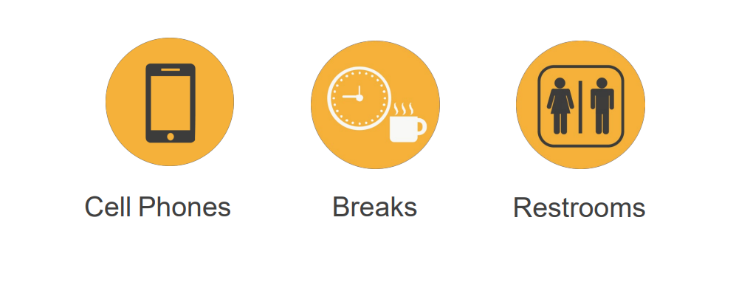
HOUSEKEEPING

Slide 4
LEARNING OBJECTIVES
Identify the actions that are processes using templates.
Identify the pages used to initiate template transactions.
Initiate full hire, concurrent hire, and termination template transactions.
Describe the PayPath Transaction system process.
Initiate positon data, job data changes and Additional Pay.
Initiate various PayPath combination transactions.

Slide 5
LEARNING TOPICS Lecture and Review
Definition
Job Codes
Pilot Roles Descriptions
Learning Objectives Review
Things to Remember
Appendix
Feedback

Slide 6
LEARNING TOPICS Hands On Training
Academic Full Hire
Voluntary Termination
Concurrent Hire
PayPath Transactions
Position Data Changes
Job Data Changes
Additional Pay
Cloning Transactions
Approving Transactions

Slide 7
Definition

Slide 8
ONBOARDING OFFBOARDING
The process begins when a Transactional Unit decides to hire a UC employee. The new hire process applies to both academics and non-academics. An employee is distinguished from a contingent worker in that while both types are tied to a department or job, an employee receives pay through UCPath, or has their benefits managed via UCPath, while a contingent worker does not.
The Voluntary termination process begins with the employee’s decision to resign or retire. Voluntary terminations are processed for both staff and academic employees.
When an employee resigns their employment at one location to accept employment at another location without a break in service, this is considered an Interlocation Transfer, rather than a Voluntary Termination. Refer to WFA.14 Transfer (Interlocation).
A UCPath Termination Template will be used to request both voluntary terminations and retirements.
Approval Workflow Engine (AWE) will allow Transactional Units to capture and route the request for approval prior to submission to the UCPath Center for processing.
There are benefits and payroll implications for voluntary terminations. These are dealt with in separate processes.

Slide 9
POSITION AND JOB DATA CHANGES
Position data changes can be made only for positions that have a single active incumbent.
The Job Data page is used for many types of job-related updates, which can be made independent of a position data change.

Slide 10
RECURRING ADDITONAL PAY
PayPath Additional Pay can be used for recurring additional pay transactions where payments are paid over multiple, consecutive pay periods. Recurring additional pay transactions entered in PayPath are routed for approvals and then transferred to a Payroll staging table to be processed automatically by UCPC Payroll additional pay batch upload process.

Slide 11
Job Codes

Slide 12
Job Codes
EMPL Class | Job Code | CTO | CTO Name
9 | 000803 | 928 | Associate Vice Chancellor and Chief Diversity Officer
9 | 000803 | 928 | Senior Associate Vice Chancellor
9 | 000803 | 928 | Associate Vice Chancellor of Research and Facilities
9 | 000804 | 928 | Interim Associate Vice Chancellor – Strategic Initiatives and International Recruitment
9 | 000900 | S31 | Director
9 | 000907 | S34 | ACT/Interim Director
9 | 000910 | S31 | Assoc Director
9 | 000917 | S34 | ACT/ Interim Assoc Director
9 | 000920 | S31 | Asst Director
9 | 000927 | S34 | ACT/Interim Asst Director
9 | 001047 | S24 | ACT/Interim College Provost
9 | 001051 | S27 | Asst College Provost
9 | 001052 | S27 | Assoc College Provost
9 | 001060 | S27 | College Provost
9 | 001068 | S27 | Vice Provost
9 | 001069 | S27 | Assoc Vice Provost
9 | 001077 | S24 | ACT/Interim Vice Provost
9 | 001087 | S24 | ACT/Interim Assoc Vice Provost
9 | 001094 | S61 | Department Vice Chair
9 | 001096 | S61 | Department Chair
9 | 001099 | 999 | Admin Stipend
9 | 001097 | S64 | Acting Department Chair

Slide 13
Job Codes
EMPL Class | Job Code | CTO | CTO Name
22 | 001000 | S21 | Dean
22 | 001007 | S24 | ACT/Interim Dean
22 | 001010 | S21 | Assoc Dean
22 | 001017 | S24 | ACT/Interim Associate Dean
22 | 001020 | S21 | Asst Dean
22 | 001027 | S24 | ACT/Interim Assistant Dean
22 | 001030 | S26 | Divisional Dean
22 | 001032 | S26 | Assoc Divisional Dean
22 | 001037 | S24 | ACT/Interim Divisional Dean
22 | 001040 | S21 | Dean- Extended Learning
22 | 001042 | 928 | Faculty Asst to Vice Chancellor
22 | 001044 | 928 | Faculty Asst to Chancellor
22 | 001055 | 928 | Faculty Asst to Provost/Dean

Slide 14
Roles

Slide 15
Transaction Roles
1: Transactional Unit
2: ORG Authority
3: Shared Services Center
4: Central Office
5: UCPath Center

Slide 16
Transaction Roles
Initiates new position.
Dean/VP/VC sends Faculty Administrator recommendation to APO for Provost App.
ORG sends Dean’s level appointment letter to the APO for input into UCPath.
Transactional Unit initiates new and updates vacant positions.
Department/Org sends requests to SSC to have position created/updated for new incumbent.
Transactional Unit/Department/ORG sends summer salary transaction, end dates to APO for input into UCPath.
Transactional Unit/Department/ORG send notifications of leave transaction are sent to APO as a copy.
Represent the needs of the individual Transactional Unit and ORG as appropriate.
Notify APO of the appropriate positions to use for Faculty Administrative hires.
Maintains employee file/documentation.
1: Transactional Unit (Initiator)
2: ORG Authority
3: Shared Services Center (AWE Approver)
4: Central Office
5: UCPath Center

Slide 17
Transaction Roles
Responsible for ensuring the appropriate policy is followed.
1: Transactional Unit (Initiator)
2: ORG Authority
3: Shared Services Center (AWE Approver)
4: Central Office
5: UCPath Center

Slide 18
Transaction Roles
If Dept/Org is NOT participating in the Pilot, then SSC is responsible for initiating positons into UCPath and notifying the Non-Pilot Unit of completed transaction and status.
1: Transactional Unit (Initiator)
2: ORG Authority
3: Shared Services Center (AWE Approver)
4: Central Office
5: UCPath Center

Slide 19
Transaction Roles
APO sends out Call for Faculty Provost Admin App.
APO sends recommendation to CAP/Provost for approval.
APO sends approved appointment letter to Faculty Appointee.
APO enters transaction into UCPath and notifies units of update.
APO is going to enter hire and Termination Templates and Paypath changes into UCPath.
APO reaches out to SSC for off-cycle checks, overpayment management and final pay.
APO initiates and approves Hire, Rehire, Transfer Templates.
APO initiates and approves Voluntary, Involuntary, and Retirement templates.
APO Initiates and approves PayPath Updates.
APO Initiates and approve reccurring additional pay.
Responsible for process design, and policy guidelines.
Provide subject matter expertise in policy related questions.
1: Transactional Unit (Initiator)
2: ORG Authority
3: Shared Services Center (AWE Approver)
4: Central Office
5: UCPath Center

Slide 20
Transaction Roles
WFA Production.
Approve hire and rehire templates.
Approve Voluntary, Involuntary, and Retirement templates.
1: Transactional Unit (Initiator)
2: ORG Authority
3: Shared Services Center (AWE Approver)
4: Central Office
5: UCPath Center

Slide 21
Intro to Template Transactions

Slide 22
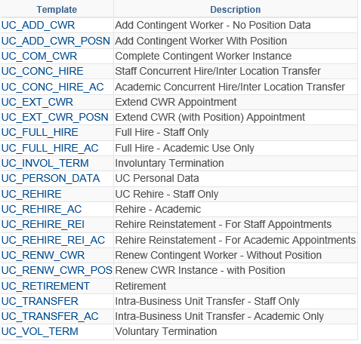
INTRO TO TEMPLATE TRANSACTIONS
Available Templates
Template transactions are initiated through a UCPath template-based page called Smart HR Templates.
Custom templates provide the fields necessary to complete the transaction.
In many cases, there is a template specific to academic and another specific to staff. For example:
UC Full Hire - Staff Only
UC Full Hire - Academic Use Only

Slide 23
INTRO TO TEMPLATE TRANSACTIONS
The actions that are processed using templates include:
Full Hires
Contingent Workers (CWR)
Concurrent Hires
Rehires
Personal Data Changes
Retirement
Intralocation Transfers
Interlocation Transfers
Terminations

Slide 24
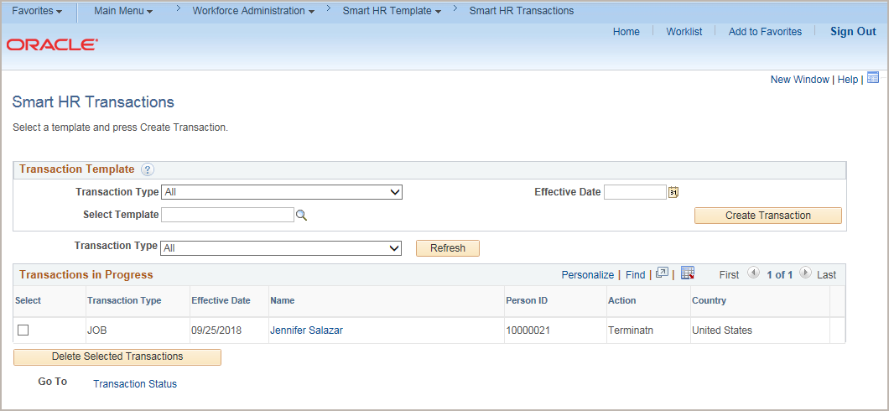
TEMPLATE TRANSACTIONS - NAVIGATION
Navigation: PeopleSoft Menu > Workforce Administration > Smart HR Transactions
The Smart HR Transactions page is the starting point to initiate a template transaction.

Slide 25
INTRO TO TEMPLATE TRANSACTIONS
The following types of transactions are processed for staff and academic employees using PayPath Actions:
PayPath Actions Transactions
Position Data Changes
Job Data Changes
Additional Pay

Slide 26
TEMPLATE TRANSACTIONS – SYSTEM PROCESS
Review the process:
Template Initiator
Template Initiator
Template Approver
Review / Approve Template Transaction
WFA Production
All
Review Person Org Summary Page
Enter and Submit Template Transaction
Process Template Transaction
View Employee Data
AWE

Slide 27
CHECK YOUR UNDERSTANDING

Slide 28
CHECK YOUR UNDERSTANDING
What is the name of the page that you would navigate to in order to initiate a template transaction?
What are some examples of the templates you can process in the Smart HR Transactions page?
What transactions are initiated using PayPath Actions?
Notes:
SS Smart HR Transactions
Hires, rehire, concurrent hires, terminations, retirements, transfers
Positon Data Changes, Job Data Changes, Additional Pay

Slide 29
Person Organizational Summary Overview

Slide 30
PERSON ORGANIZATIONAL SUMMARY
Navigation: PeopleSoft Menu > Workforce Administration > Personal Information > Person Organizational Summary
Use the Person Org Summary page to view a summary of an employee’s current organizational relationship, including HR and payroll status and all current job assignment details.
The Person Org Summary page displays current employee information for all organizational relationships:
Employee
Contingent Worker (CWR)
Person of Interest (POI)
An employee may have more than one organizational relationship concurrently. For example, the person may be an employee at one UC Location, and a CWR at another.
This page does not display historical or future-dated employment details.
You can view job assignment information for any UC employee; it is not restricted by business unit.

Slide 31
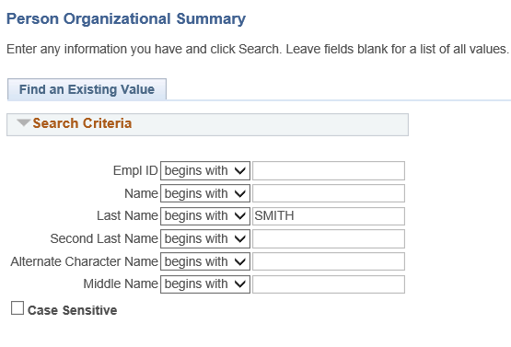
PERSON ORGANIZATIONAL SUMMARY: SEARCH PAGE
Navigation: PeopleSoft Menu > Workforce Administration > Personal Information> Person Organizational Summary
Review the Person Organizational Summary page.
Search by Last Name and determine if a POI, CWR, or EMP instance already exists for the person.
Example: Check to see if Naomi Smith exists in UCPath. Enter her last name and click Search.

Slide 32
PERSON ORGANIZATIONAL SUMMARY
Navigation: PeopleSoft Menu > Workforce Administration > Personal Information > Person Organizational Summary
The header displays the employee’s status information. If there is more than one row of data, click the View All link.

Slide 33
Academic Full Hire

Slide 34
SMART HR TRANSACTIONS
Navigation: PeopleSoft Menu > Workforce Administration > Smart HR Template > Smart HR Transactions
The Smart HR Transactions page is the starting point to initiate a template transaction.
The Transaction Type field is not used by UC.
Use the Select Template field to select the appropriate template.
You also can delete transactions you have initiated, as long as they have not been approved.

Slide 35
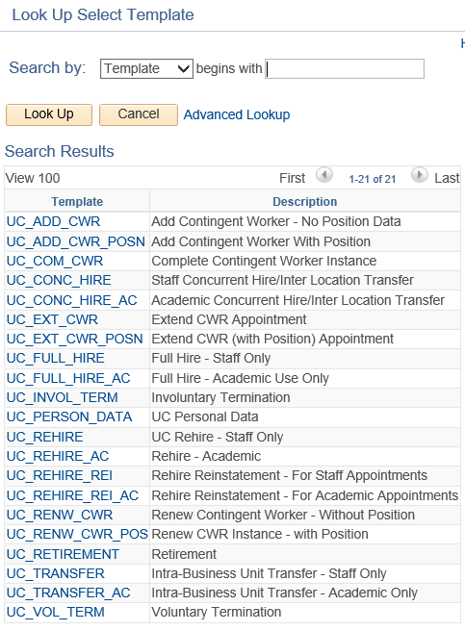
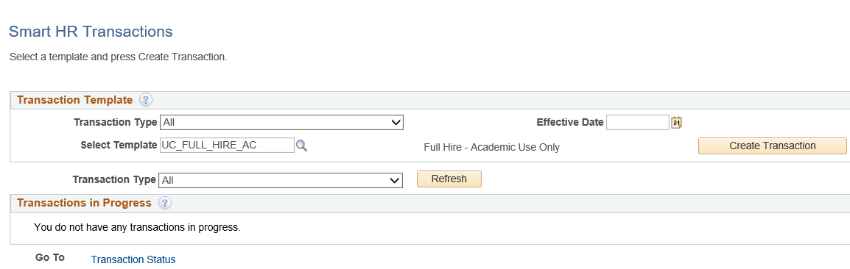
SMART HR TRANSACTIONS
Navigation: PeopleSoft Menu > Workforce Administration > Smart HR Template > Smart HR Transactions
Use the Select Template look up to select the template for the transaction you need to initiate.
Click the Search button to select a template.

Slide 36
SMART HR TRANSACTIONS
Navigation: PeopleSoft Menu > Workforce Administration > Smart HR Template > Smart HR Transactions
After you select the template, and select the Effective Date, click the Create Transaction button.
Click the Search button to select a template.

Slide 37
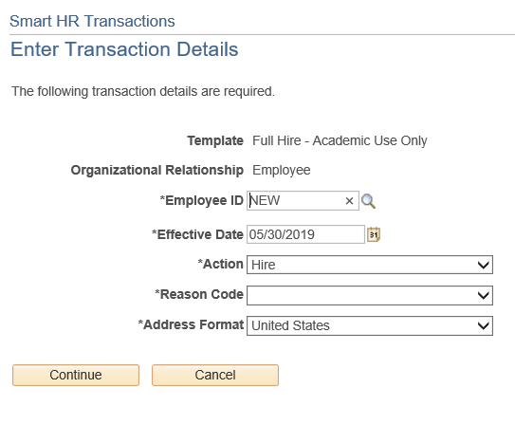
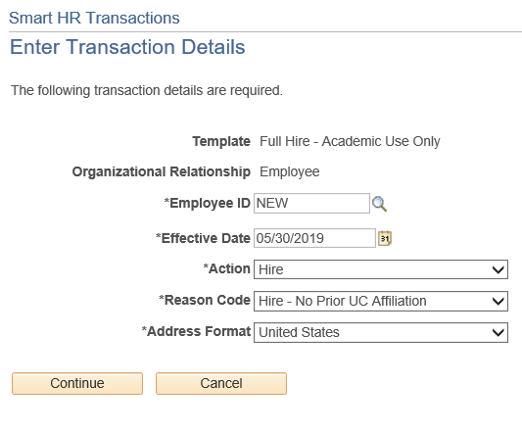
SMART HR TRANSACTIONS
Navigation: PeopleSoft Menu > Workforce Administration > Smart HR Template > Smart HR Transactions
Select the appropriate Reason Code. Each template has a unique list of Reason codes.
Click the Continue button.
For new hires, in the Employee ID field, accept the default of NEW.
Ensure that you select the correct Job Effective Date and Reason Code. These fields are important entry points for the employee’s record and have many downstream effects.
In the Address Format field, accept the default of United States.

Slide 38
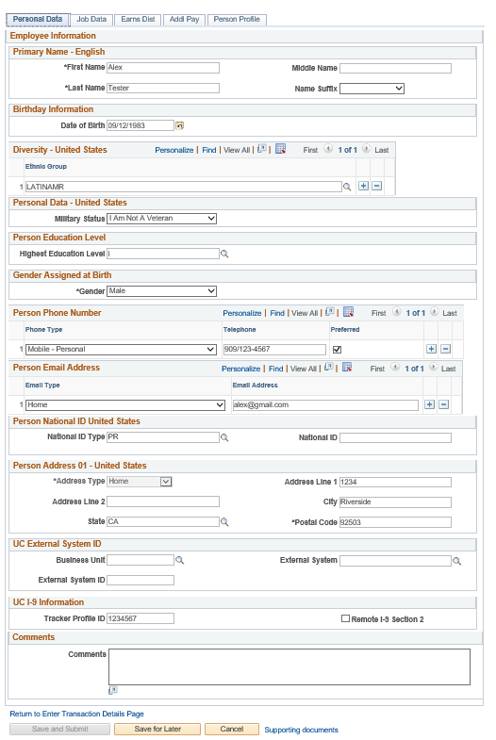
ACADEMIC FULL HIRE PERSONAL DATA
The academic full hire template appears. There are five tabs on this template: Personal Data, Job Data, Earns Dist, Addl Pay, and Person Profile.
Click in the First Name field.
Click in the Last Name field.
Click in the Date of Birth field.
Click the Look Up Ethnic Group button.
Select the appropriate Military Status, If known, or leave the field blank.
Select the Highest Education Level, If known or accept the default of A (Not Indicated).
Select the Phone Type.
A Preferred phone number must be identified by selecting the check box.
Select Email Type.

Slide 39
ACADEMIC FULL HIRE PERSONAL DATA
In the National ID Type field, accept the default of PR for Social Security. Every effort should be taken to include the SSN before submitting the template.
Click in the Address Line 1 field.
Click in City field.
Click in State field.
Click in Postal Code field.
Notes:
If applicable, use the UC External System ID section to enter external system information to facilitate matching of IDs with IDM systems. If providing the information, you must enter values for all three fields. The Business Unit in this section must match the Business Unit associated with the Position Number you enter on the Job Data tab (the next tab).

Slide 40
ACADEMIC FULL HIRE PERSONAL DATA
If the new hire has an existing tracker profile, then you can add their Tracker Profile ID and indicate whether their I-9 section 2 needs to be completed remotely. This information is copied to the employee's Person Profile component.
Click in the Tracker Profile ID field.
Use the Comments field to enter specific details or an explanation regarding the transaction. Click the Job Data tab.

Slide 41
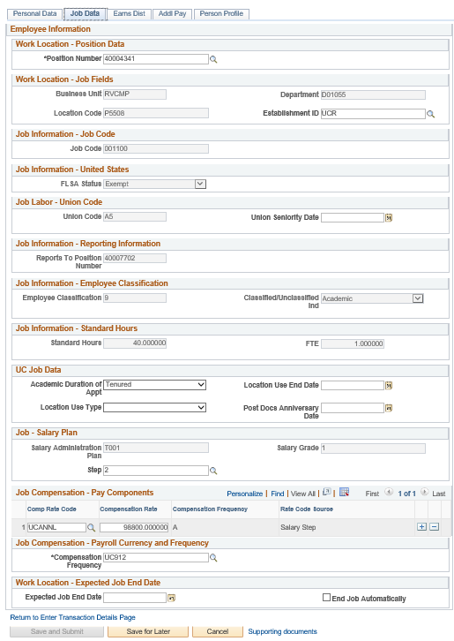
ACADEMIC FULL HIRE JOB DATA
Click Position number. The following fields will automatically populate based on Position number. You only have access to position numbers within your business unit.
Business Unit
Location Code
Department
Establishment ID
Job Code
FLSA Status
Union Code
Reports to Position number
Employee Classification
Classified/Unclassified
Standard Hours
FTE
Salary Administration Plan
Salary Grade
Compensation frequency all default

Slide 42
ACADEMIC FULL HIRE JOB DATA
Enter Academic Duration of Appointment. This is for locations to track additional information relating to the Expected Job End Date field. Options include:
Continuing (Unit 18)
End Date (Academic Term Appts)
Indefinite
Potential Security
Security (LSOE)
Tenure Track (Ladder Rank)
Tenured

Slide 43
ACADEMIC FULL HIRE JOB DATA
Select the Step.
The Comp Rate Code, Compensation Rate, and Compensation Frequency fields are automatically populated based on the Step that was entered.
You can add additional compensation rows by clicking the add a row (+) button. For example, if you need to add an off scale component.
Use the Supporting documents link to attach supporting documents for the new hire.
An Expected Job End Date should be entered for all academic employee classes, except:
3 - Academic Recall
9 - Faculty
10 - Non-Faculty
11 - Academic Student
14 - Academic Contingent Worker
21 - Emeriti
22 - Deans/Faculty Administrators
23 - Post Docs
Notes:
The payroll-related Compensation Frequency field automatically populates based on the job code. The payroll-related Compensation Frequency field automatically populates based on the job code. If the Compensation Frequency in the Job Compensation - Pay Components section is A, then the Compensation Frequency in the Job Compensation - Payroll Currency and Frequency section can be any of the following: B, M, UC912, UC_10, UC_11, UC_12, UC_9M or UC_FY. If the Compensation Frequency in the Job Compensation - Pay Components section is H, then the Compensation Frequency in the Job Compensation - Payroll Currency and Frequency section should be H.
If the End Job Automatically check box is selected the UCPath Center will run a process to terminate the employee as of the Expected Job End Date.

Slide 44
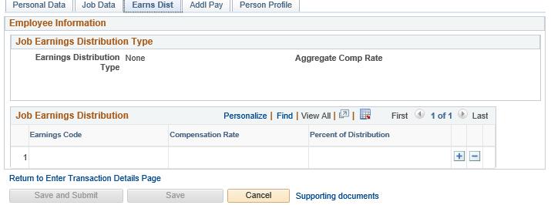
ACADEMIC FULL HIRE EARNS DISTRIBUTION
Click the Earns Dist tab.
In most cases, the Job Earnings Distribution section is automated.
The Job Earnings Distribution section also can be used to manually enter distribution information.
After the Earnings Distribution Type is selected, the Aggregate Comp Rate field is populated with the monthly amount.
If By Amount is selected, the total of all compensation rates entered must add up to the monthly comp rate.
If By Percent is selected, the total of all percentages entered must add up to 100%.
For certain academic comp rate codes, such as Health Science Comp Plan, earnings codes are defaulted based on the Comp Rate Code entered on the Job Data tab. Also in those cases, earning distribution type is By Amount, and amounts are automatically calculated.

Slide 45
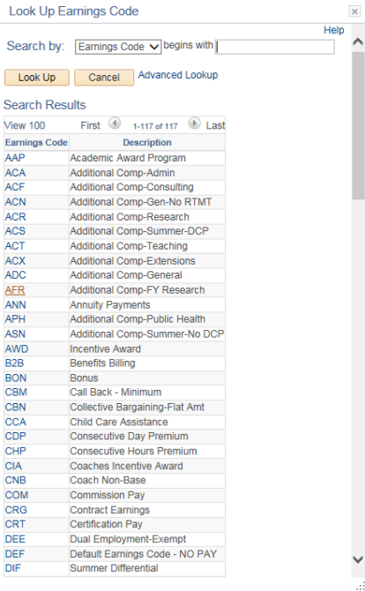
ACADEMIC FULL HIRE ADDITIONAL PAY
Click the Addl Pay tab.
There may be cases where an employee is paid a recurring flat amount. In these types of cases, the compensation section is not populated on the Job Data tab. Instead, the Additional Pay section is used.
It is recommended not to use this template for one time additional pay. Instead, use the one time payments page.
Use Supporting documents to attach supporting documents.
Click the Save and Submit button.

Slide 46
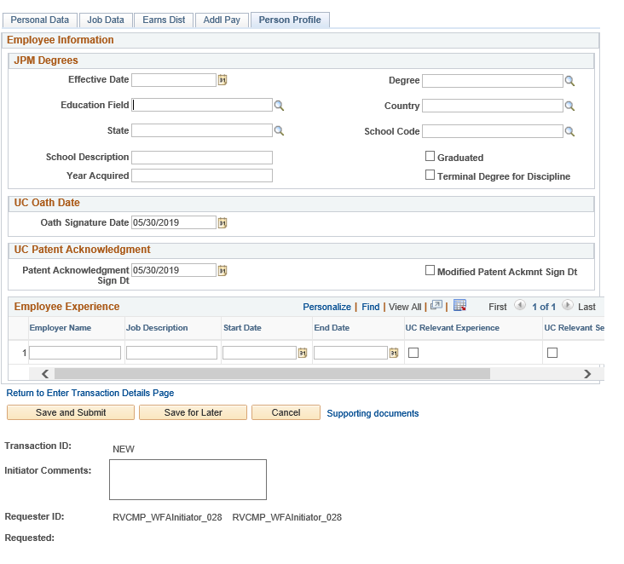
ACADEMIC FULL HIRE PERSON PROFILE
Click on Person Profile.
Use the Person Profile page to enter the employee's Degrees, Oath Signature Date, and Patent Acknowledgment signature date. Click in the Oath Signature Date field.
Click in the Patent Acknowledgment Sign Dt field.
Use the Supporting documents link to attach supporting documents for the new hire.
Enter comments for the Approver in the Initiator Comments field. Comments you enter here appear only with the request; they do not appear on the employee’s record after the transaction is processed to completion. You can enter Initiator Comments on any of the tabs within this template.
Click Save and Submit button.
Notes:
The information entered in the JPM Degrees, UC Oath Date and UC Patent Acknowledgement sections is copied to the employee's Person Profile component after the template is processed by UCPC WFA Production.

Slide 47
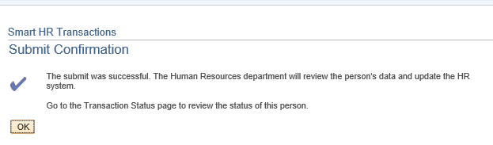
ACADEMIC FULL HIRE CONFIRMATION
Once the transaction has been submitted, the Initiator will receive a confirmation.
Click the OK button to go to the Transaction Status page to review the status of this person.
The template transaction is routed for approval, and appears in the Transactions in Progress section until it is processed.
You have initiated a Full Hire Academic template transaction.

Slide 48
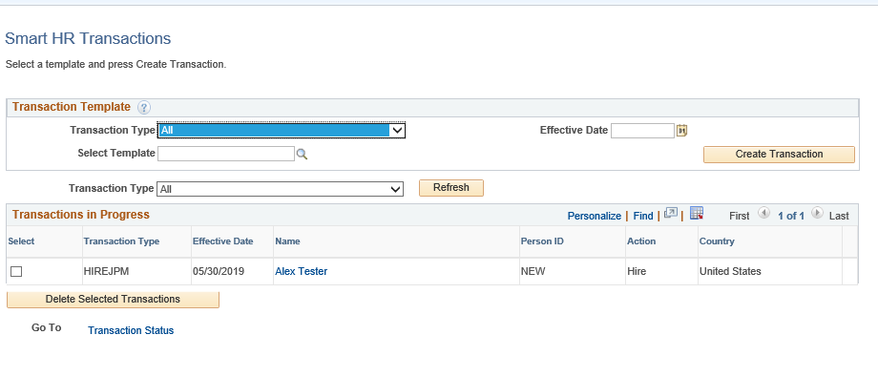
ACADEMIC FULL HIRE SMART HR TRANSACTIONS
You will be able to view your submitted transaction in the Smart HR Transactions page.

Slide 49
Voluntary Termination

Slide 50
SMART HR TRANSACTIONS
Navigation: PeopleSoft Menu > Workforce Administration > Smart HR Template > Smart HR Transactions
The Smart HR Transactions page is the starting point to initiate a template transaction.
The Transaction Type field is not used by UC.
Use the Select Template field to select the appropriate template.
You also can delete transactions you have initiated, as long as they have not been approved.

Slide 51
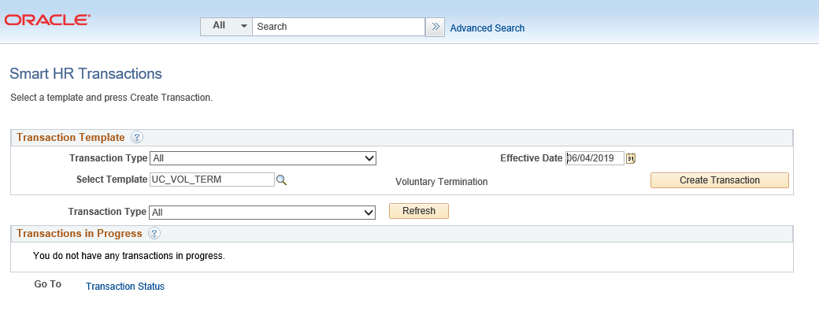
SMART HR TRANSACTIONS
Navigation: PeopleSoft Menu > Workforce Administration > Smart HR Template > Smart HR Transactions
Use the Select Template look up to select the template for the transaction you need to initiate.
Click the Search button to select a template.

Slide 52
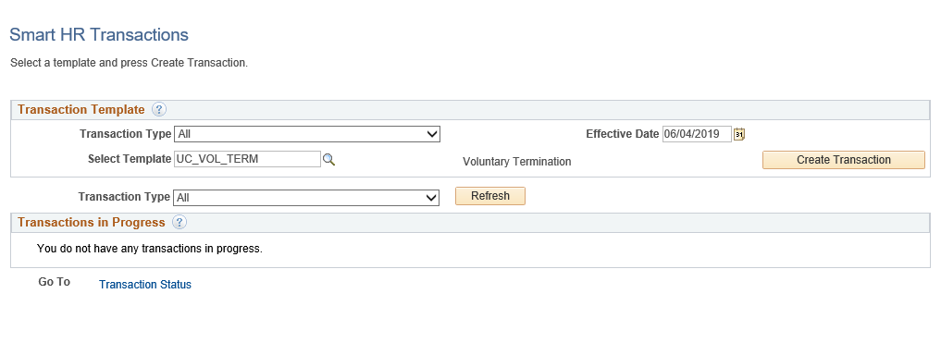
SMART HR TRANSACTIONS
Navigation: PeopleSoft Menu > Workforce Administration > Smart HR Template > Smart HR Transactions
After you select the template, and select the Effective Date, click the Create Transaction button.

Slide 53
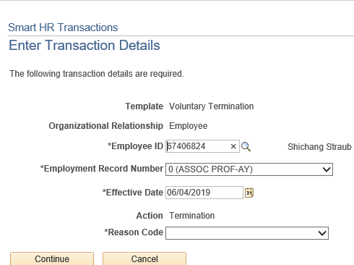
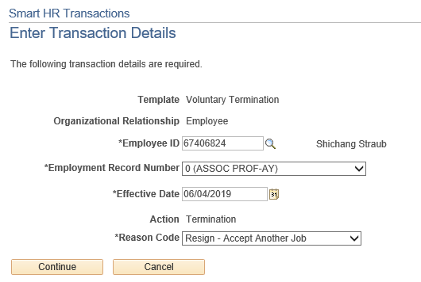
SMART HR TRANSACTIONS
Navigation: PeopleSoft Menu > Workforce Administration > Smart HR Template > Smart HR Transactions
Select the appropriate Employee ID.
Select the appropriate Reason codes.
Click the Continue button.

Slide 54
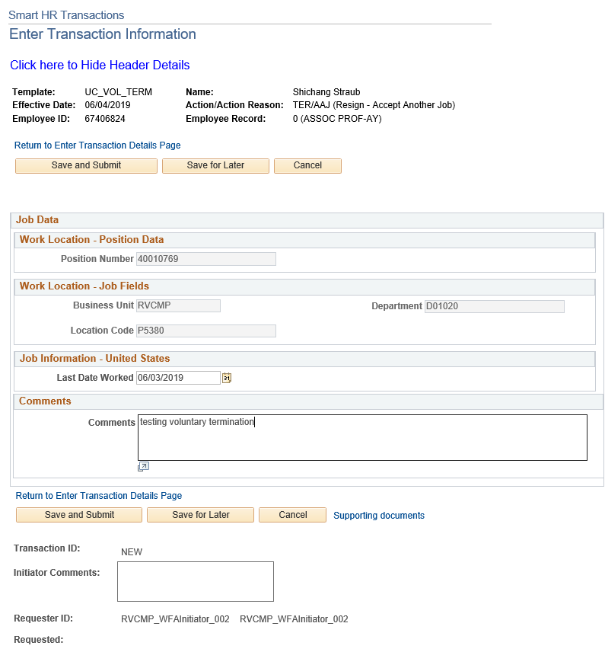
VOLUNTARY TERMINATION
Click Save and Submit.

Slide 55
VOLUNTARY TERMINATION CONFIRMATION
Once the transaction has been submitted, the Initiator will receive a confirmation.
Click the OK button to go to the Transaction Status page to review the status of this person.
The template transaction is routed for approval, and appears in the Transactions in Progress section until it is processed.
You have initiated a Voluntary Termination template transaction.

Slide 56
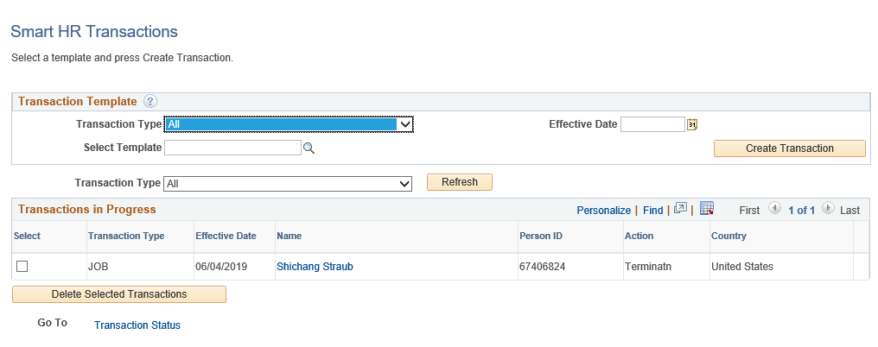
VOLUNTARY TERMINATION
You will be able to view your submitted transaction in the Smart HR Transactions page.

Slide 57
Academic Concurrent Hire

Slide 58
CONCURRENT HIRE
Available Templates
A staff or academic employee adds an additional job, which is concurrent to his or her existing job with UC.
Non-Dual: Two or more jobs that do not exceed a total percent time of 100%.
Dual: Two or more jobs that exceed a total percent time of 100%.
A separate concurrent hire template is available for academic and for staff.

Slide 59
SMART HR TRANSACTIONS
Navigation: PeopleSoft Menu > Workforce Administration > Smart HR Template > Smart HR Transactions
The Smart HR Transactions page is the starting point to initiate a template transaction.
The Transaction Type field is not used by UC.
Use the Select Template field to select the appropriate template.
You also can delete transactions you have initiated, as long as they have not been approved.

Slide 60
SMART HR TRANSACTIONS
Navigation: PeopleSoft Menu > Workforce Administration > Smart HR Template > Smart HR Transactions
Use the Select Template look up to select the template for the transaction you need to initiate.
Click the Search button to select a template.

Slide 61
SMART HR TRANSACTIONS
Navigation: PeopleSoft Menu > Workforce Administration > Smart HR Template > Smart HR Transactions
After you select the template, and select the Effective Date, click the Create Transaction button.
Notes:
Transferred employees must NOT have a break in service.

Slide 62
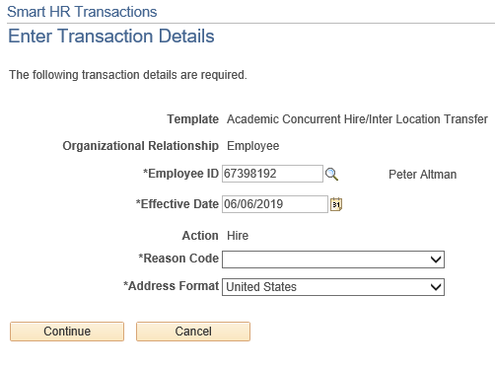
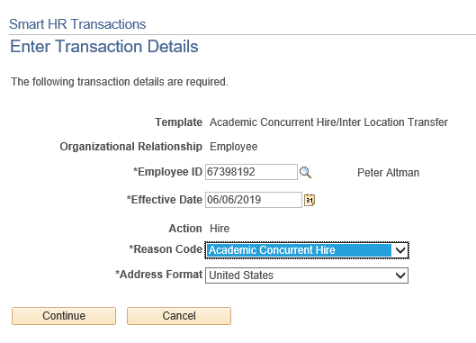
SMART HR TRANSACTIONS
Navigation: PeopleSoft Menu > Workforce Administration > Smart HR Template > Smart HR Transactions
Select the appropriate Reason Code. Each template has a unique list of Reason codes.
Click the Continue button. Click the OK button when the UCPath message indicating the individual is in the system appears.
1
Use Academic Concurrent Hire to add either a Dual or Non-Dual employment.
Notes:
Use Academic Inter BU Transfer for an inter-business unit transfer of an academic employee. Example: A faculty member from UCLA is transferred to a new position at UCR. There is no break in Service. This type of transfer is OUTSIDE UCR (BU – Campus/Location).

Slide 63
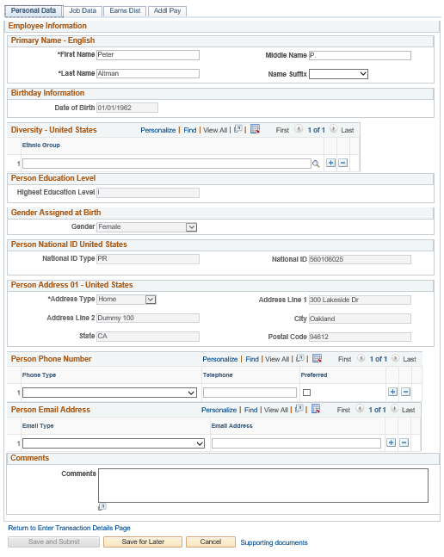
CONCURRENT HIRE PERSONAL DATA
The concurrent hire template appears. Four tabs are available on this template: Personal Data, Job Data, Earns Dist, and Addl Pay.
The employee's personal data automatically populates from the employee's existing personal data information. If a change is required for personal data, it should be submitted using Employee Self Service or the Personal Data Change Template.

Slide 64
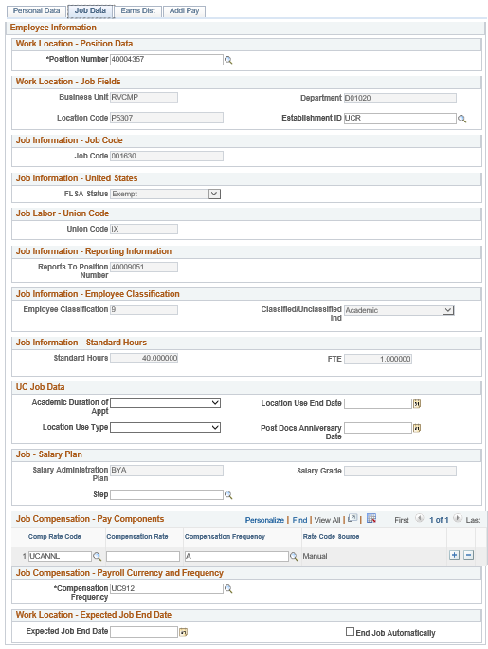
CONCURRENT HIRE JOB DATA
Enter the Position Number of the concurrent job, or search for it using the look up. You only have access to position numbers within your business unit. The following fields will automatically populate based on Position number:
Business Unit
Location Code
Department
Establishment ID
Job Code
FLSA Status
Union Code
Reports to Position number
Employee Classification
Classified/Unclassified
Standard Hours
FTE

Slide 65
CONCURRENT HIRE JOB DATA
Some job codes have steps associated with them.
For this example, the job code is not associated with the step.
Select the Comp Rate Code. Once selected, the Compensation Frequency is automatically populated.
Comp Rate Codes are used to define each component of the employee’s base salary.
Compensation Rate is the amount paid at the compensation frequency.
Notes:
When a Step is entered, UCPath automatically updates the Job Compensation - Pay Components fields and the compensation information cannot be changed. Some job codes do not have steps associated with them, in which case the Job Compensation - Pay Components fields must be manually entered. If the job has above scale component of pay, then step does not need to be selected. Enter applicable above scale comp rate codes in the Job Compensation - Pay Components section.

Slide 66
CONCURRENT HIRE JOB DATA
If the employment is a short term assignment or temporary hire, enter the date the position ends in the Expected Job End Date field. An expected end date should be entered for all academic employee classes, except:
3 - Academic Recall
9 - Faculty
10 - Non-Faculty
11 - Academic Student
14 - Academic Contingent Worker
21 - Emeriti
22 - Deans/Faculty Administrators
23 - Post Docs

Slide 67
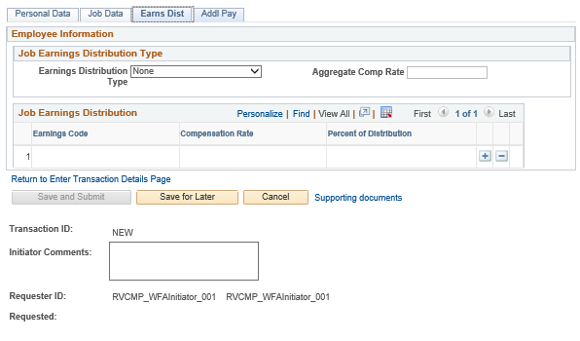
CONCURRENT HIRE EARNS DISTRIBUTION
Click the Earns Dist tab.
In most cases, the Job Earnings Distribution section is automated.
The Job Earnings Distribution section also can be used to manually enter distribution information.
After the Earnings Distribution Type is selected, the Aggregate Comp Rate field is populated with the monthly amount.
If By Amount is selected, the total of all compensation rates entered must add up to the monthly comp rate.
If By Percent is selected, the total of all percentages entered must add up to 100%.
For certain academic comp rate codes, such as Health Science Comp Plan, earnings codes are defaulted based on the Comp Rate Code entered on the Job Data tab. Also in those cases, earning distribution type is By Amount, and amounts are automatically calculated.
Notes:
If the Comp Rate code entered on the Job Data tab has a mapped Earnings Code, the Job Earnings Distribution section is updated automatically.

Slide 68
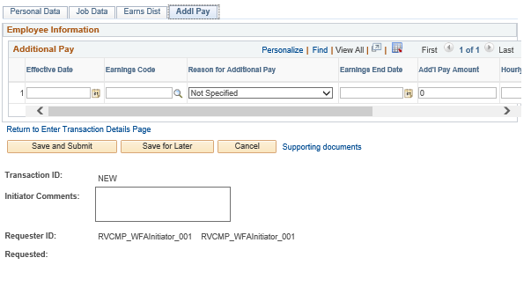
CONCURRENT HIRE ADDITIONAL PAY
Click the Addl Pay tab.
There may be cases where an employee is paid a recurring flat amount. In these types of cases, the compensation section is not populated on the Job Data tab. Instead, the Additional Pay section is used.
It is recommended not to use this template for one time additional pay. Instead, use the One Time Payments page.
Use Supporting documents to attach supporting documents for concurrent hire.
Click the Save and Submit button.

Slide 69
ACADEMIC FULL HIRE CONFIRMATION
Once the transaction has been submitted, the Initiator will receive a confirmation.
Click the OK button to go to the Transaction Status page to review the status of this person.
The template transaction is routed for approval, and appears in the Transactions in Progress section until it is processed.
You have initiated a Full Hire Academic template transaction.

Slide 70
ACADEMIC FULL HIRE SMART HR TRANSACTIONS
You will be able to view your submitted transaction in the Smart HR Transactions page.

Slide 71
PayPath Transactions

Slide 72
PAYPATH ACTIONS OVERVIEW
The PayPath Actions component offers a one-stop shop for processing various types of transactions, and the flexibility to submit multiple actions in a single transaction.
There are two PayPath Actions components; one for academic, and one for staff. The appropriate component displays based on the type of employee selected.
The following types of transactions are processed for staff and academic employees using PayPath Actions:
PayPath Actions Transactions
Position Data Changes
Job Data Changes
Additional Pay

Slide 73
PAYPATH ACTIONS EXAMPLES
Examples of changes requested through PayPath Actions:
Academic Merit, Promotion or Change in Series
Position and/or Job Data FTE Changes
Salary Only Changes / Pay Rate Changes
Summer Compensation
Change in Status from Without Salary (WOS) to Paid or Paid to WOS
Short Work Break / Return from Short Work Break
Abeyance / Return from Abeyance
Changes to existing concurrent appointments
Recurring Additional Pay Payments
Retro Academic Merits, Promotions, Series Changes
Phased Retirement or Employee Reduction In Time (ERIT)
Probationary Status and Trial Employment Changes

Slide 74
PAYPATH TRANSACTION – SYSTEM PROCESS
Enter and Submit PayPath Transaction
Review / Approve PayPath Transaction
View Employee Data
Navigate to PayPath Actions component
PayPath Initiator
PayPath Initiator
PayPath Approver
All

Slide 75
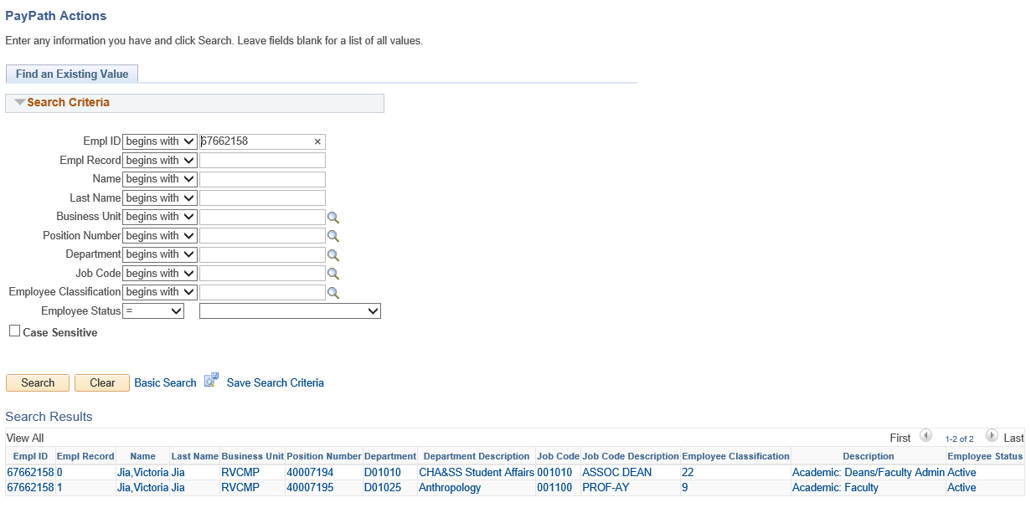
PAYPATH TRANSACTION
Navigation: PeopleSoft Menu > UC Customizations > UC Extensions > PayPath Actions
Enter search criteria to locate an employee. In this example, a search was performed on Employee 67662158.

Slide 76
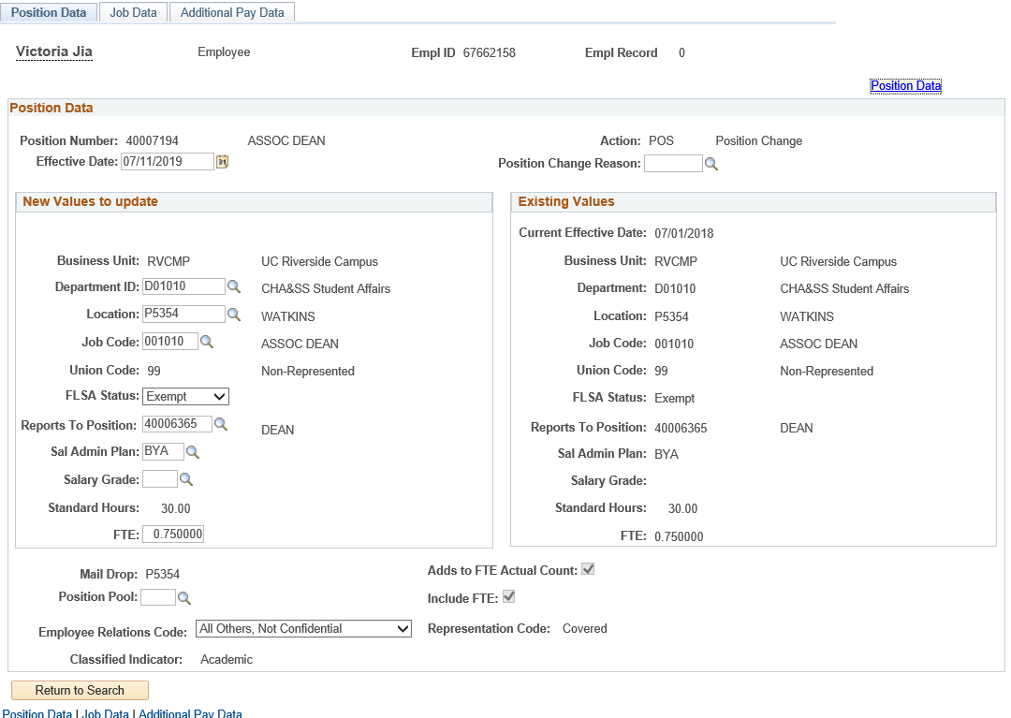
PAYPATH TRANSACTION
Navigation: PeopleSoft Menu > UC Customizations > UC Extensions > PayPath Actions
The PayPath Actions component is comprised of three pages: Position Data, Job Data, and Additional Pay Data. Navigate to the appropriate page to enter the related update.

Slide 77
PAYPATH ACTIONS – POSITION DATA PAGE
Navigation: PeopleSoft Menu > UC Customizations> UC Extensions > PayPath Actions
Use the Position Data page to enter changes to the position data. The Position Data provides two areas: Existing Values and New Values to update. This allows you to compare the existing position information while you enter the updated information. If the employee is in a multi-headcount position, the fields of the Position Data page are view-only, and you cannot enter changes. However, you can still enter Job Data changes.

Slide 78
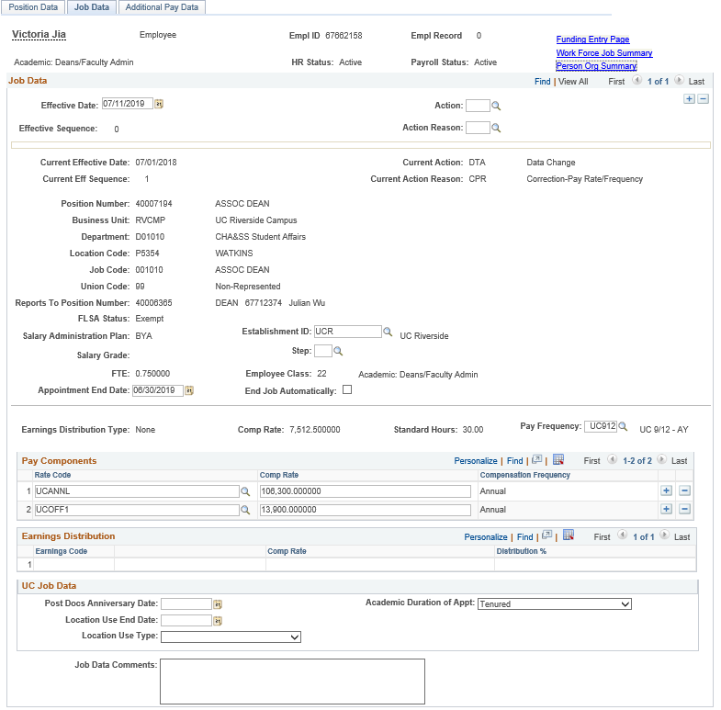
PAYPATH ACTIONS – JOB DATA PAGE
Navigation: PeopleSoft Menu > UC Customizations > UC Extensions > PayPath Actions
Use the Job Data page to enter various job data changes.

Slide 79
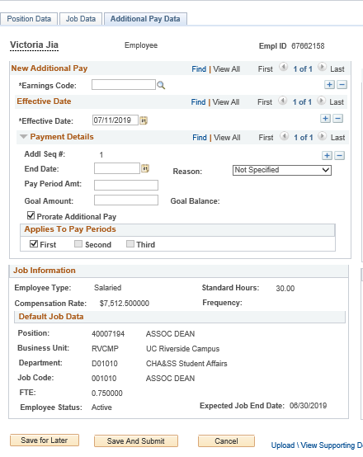
PAYPATH ACTIONS – ADDITIONAL PAY DATA PAGE
Navigation: PeopleSoft Menu > UC Customizations > UC Extensions > PayPath Actions
Use the top portion of the Additional Pay Data page to enter new additional pay information for an employee. If the employee has current additional pay information, it appears on the right side of the page.
The middle section provides details about the employee’s current Job Information.
Use the bottom portion of this page to:
Upload or view supporting documents.
Enter comments to the Approver.
View the Transaction ID, Workflow Status, and Request Status.
The buttons allow you to save the transaction for later processing, submit the transaction for approval, or cancel the transaction.

Slide 80
PAYPATH ACTIONS – EFFECTIVE DATES
Each Position Data and/or Job Data transaction must have the same Effective Date.
UCPath prevents the entry of multiple effective dates.
After you enter the Effective Date on one of the tabs, the Effective Date field becomes view-only on the other tabs and for new rows.
If you have changes that fall on different effective dates, you must enter a separate PayPath transaction for each effective date. Also, you must wait until the first PayPath transaction has completed the approval process before entering the next transaction.
Exception for Additional Pay Data:
You can enter multiple Effective Dates for Additional Pay Data transactions.

Slide 81
RETROACTIVE CHANGES
Changes can be entered retroactively for Position Data and Job Data.
If a retro date is prior to your Locations UCPath conversion date, it must be submitted to UCPath Center via a case.
After the change is approved, it is saved to UCPath, and the update is applied to the appropriate component in the appropriate row, according to the Effective Date.
For position and job updates, all rows of data after the retro change are also updated.
The PayPath Actions pages display the latest effective dated row. Keep in mind that this could be a future dated row.
To view all rows of employee data, access the Workforce Job Summary page directly from the PayPath Actions Job Data page.

Slide 82
CHECK YOUR UNDERSTANDING

Slide 83
CHECK YOUR UNDERSTANDING
The PayPath Actions component is comprised of how many pages?
What are the name of the 3 pages in the PayPath Actions component?
Each Position Data and/or Job Data transaction must have the same _________?
Notes:
3
Positon, Job and Additional Pay
Effective Date

Slide 84
Position Data Changes

Slide 85
POSITION DATA OVERVIEW
Position Data changes can be initiated for filled positions where only one employee is assigned to the position.
The PayPath Actions search page restricts you from accessing a position that is vacant. The system displays a message: “No matching values. You have entered a position number that is vacant.”
The Position Data page appears in display-only mode if the employee selected is in a multi-headcount position, therefore restricting any position data updates.
You can still enter Job Data updates for employees in a multi-headcount position.
If the employee should be broken off from an existing multi-headcount position, their job data must first be updated with the new position.

Slide 86
POSITION DATA CHANGES
When a Position Data change is entered, a new row with the same Effective Date is automatically inserted in the Job Data page and displays the updated position information.
All Job Data fields that are controlled by Position Data appear as display-only.
If needed, you can add additional Job Data rows (with the same effective date) to add job-related updates.
For example:
Position Data change: Employee promoted to a new job code.
Job Data change: Employee receives a pay rate increase.

Slide 87
POSITION DATA CHANGE – ACTION REASON CODE
Action and Action Reason codes further define the purpose of Position Data Change transactions.
For Position Data Changes, the Action is always the same: POS. You need to complete only the Position Change Reason.

Slide 88
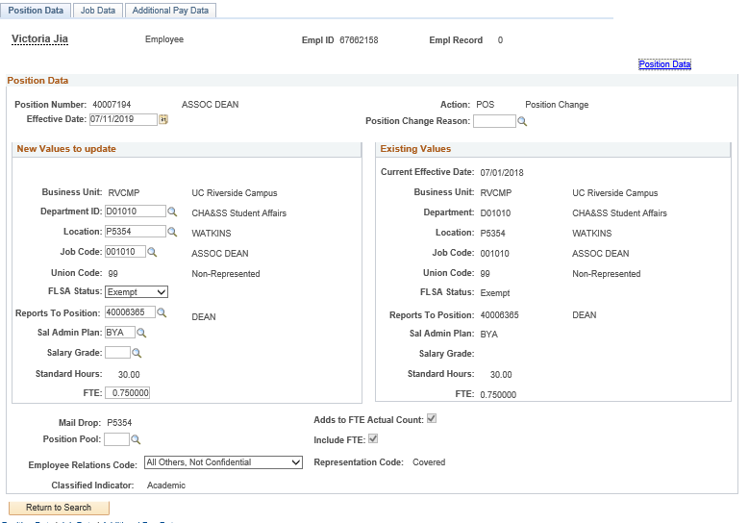
POSITION DATA PAGE
Navigation: PeopleSoft Menu > UC Customizations > UC Extensions > PayPath Actions
Enter the Effective Date for the position update.
Enter the Position Change Reason for the position update.
Use the Position Data page to enter changes to position data.
You must enter the Effective Date and the Position Change Reason fields before entering the update.
The Effective Date cannot be the same date as any existing effective date for the employee in the Position Information component. This is because there is no effective date sequencing for position information. Use the Position Data link to review employee position information including existing effective dates.
Position information updated on this page also updates the Job Data page.
Enter the updates in the editable field(s).

Slide 89
CHECK YOUR UNDERSTANDING

Slide 90
CHECK YOUR UNDERSTANDING
Position Data changes in PayPath Actions can be initiated for what types of positions?
Position information that is updates on the Position Data page also updates the position-related information in the _______ page?
In addition to the effective date you must always enter the __________?
Notes:
Position Data changes in PayPath Actions can be initiated for filled positions where only one employee is assigned to the position.
Job Data
Positon Change Reason

Slide 91
Job Data Changes

Slide 92
JOB DATA CHANGES OVERVIEW
The Job Data page is used for many types of job-related updates, which can be made independent of a Position Data change.
However, if a Position Data change is made, PayPath automatically updates the employee’s Job Data page to display the new position information.
There are many types of Job Data changes, most of which fall into the first three categories.
Data
Pay Rate
Job Earnings Distribution (JED)
Short Work Break

Slide 93
CHANGE TYPE - DATA
Examples of data changes requested through PayPath include:
Extension of Appointment End Date
Extension of Location Use End Date
Academic Reappointment
Change from Limited to Career Status and Change of Employee Class (Staff Only)
Update to Probation Code and/or Probation Date
Data

Slide 94
CHANGE TYPE – PAY CHANGE
Examples of pay changes requested through PayPath include:
Change to rate of pay for staff or academic
Merit/Reappointment
Equity increases
Changes to negotiated salaries
Adjustments to off-scale salary amounts
Step increase progression
Pay components (for example, X, X’, or Annual Salary) automatically populate based on selection of a salary step.
Pay Rate

Slide 95
CHANGE TYPE – JOB EARNINGS DISTRIBUTION
The Job Earnings Distribution (JED) is primarily used to distribute earnings by earn codes, either by percentage or by amount, and is important for exempt employees as it controls how much they are paid when an adjustment to their FTE is not applicable.
Examples of JED changes requested through PayPath include:
Employee Reduction in Time (ERIT)
Phased Retirement Program
HSCP-related automated JED by Earn Code
NSTP-Negotiated Salary Trial Program
Job Earnings Distribution (JED)

Slide 96
CHANGE TYPE – SHORT WORK BREAK
The UCPath Short Work Break (SWB) process refers to placing an employee on, or returning them from, a short work break.
The action of SWB can be used to stop pay for an employee in the system for a temporary period of time and moves them to a “work break” status.
Employees on SWB are monitored on a regular basis. The UCPath Center is responsible for monitoring the Short Work Break Audit Report, and works with Locations to confirm the appropriate course of action regarding the employee on SWB.
Short Work Break

Slide 97
SHORT WORK BREAK – ACADEMIC EXAMPLES
Type | Description
Academic Students | Used to put academic students off pay status over the summer or in between quarters/semesters.
Unit 18- Benefits Bridge Eligible | Used to put a Unit 18 employee off pay status in between quarters/ semesters of active employment. The employee is eligible to request a Benefits Bridge.
Unit 18- Benefits Bridge Not Eligible | Used to put a Unit 18 employee off pay status in between quarters/ semesters of active employment. The employee is not eligible to request a Benefits Bridge.
University Extension (UNEX) | Used to put a UNEX Teacher off pay status in between periods of active employment.
Variable Appointment | Used to put an exempt academic employee with a highly variable schedule off pay status in between periods of active employment.
Research Funding Bridge | Used to place an employee that is awaiting research funding on SWB.

Slide 98
MULTIPLE JOB DATA CHANGES
Effective Date sequencing is important when compensation is involved. Guidelines for entering multiple rows of Job Data in a single transaction:
Must be the same Effective Date.
The sequence number is automatically populated when you add a row in the Job Data tab.
Enter the rows in sequential order or the order in which they occur.
Seq. 0 is the first update, then add a row.
Seq. 1 is the next update, then add a row.
Seq. 2 is the next update, and so forth.
Action | Effective Date | Effective Seq. | Notes
Position Promotion | 3/1/2016 | 0 | Position Data change automatically inserts the first row in PayPath Job Data.
Pay Rate Change / Promotion | 3/1/2016 | 1 | Second row added by user.
Pay Rate Change / Equity | 3/1/2016 | 2 | Third row added by user.

Slide 99
JOB DATA PAGE
Navigation: PeopleSoft Menu > UC Customizations > UC Extensions > PayPath Actions
Enter the Action and Action Reason for the job data update.
Enter the Effective Date for the job data update.
Click + to add multiple job data changes in the same transaction. Multiple changes can be entered only for the same Effective Date.
Use the Job Data page to enter updates to job-related data such as pay, earnings distribution, and short work break.
You must enter the Effective Date and the Action and Action Reason fields before entering an update.
Use the PayPath Job Data Comments to record details about the position and/or job changes.
Notes:
Use the Job Data page to enter updates to job-related data such as pay, earnings distribution and short work break.
You must enter the Effective Date and the Action and Action Reason fields before entering an update.

Slide 100
CHECK YOUR UNDERSTANDING

Slide 101
CHECK YOUR UNDERSTANDING
If you need to make Job Earnings Distribution (JED) changes in PayPath, what page do you use?
Employee Reduction in Time (ERIT) is what an example of what type of change?
This action can be used to stop pay for an employee in the system for a temporary period of time, and moves them to a “work break” status.
Notes:
Job Data Page
Job Data change
Short Work Break

Slide 102
Additional Pay

Slide 103
ADDITIONAL PAY OVERVIEW
Additional Pay is any compensation above a University employee’s regular base compensation.
There are two types of additional pay transactions:
One time – applies to a single pay cycle or non-consecutive pay cycles.
Recurring – payments are paid over multiple, consecutive pay periods.
Additional pay transactions entered in PayPath are routed for approvals and then transferred to a Payroll staging table to be processed automatically by UCPC Payroll additional pay batch upload process.
Additional pay must be entered as a flat per pay period amount.
All pro-rated payments should be calculated prior to entering the flat amount.
When an employee is hired and the Hire Template transaction has been submitted for approval, the employee is not available in PayPath until the Hire Template has been approved and processed by UCPC WFA Production.
After the employee is available in PayPath, the employee’s additional pay data cannot be updated until the Payroll nightly process has assigned the employee’s pay group.

Slide 104
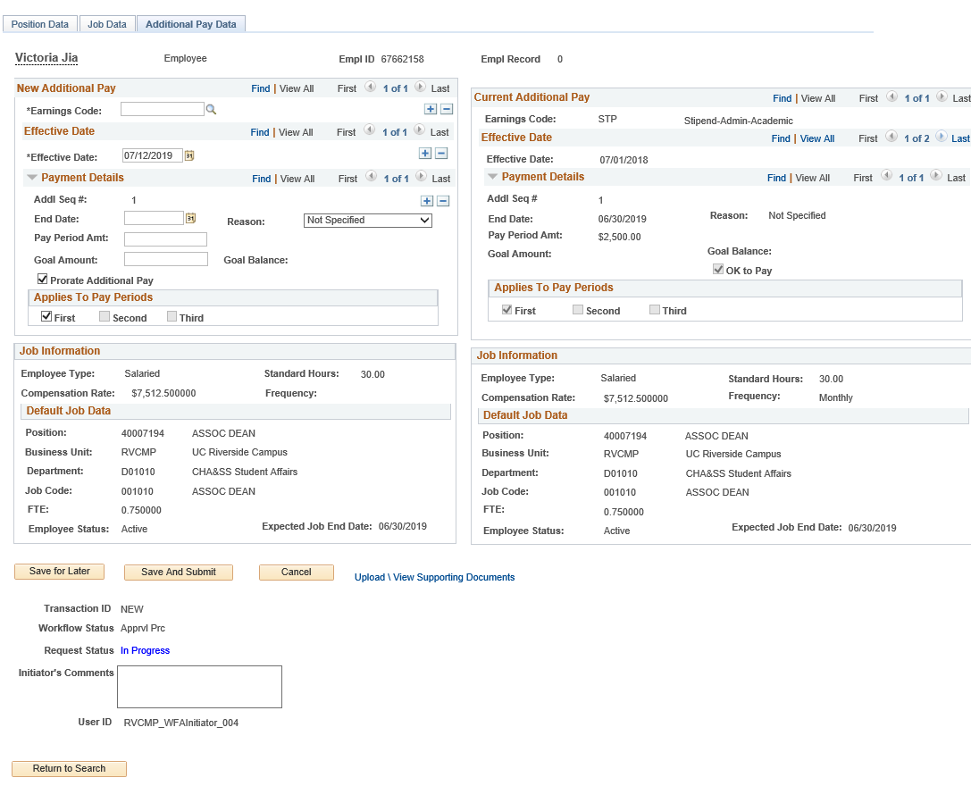
ADDITIONAL PAY DATA PAGE
Navigation: PeopleSoft Menu > UC Customizations > UC Extensions > PayPath Actions
Enter the Earnings Code, Effective Date, and Pay Period Amount. You can also enter a Goal Amount or End Date.
In this example, the employee has existing additional pay, which displays in the Current Additional Pay section.
This section displays a summary of the employee’s current job data.
Use the PayPath Actions Additional Pay Data page to enter specific information about the payment.
Ignore Goal Amount and Prorate Additional Pay.

Slide 105
UPDATE ADDITIONAL PAY
Navigation: PeopleSoft Menu > UC Customizations > UC Extensions > PayPath Actions
Updates can be made to existing recurring additional pay transactions.
The update must be for the same Earnings Code.
The update must have an Effective Date that is within the existing recurring pay Effective Date (start date) and End Date.
After you enter the Earnings Code and the new Effective Date, the current recurring information populates, and the Override Data button appears. Click the Override Data button to open the recurring information fields for edit.

Slide 106
RETROACTIVE ADDITIONAL PAY
Navigation: PeopleSoft Menu > UC Customizations > UC Extensions > PayPath Actions
Retroactive dating is available for additional pay.
The steps for entering a retroactive additional pay transaction are similar to any other additional pay, with the exception of the Effective Date.
In the Effective Date field, enter the previous pay period date that the additional pay should have started.

Slide 107
CHECK YOUR UNDERSTANDING

Slide 108
CHECK YOUR UNDERSTANDING
There are how many types of additional pay transactions?
When would you use one time pay?
When would you use recurring pay?
Notes:
One-time – applies to a single pay cycle or non-consecutive pay cycles.
Recurring – payments are paid over multiple, consecutive pay periods.

Slide 109
How to Clone a Denied Transaction

Slide 110
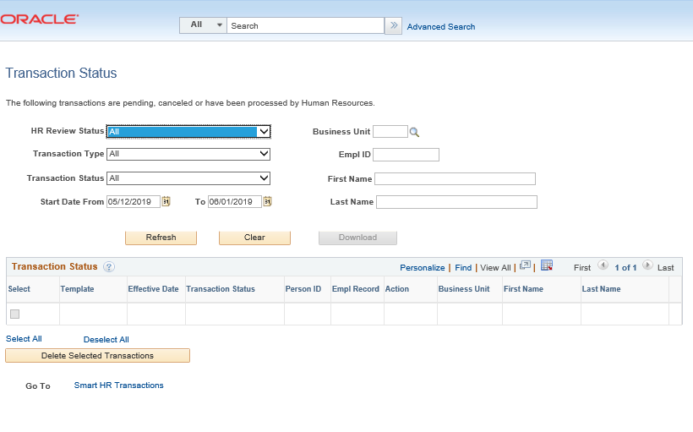
CLONING A TRANSACTION
Navigation: PeopleSoft Menu > Workforce Administration > Smart HR Template > Transaction Status
The AWE Approver denied the transaction, which is routed back to the Initiator’s Transaction Status page.
Click Refresh on the Transaction Status page to view your transactions.

Slide 111
CLONING A TRANSACTION
Navigation: PeopleSoft Menu > Workforce Administration > Smart HR Template > Transaction Status
The Initiator is able to Clone transaction by clicking on the Clone button.
Once you click the Clone button, the button will grey out.
Go to Smart HR Transactions at the bottom of the page to access the cloned template.
The cloning function is available when:
A template transaction is denied by a Location Approver,
Or when a template transaction is cancelled by UCPC WFA Production.
Clone button will grey out what you click on it.
Click on Smart HR Transactions.

Slide 112
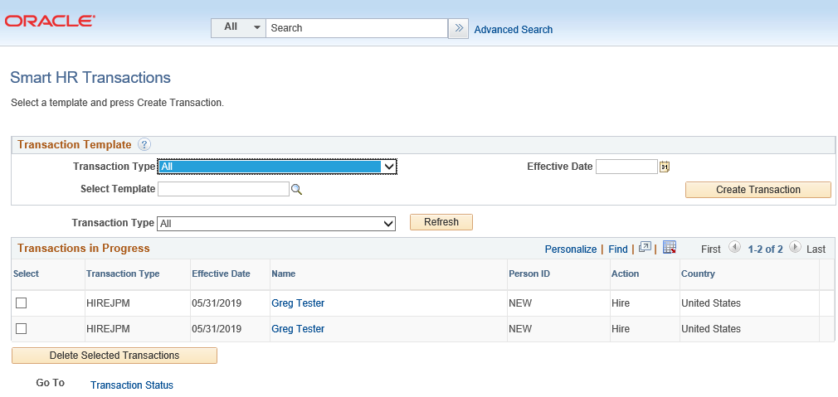
CLONING A TRANSACTION
Initiator will be able to view the cloned transaction.
Transaction number 2 is the cloned transaction; click on this transaction to resubmit.
Transaction number 1 is the original transaction; click on this transaction to view denial comments.
TIP: If you click on the original transaction #1, you will not be able to click the Save and Submit button because it will be greyed out. The cloned transaction will always be on the bottom of the original transaction.
1
Original Transaction
2
Cloned Transaction

Slide 113
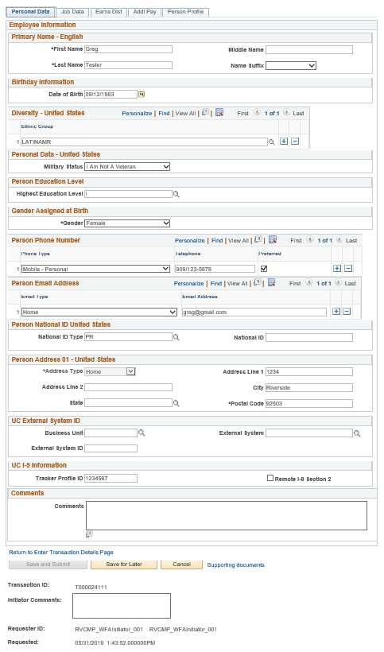
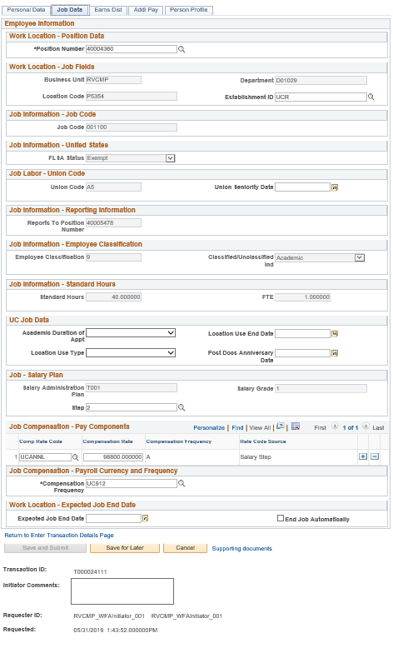
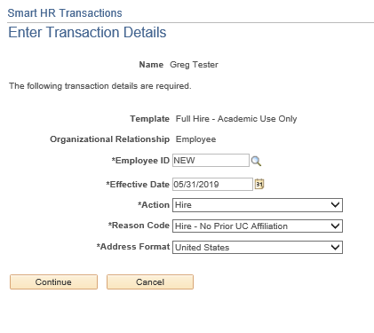
RESUBMITTING A CLONED TRANSACTION
Navigation: PeopleSoft Menu > Workforce Administration > Smart HR Template > Transaction Status
Click on the Continue button to view Transaction Details.

Slide 114
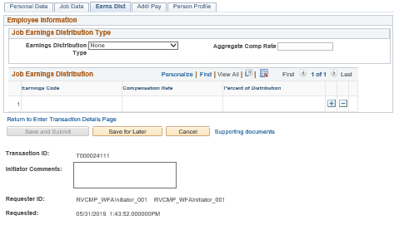
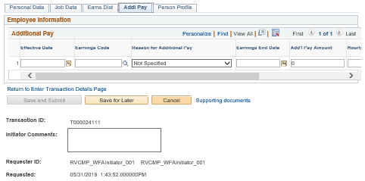
CLONING A TRANSACTION
Navigation: PeopleSoft Menu > Workforce Administration > Smart HR Template > Transaction Status

Slide 115
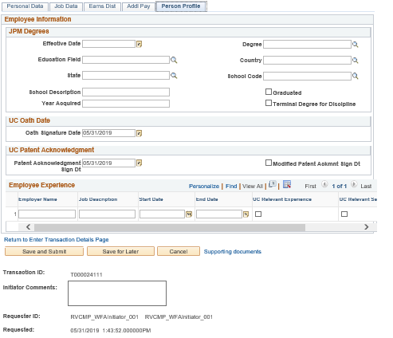
CLONING A TRANSACTION
Navigation: PeopleSoft Menu > Workforce Administration > Smart HR Template > Transaction Status
Once you have corrected what needs to be corrected, resubmit the transaction by clicking on Save and Submit.

Slide 116
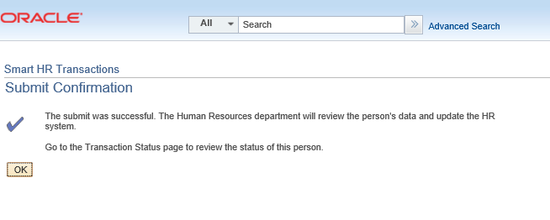
SUBMIT CONFIRMATION
Once the transaction has been submitted, the Initiator will receive a confirmation.
Click the OK button to go to the Transaction Status page to review the status of this person.
The template transaction is routed for approval and appears in the Transactions in Progress section until it is processed.
You have resubmitted a full hire academic template transaction.
The template transaction is routed to AWE for approval.

Slide 117
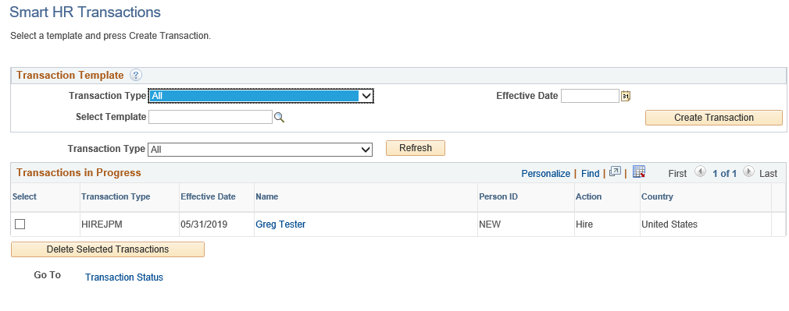
VIEW DENIAL COMMENTS ON ORIGINAL TRANSACTION
Navigation: PeopleSoft Menu > Workforce Administration > Smart HR Template > Smart HR Transactions
Click on person’s name.
The Transaction Details will appear on the screen. Click on Continue.
Initiator views comments in the Smart HR Transactions page.
Initiator clones in the Transaction Status page.

Slide 118
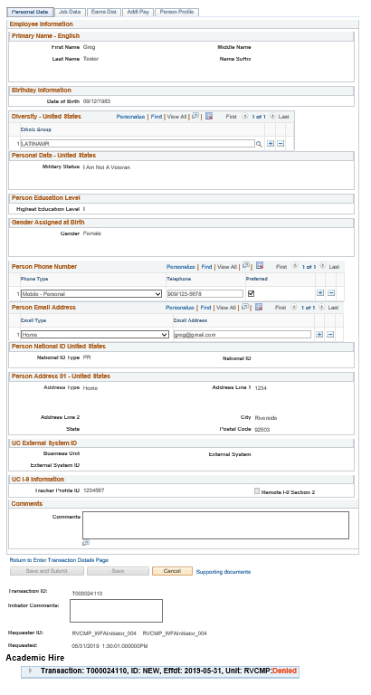
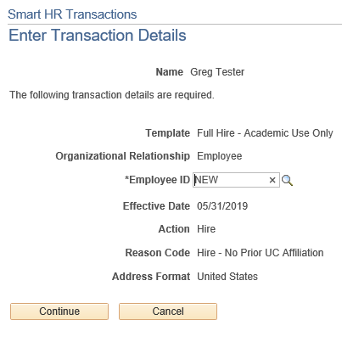
VIEW DENIAL COMMENTS
Navigation: PeopleSoft Menu > Workforce Administration > Smart HR Template > Smart HR Transactions
Click the Continue button on the Transaction Details page.
To view denial comments from the AWE Approver, click on the arrow.

Slide 119
Transaction Status

Slide 120
TRANSACTION STATUS
Navigation: PeopleSoft Menu > Workforce Administration > Smart HR Template > Smart HR Transactions
Navigation: PeopleSoft Menu > Workforce Administration > Smart HR Template > Transaction Status Page
Use the following pages to view the status of template transactions.
SS Smart HR Transaction Page
Use to view the status of template transactions that are still in the approval workflow (AWE).
Transaction Status Page
Use to view the status of template transactions that have completed the approval workflow (AWE) and are being processed by UCPath Center WFA Production.
Notes:
The POI Initiator receives a workflow email when a new
Person ID is created.
The POI Approver receives a workflow email when a new person of interest request is pending approval

Slide 121
SMART HR TRANSACTIONS PAGE
Navigation: PeopleSoft Menu > Workforce Administration > Smart HR Template > Smart HR Transactions
Use the SS Smart HR Transactions page to:
View the status of a template transaction, and where it is within the approval workflow (AWE).
View transactions you have submitted, along with all transactions submitted within your business unit.
See the comments from the Approver who denied the transaction.
Review the template entry details (the fields are view-only).
Notes:
The POI Initiator receives a workflow email when a new
Person ID is created.
The POI Approver receives a workflow email when a new person of interest request is pending approval

Slide 122
SMART HR TRANSACTIONS PAGE
Navigation: PeopleSoft Menu > Workforce Administration > Smart HR Template > Transaction Status
Use the Transaction Status page to view the status of templates after they have completed AWE.
This page tracks the status of templates after they have been routed and approved at the Locations.
View transactions you have submitted, along with all transactions for departments for which you have security access.
This page is also used to clone a transaction that was cancelled or denied.
If you clone a transaction denied at the location, both the original and the clone appear in the list.
Tip: The cloned (new) transaction appears below the original denied transaction in the default sorting of the list.
Notes:
The POI Initiator receives a workflow email when a new
Person ID is created.
The POI Approver receives a workflow email when a new person of interest request is pending approval

Slide 123
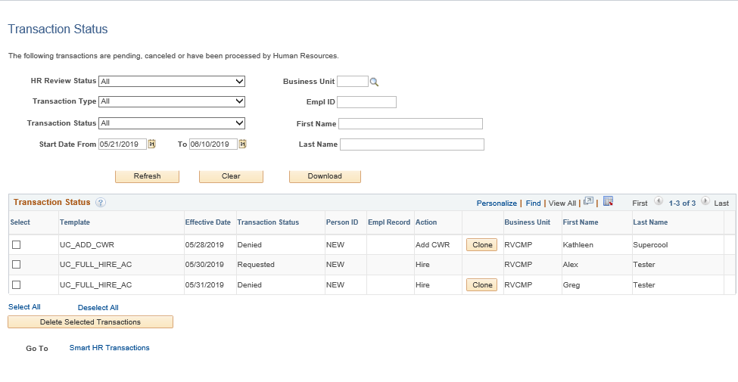
SMART HR TRANSACTIONS PAGE
Navigation: PeopleSoft Menu > Workforce Administration > Smart HR Template > Transaction Status
Transaction Status values are: Requested, Completed, Hired/Added, Denied, and Cancel.
If a transaction is cancelled or denied, you can View Comments to see why it was cancelled/denied, then Clone the existing template information into a new template, correct, and resubmit.
Notes:
The POI Initiator receives a workflow email when a new
Person ID is created.
The POI Approver receives a workflow email when a new person of interest request is pending approval

Slide 124
CHECK YOUR UNDERSTANDING

Slide 125
CHECK YOUR UNDERSTANDING
When is the cloning function available?
You can view denial comments in what page?
Where do you go to clone a transaction?
Notes:
1. The cloning function is available when:
A template transaction is denied by a location approver, or when a template transaction is cancelled by UCPC WFA Production.
2. Initiator views comments in the Smart HR Transactions page.
3Initiator clones in the Transaction Status page.

Slide 126
Approving a Transaction

Slide 127
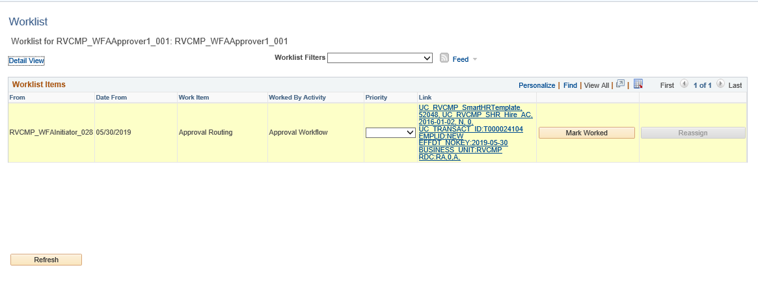
AWE APPROVAL ROLE
The template transaction has been routed for approval and appears in the Worklist.
Click on appropriate template to Approve or Deny the transaction.
Click the link to review, approve, or deny.

Slide 128
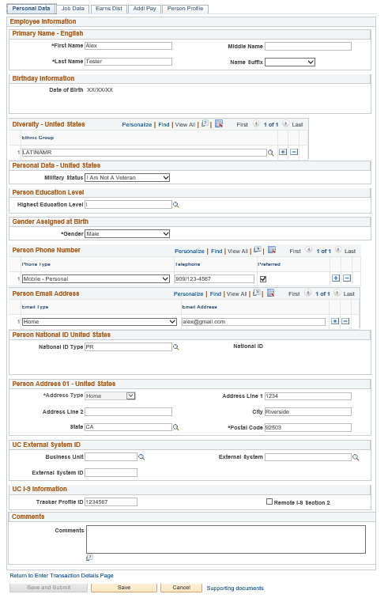
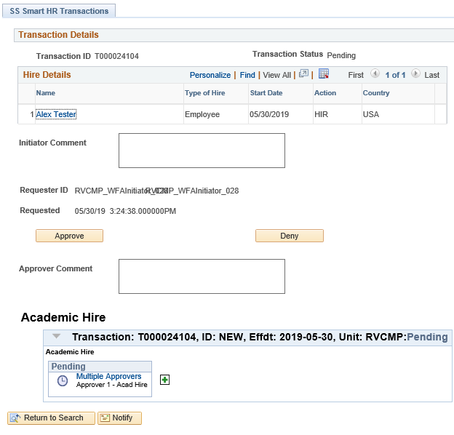
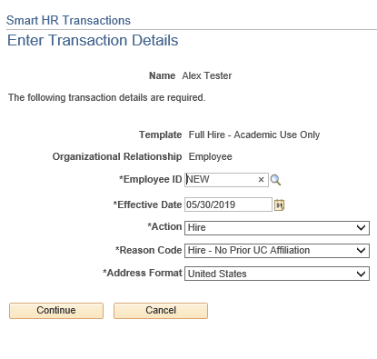
AWE APPROVAL ROLE
Template Transaction will appear.
Click on the Persons Name to view Transaction Details.
Transactional Details will appear. Click Continue.
Notice that the Save and Submit button are greyed out, because this is the original transaction.

Slide 129
AWE APPROVAL ROLE
In this example, we will be approving the Academic Full Hire Transaction. Click Approve.

Slide 130
AWE APPROVAL ROLE
This example shows an approved Academic Full Hire request.
Below you can see that the template was Approved.

Slide 131
SharePoint Instructions and Hands on Training

Slide 132
SHAREPOINT LIST INSTRUCTIONS
Open the Cisco AnyConnect client.
Enter the VPN name: sdsc-vpn.ucop.edu
Click Connect.
Select the Group: hbldtrn0-training
Enter one of the following username:
• ucr_ucpathvpn_01
• ucr_ucpathvpn_02
The VPN password for the week of 7/8/19 is: ~~9+Game+Rome~~
Once Connected to the VPN:
Go to https://hbldtrn0.ucpath-build.devops.universityofcalifornia.edu/psp/HBLDTRN0/?cmd=login&languageCd=ENG&
Enter the Tester ID\Password provided in the SharePoint Scenarios.

Slide 133
SHAREPOINT LIST INSTRUCTIONS
Testing SharePoint: https://ucrshare.ucr.edu/sites/FOM_UCPath/SitePages/Home.aspx
Preferred browsers are Internet Explorer and Chrome. (Save the link as a favorite)
Select UCPath Transaction Training Scenarios from the left side Quick Menu:

Slide 134
VIEWING LIST OPTIONS
When the list opens, note the tabs at the top of the screen:

Slide 135
VIEWING LIST OPTIONS part 2
By selecting ‘List’ you can filter the view on the process you are transacting. The default view is All Transactions. Select a specific transaction type to view the list containing only those transactions:

Slide 136
UPDATING AND EDITING A SHAREPOINT LIST
Many functions of a SharePoint list are similar to MS Excel, except that it is in a central location, and can be accessed / updated by multiple people at the same time.
Use the list headers to filter and sort. Only you will see these temporary changes.
By selecting your name in the drop-down, you will have easy access to only your transactions. This is especially helpful if your name appears several pages into the list.

Slide 137
UPDATING AND EDITING A SHAREPOINT LIST part 2
You can update your test by editing directly by clicking into the cell. Some cells are controlled by a drop-down choice; others are free-form. To save your change, click in another cell.

Slide 138
LEARNING OBJECTIVES REVIEW
Having completed this course, you should be able to:
Identify the actions that are processes using templates.
Identify the pages used to initiate template transactions.
Initiate Full Hire, Concurrent Hire, and Termination template transactions.
Describe the PayPath Transaction system process.
Initiate Positon Data, Job Data Changes, and Additional Pay.
Initiate various PayPath combination transactions.

Slide 139
THINGS TO REMEMBER
The Last Date Worked auto populates with a date that is one day prior to the Effective Date.
If you find yourself navigating to the same pages and/or components, you may want to bookmark them to avoid having to constantly navigate through many menus.
View comments entered by a Location Initiator or Approver in the Smart HR Transaction Page.
Clone a transaction that was cancelled or denied in the Transaction Status Page. If you clone a transaction denied at the location, both the original and the clone appear in the list.
Tip: The cloned (new) transaction appears below the original denied transaction in the default sorting of the list.

Slide 140
THINGS TO REMEMBER
If you aren’t searching by the EMPL ID, always change the operator from “Begins with”, which is always the default, to “Contains”, by clicking on the arrows.
When navigating in UCPath, always use the buttons and links within the site to navigate. Do not use the Back and Next buttons in your web browser toolbar.
Your security access to key pages and components in the UCPath Workcenter is the same as your access to those pages and components from the PeopleSoft Menu.
Job Data changes can be made independent of a position data change. However if a position data change is made, PayPath automatically updates the Job Data page to display the new positon information.

Slide 141
THINGS TO REMEMBER
Enterprise Directory is updated 30 days after Staff termination, 90 days after Faculty Termination, and 180 days after Termination for Post-Docs. Affiliates have until the end date set up for them when the account was created. In all cases, the account can be immediately inactivated in the Enterprise Directory by a departmental Enterprise Directory admin or ITS Super User.
The position must already exist in the system before the hire template can be entered.
Position Data and Job Data changes can be entered in a single PayPath transaction; however they must have the same Effective Date. You can enter multiple Additional Pay entries with different Effective Dates in a single PayPath transaction.
All Job data fields that are controlled by Positon Data appear as display-only.
After a PayPath transaction is submitted for approval (Pending Approval status), you cannot enter another PayPath transaction for that employee record until the pending transaction has been processed by all Approvers.

Slide 142
APPENDIX
PayPath Onboarding and Offboarding EMPL Class 22 Process Map
PayPath Onboarding and Offboarding EMPL Class 22 Process Design Workbook

Slide 143
Your Feedback Please
http://bit.ly/ucpathpilottraining

