Slide 1
Ucr ucpath transaction pilot
POSITION CONTROL

Slide 2
TRAINER INTRODUCTION
Shannon Minter
Title: UCPath Business Support Analyst
Department: UCPath Campus Support Center
Year(s) @UC: 2 1/2
Previous Experience: 14 years of professional human resources analyst experience, focusing on classification & compensation, training development, position management, and recruitment.

Slide 3
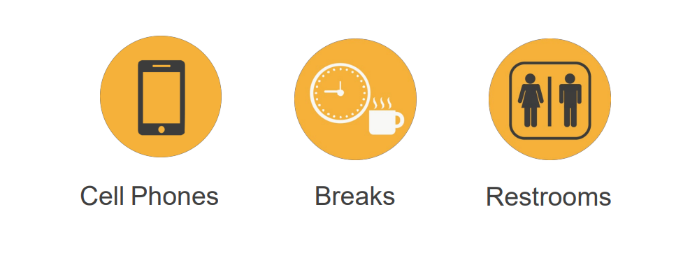
HOUSEKEEPING

Slide 4
LEARNING OBJECTIVES
Understand how Positions are used in UCPath
Insert Learning Objective Review Topic Here
Explain Differences between a single and multi-headcount position
Insert Learning Objective Review Topic Here
Add new positions
Insert Learning Objective Review Topic Here
Update Existing vacant positions
Insert Learning Objective Review Topic Here

Slide 5
LEARNING TOPICS
POSITION CONTROL OVERVIEW
VIEW POSITION INFORMATION
ADD NEW POSITIONS
UPDATE VACANT POSITIONS
REVIEW POSITION CONTROL TRANSACTIONS
VIEW POSITION INFORMATION
KEY SYSTEM STEPS TO ADD A NEW POSITION
INITIATE POSITION CONTROL REQUEST FOR A NEW POSITION
KEY SYSTEM STEPS TO UPDATE VACANT POSITIONS
ACCESS AND VIEW EXISTING POSITION CONTROL REQUEST TRANSACTIONS
INITIATE POSITION CONTROL REQUEST FOR UPDATES TO A VACANT POSITION
SHAREPOINT INSTRUCTIONS

Slide 6
Position Control Overview

Slide 7
POSITION CONTROL OVERVIEW
The Position Control module of UCPath is designed to maintain effective-dated history of all UC positions – filled and vacant.
Benefits of Position Management
Link key data elements and facilitate hiring process.
Define reporting hierarchy and organizational structure of a department.
Tie employees to accounting chart fields that determine how labor costs are distributed.
Use position data for organizational planning, recruitment, career planning and budgeting
When a position is vacated it should be evaluated based on the department's overall budget; it can be inactivated or remain open if there are plans to refill it.
Benefits of Position Data Management

Slide 8
HOW UC USES POSITION MANAGEMENT
All existing employees, including student employees, are assigned a position during conversion.
Most employees are assigned to a single headcount position (one-to-one).
Multiple headcount positions (one-to-many) are used only for non-permanently-funded or non-represented positions.
For employees with multiple jobs, each assignment has a unique position number.
Position Pools are assigned to positions for Work Study funding purposes.
Contingent Workers (CWRs) who supervise others must be hired with a position. CWRs who do not supervise others are hired without a position.
Multi headcount positions should not be used for supervisor and managers as it affects TARS downstream.
One-to-One
Positons
One-to-Many
Positons

Slide 9
JOB VERSUS POSITION
Many employees throughout the various UC Locations share the same title and job code, but each employee has a unique position number.
A position is like an empty box on an org chart. You assign: Business Unit, Job Code (title), Union Code, FLSA Status, and more. The person who is assigned the box inherits those attributes and is referred to as the incumbent.
An advantage of using a position is that you can define the jobs in the department, even if people are not in them.
Job
The joining together of a position and person
Position
Independent of employee
Person
An employee

Slide 10
RELATIONSHIP BETWEEN POSITION DATA AND JOB DATA
Position Data
Establishes key job-related data elements.
Establishes departmental structure and organizational hierarchy, including Reports To supervisor.
Maintained whether position is filled or vacant.
Employee Job Data
Key job-related data default from position data when employee is assigned to a position.
Some position changes affect employee job data; for some updates, UCPath automatically maintains the current incumbent’s job data.
Department
Job Code
Salary Admin Plan &
Grade
Reports to
FTE*
Employee Class
Compensation Rate
Expected Appointment
End Date
FTE*
Position actions and job actions can occur independently or simultaneously, depending on the change(s).

Slide 11
JOB CODES, POSITIONS, AND EMPLOYEES
Position 40000001
ADMIN AST 2 – PENSION & RETIREMENT PROGRAM
Priya Chopra
Job Code 1001
ADMIN AST 2
Position 40000002
ADMIN AST 2 - LOCAL HR SRVCS
Toya Walker
Position 40000003
ADMIN AST 2 - UC WASHINGTON CTR
Emilio Montoya

Slide 12
HOW DOES POSITION DATA WORK?
JOB DATA TABLES
Incumbent history is stored in Job Data tables, which allows for reporting of data.
POSITION ATTRIBUTES
When an employee is hired, promoted or transferred they are assigned a new position. All position attributes flow to job data; re-entry of data is not required.
POSITION ATTRIBUTES
Reclassification and other position changes begin with an update to the position record. If the effective date is a current or future date, the system automatically updates the incumbent’s job data.
POSITION IS STATIC
While an employee may change position, position data remains constant.

Slide 13
HOW DOES POSITION DATA WORK?
POSITION ATTRIBUTES: When an employee is hired, promoted or transferred, they are assigned a new position. All position attributes flow to job data; re-entry of data is not required.
JOB DATA TABLES: Incumbent history is stored in Job Data tables, which allows for reporting of data.
JOB IS STATIC: While an employee may change position, position data remains constant.
POSITION ATTRIBUTES: Reclassification and other position changes begin with an update to the position record. If the effective date is a current or future date, the system automatically updates the incumbent’s job data.

Slide 14
POSITION CONTROL REQUESTS - APPROVALS
Departments request creation of a new position or updates to existing vacant position, and obtain necessary pre-approvals before system entry.
Position Control Requests utilize Approval Workflow Engine (AWE) to route requests locally for approvals before writing to UCPath.
Position Control Initiator
Departments request creation of a new position or updates to existing vacant position.
POI Approver
Position Control Approver
Review, approve, or deny position request
AWE

Slide 15
POSITION FUNDING AND DEPARTMENTAL BUDGETS
Funding refers to the assignment of the account(s) that pays for a position’s compensation.
Position Funding Set Up: This needs to be entered into the FAU tool at least one day after it has been created and approved.
Vacated Position: When a position is vacated, it should be evaluated based on the department's overall budget; it can be inactivated or remain open if there are plans to refill it.

Slide 16
THINGS TO REMEMBER
Position numbers are eight numeric characters, and are auto-generated by UCPath.
A position is required to hire or rehire an employee.
Positions can be maintained even when vacant.
Employees are assigned to more than one position when they have more than one job.
Positions are typically assigned to only one employee. Some positions can be multi-headcount positions, but there are many attributes that must be shared.

Slide 17
CHECK YOUR UNDERSTANDING

Slide 18
View Position Information

Slide 19
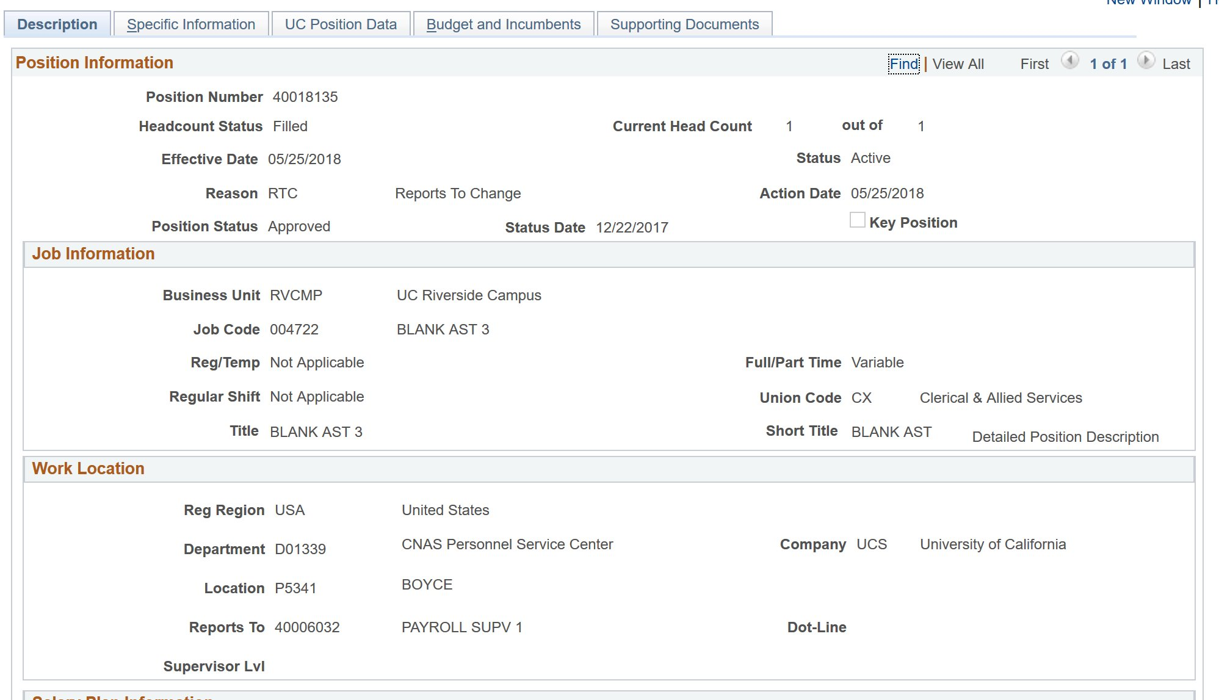
VIEW POSITION INFORMATION - OVERVIEW
View position information using the Add/Update Position Info component.
This page allows you to view detailed information for a specific position.
Position Administrators have date entry access (Add/Update/Display) for this component.
Position Control Initiators have view-only access, as shown in this example.

Slide 20
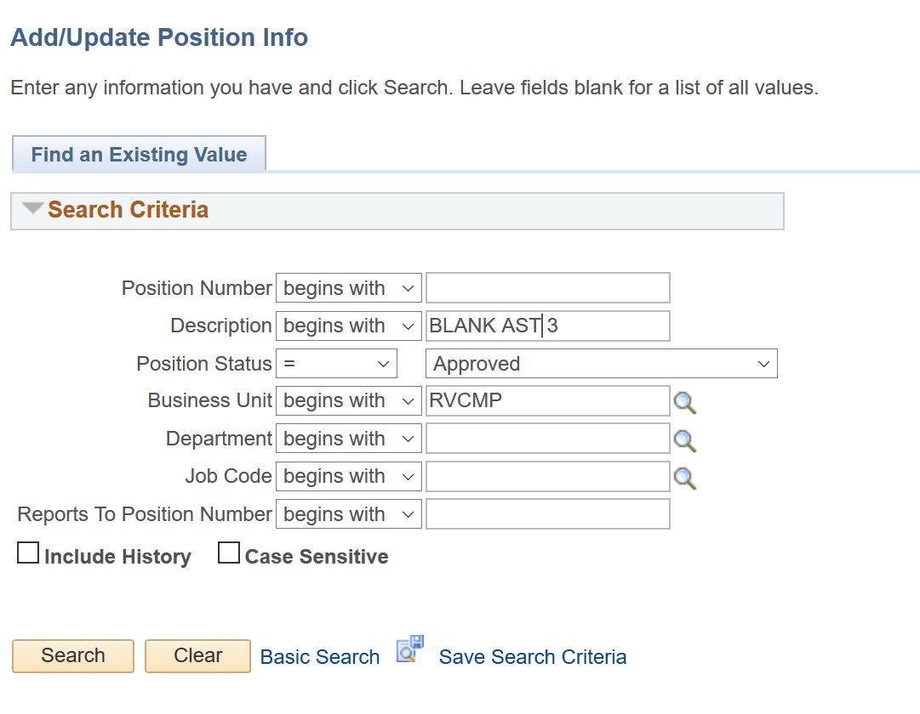
SEARCH FOR POSITION
Navigation: PeopleSoft Menu > Organizational Development > Position Management > Maintain Positions/Budgets > Add/Update Position Info- this should be position control path
Use the Find an Existing Value page to search for an specific position. If you do not know the position number, you can use other search fields.
If you know the position number, enter it and click Search.
Select the Include History option to access and view position data rows.
If you do not know the position number, you can use other known values, as in this example.

Slide 21
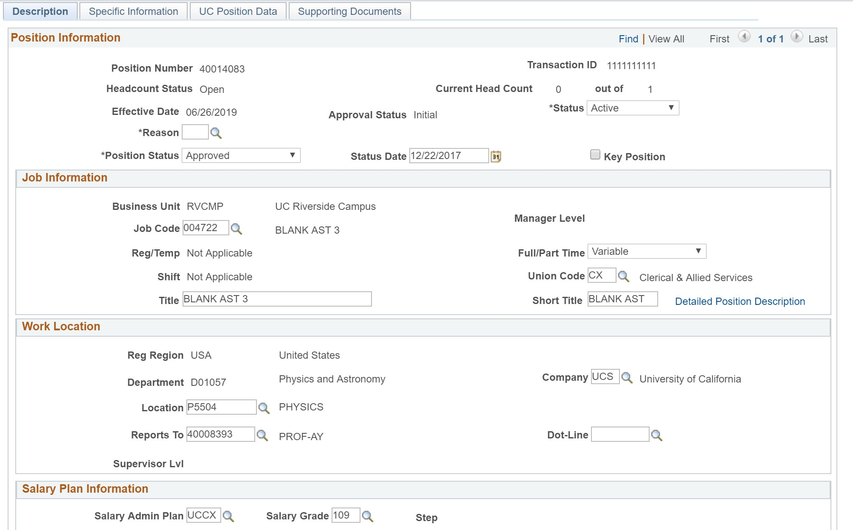
ADD / UPDATE POSITION INFO COMPONENT
Navigation: PeopleSoft Menu > UC Customizations > UC Extensions > Position Control Request
Current Head Count will show 0, indicating the position is vacant.
Having the correct Reports To impacts downstream processes, such as TARS.

Slide 22
CHECK YOUR UNDERSTANDING

Slide 23
Add New Positions

Slide 24
ADD NEW POSITION - OVERVIEW
When a department identifies the need for a new position, it can be requested in UCPath via Position Control.
Org/department provides necessary position information to Position Control Initiators for entry into UCPath.
Position Control Initiator requests new position through Position Control Request page, which is routed through AWE workflow.

Slide 25
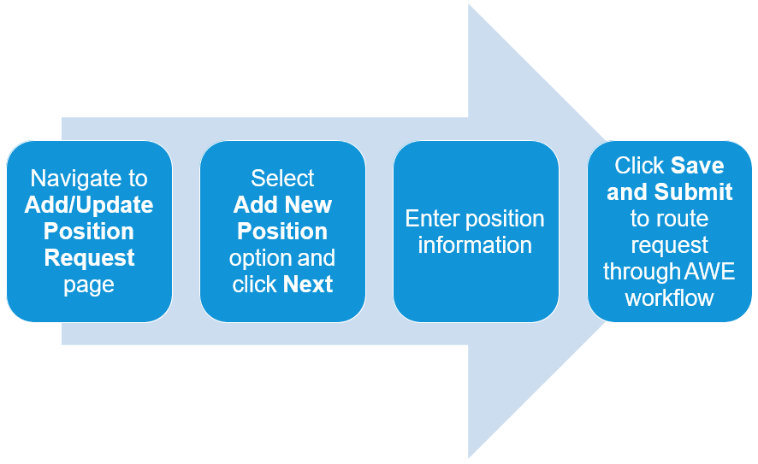
ADD NEW POSITION – KEY SYSTEM STEPS

Slide 26
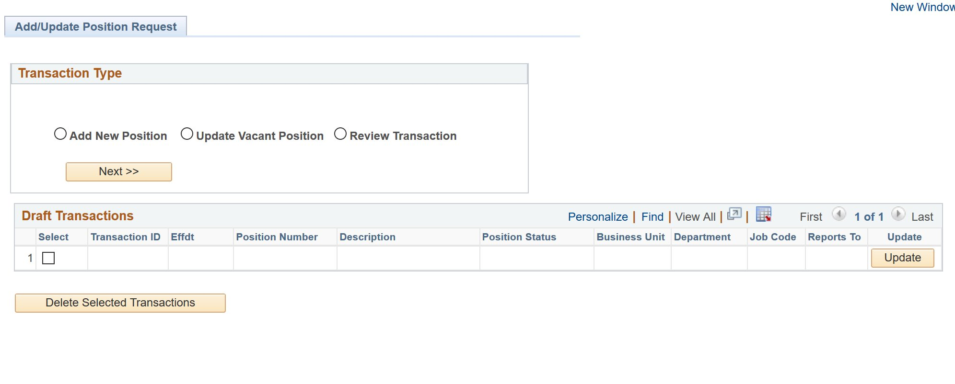
ADD / UPDATE POSITION REQUEST PAGE
Navigation: PeopleSoft Menu > UC Customizations > UC Extensions > Position Control Request
The system displays the Add/Update Position Request page.
Click the Add New Position option and click Next to begin the steps for adding a new position control request.

Slide 27
CHECK YOUR UNDERSTANDING

Slide 28
Initiate Position Control Request For A New Position

Slide 29
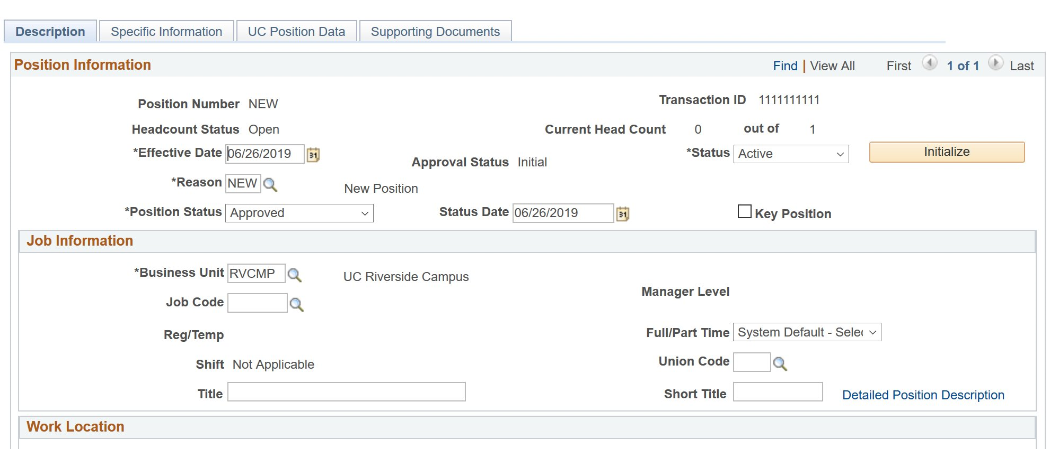
POSITION CONTROL REQUEST COMPONENT
Use the Position Control Request component to enter details regarding the new position you are requesting.
The initial steps for requesting a new position include entering the date on which the position becomes effective, entering job information, including the job code, and specifying work location information.

Slide 30
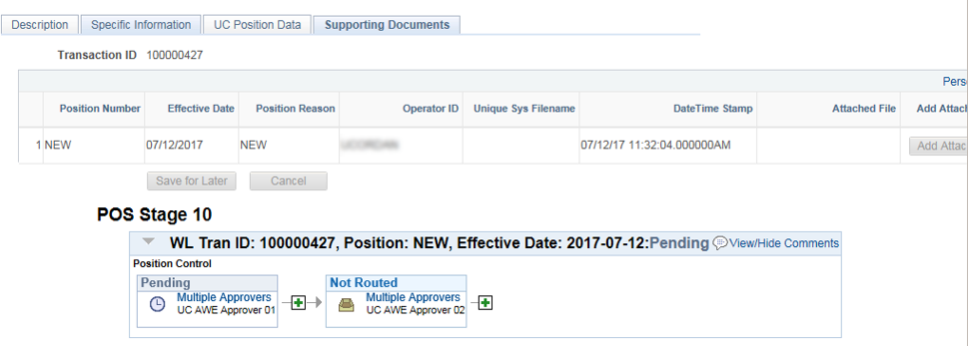
APPROVAL WORKFLOW
When you successfully save and submit a Position Control Request transaction, the system automatically routes it to the appropriate Location Approver(s).
The bottom portion of the Supporting Documents page displays the approval flow and the Approvers to which the system routes the transaction. In this example, there are two levels of approval and multiple Approvers set up at each level. The transaction is pending the first level approval.
To display the specific Approvers’ names for an approval level, click the Multiple Approvers link.

Slide 31
EMAIL NOTIFICATIONS
System-generated notifications confirm when your Position Control transaction is submitted, and when it is approved.

Slide 32
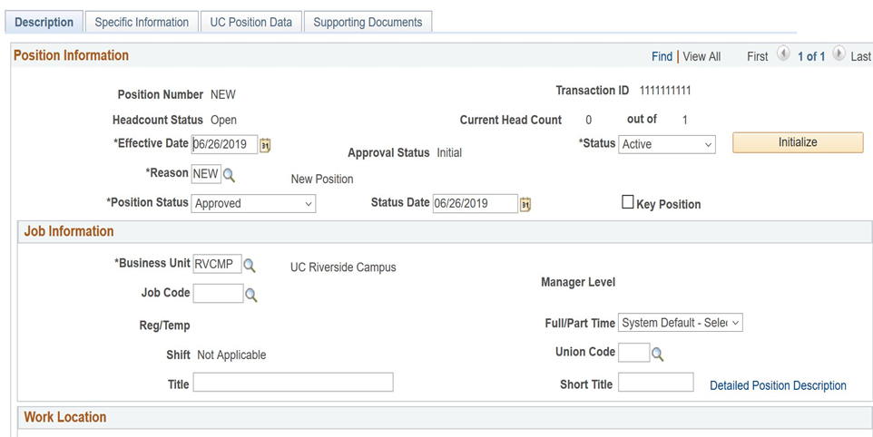
CLONE AN EXISTING POSITION
You can clone information from an existing position in UCPath to initiate a request for a new one.
Click Initialize (cloning feature) to begin the steps for cloning data from an existing position.
The system displays the Default Position Data dialog box, which you use to specify the position from which you want to clone the data.

Slide 33
CHECK YOUR UNDERSTANDING

Slide 34
Update Vacant Positions

Slide 35
UPDATE VACANT POSITION - OVERVIEW
Use when updating a vacant position’s data, such as the reports to position, job code, salary plan, and so forth.
A vacant position is unfilled on or after the Effective Date you enter on the Find an Existing Value page of the Position Control Request.
Updates to vacant positions have fewer downstream effects since there is not an incumbent.
Remember:
Updates to a filled position must be completed using a
PayPath Actions transaction, which we will cover in Phase 2.
Updates to a multi-headcount position must be made directly in the Add/ Update Position Info component by a Position Administrator, which must be sent to the SSC.

Slide 36
Key System Steps To Update Vacant Positions

Slide 37
UPDATE VACANT POSITION – KEY SYSTEM STEPS
Select Update Vacant Position option and click Next
Click Save and Submit to route request through AWE
workflow
Navigate to Add/Update Position Request page
Search for and select appropriate position
Update appropriate position data

Slide 38
ADD / UPDATE POSITION REQUEST PAGE
Navigation: PeopleSoft Menu > UC Customizations > UC Extensions > Position Control Request
The system displays the Add/Update Position Request page.
Click the Update Vacant Position option and then click Next to begin the steps for initiating a position update control request.

Slide 39
Access And View Existing Position Control Request Transactions

Slide 40
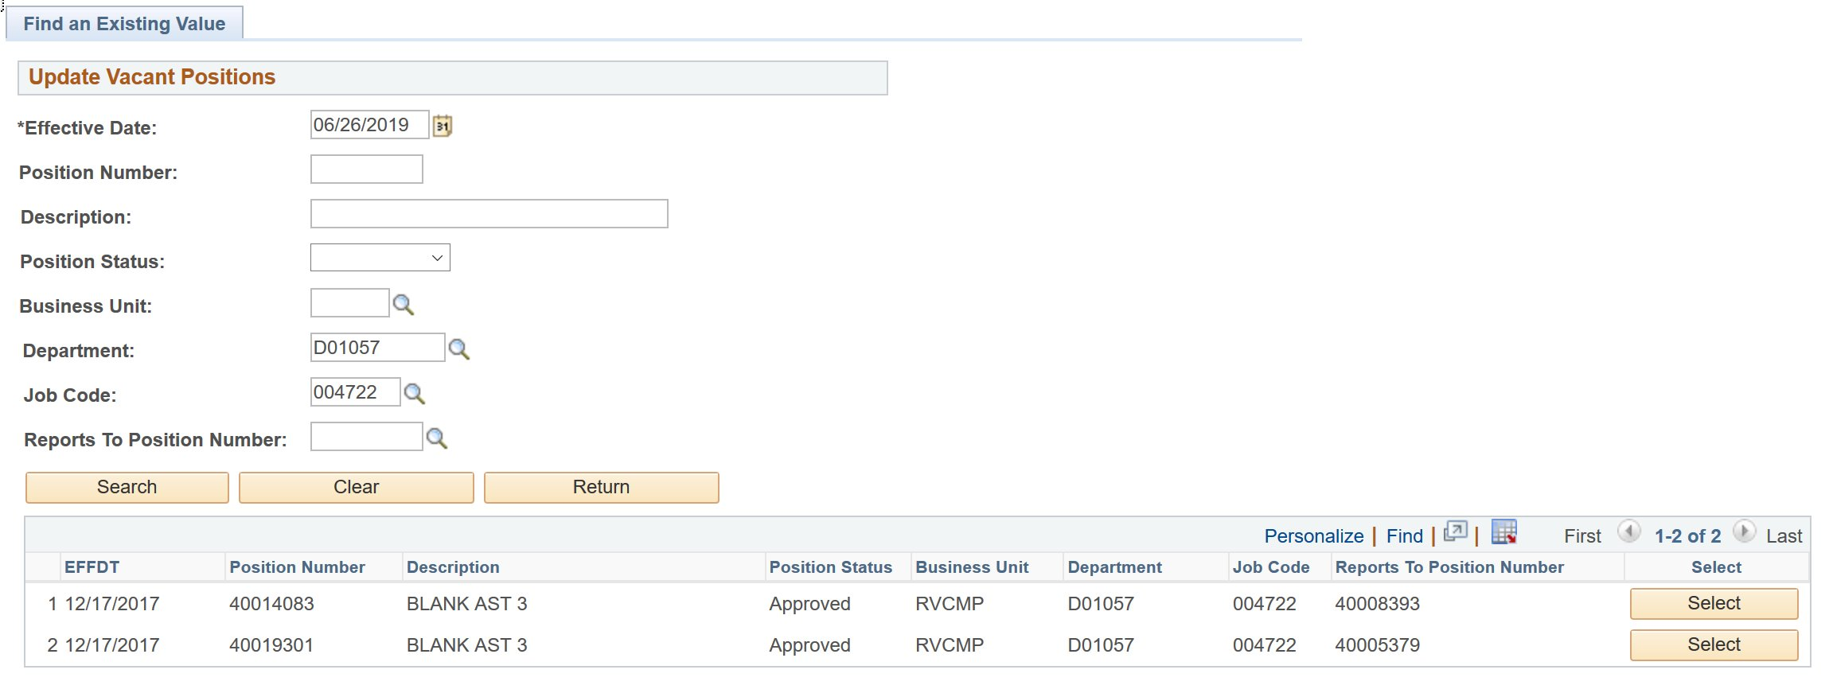
FIND AN EXISTING VALUE PAGE
Use the Find an Existing Value page to search for the vacant position you want to update.
The search results section displays only those vacant positions that match the search values you entered.
Click the Select button next to the position you must update.

Slide 41
CHECK YOUR UNDERSTANDING

Slide 42
Initiate Position Control Request For Updates To A Vacant Position

Slide 43
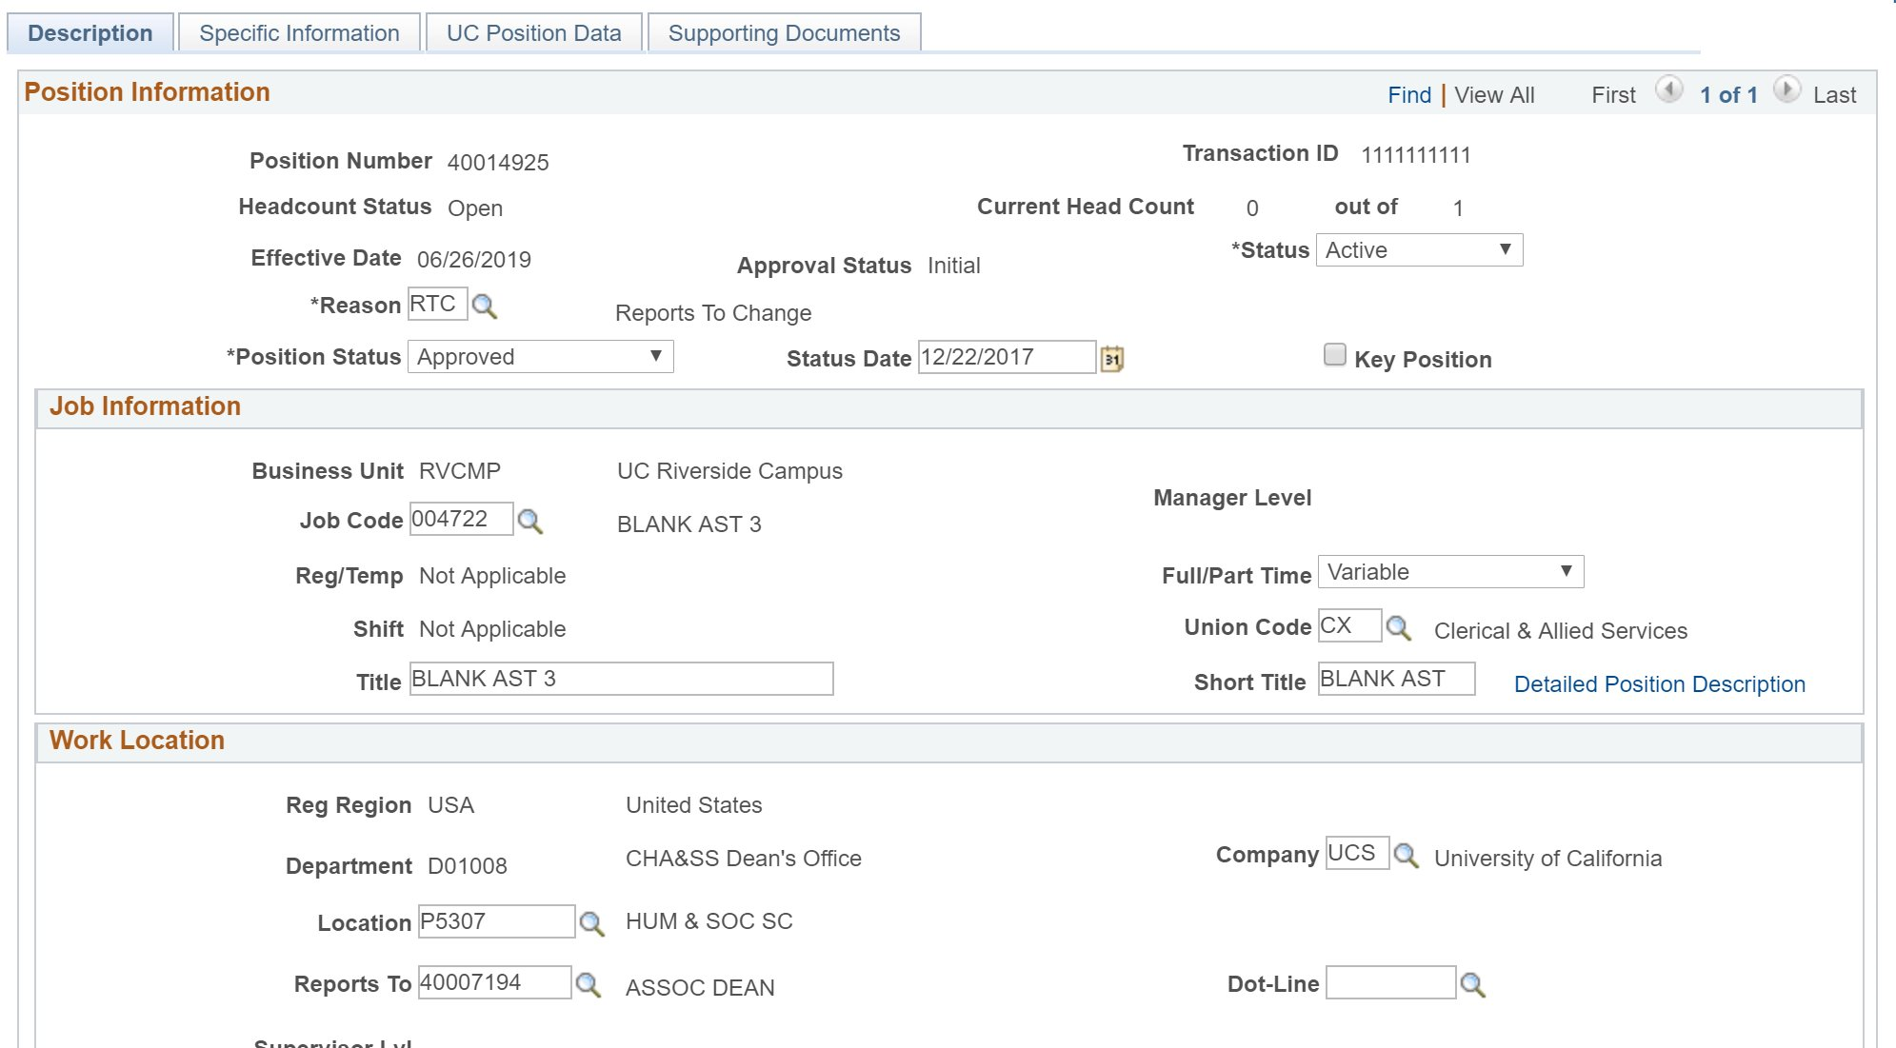
POSITION CONTROL REQUEST COMPONENT
Use the Position Control Request component to make changes to a vacant position, such as moving the position from one department to another, updating the work phone, or updating the position status.
The initial steps for updating a vacant position are ensuring the headcount is 0, and selecting the appropriate reason for the update.

Slide 44
Position Control Reason Codes

Slide 45
REASON CODES
There are several Reason Codes associated with a position update in UCPath:
Action | Reason | Description
POS | ACR | Accretion to Bargaining Unit
POS | ADJ | Created for Payroll Adjustment
POS | APU | APU Change
POS | CID | Change in Duty Station
POS | CNV | Conversion Use Only
POS | COR | Correction Salary Plan, Grade, etc.
POS | CWT | Change in Working Title
POS | E2C | Mass Position Creation
POS | ERC | Update Employee Relations Code
POS | FL2 | FLSA Update – Does Not Meet
POS | FL3 | FLSA Revert
POS | FLS | FLSA Override Due to Review
POS | FTE | Revert to Position FTE
POS | IN1 | Inactive – Business Unit Transfer
POS | IN2 | Inactive – No Plan to Refill
POS | IN3 | Inactive – Void Position
POS | INA | Position Inactivated
POS | JFT | Job Data FTE Override

Slide 46
REASON CODES (continued)
There are several Reason Codes associated with a position update in UCPath:
Action | Reason | Description
POS | JFT | Job Data FTE Override
POS | JRD | Job Reclassification – Downward
POS | JRL | Job Reclassification – Lateral
POS | JRU | Job Reclassification – Upward
POS | LVL | Post Doc Level Progression
POS | MCD | Update Mail Code
POS | NEW | New Position
POS | PIT | Permanent Increase In Time (FTE)
POS | POC | Position Only Change
POS | PRI | Permanent Reduction - Layoff
POS | PRO | Promotion
POS | PRT | Permanent Reduction In Time (FTE)
POS | REG | Regularization
POS | REO | Re-Organization/Restructure
POS | RTC | Reports To Change
POS | SEC | Series Change
POS | TIT | Temporary Increase in Time
POS | TRT | Temporary Decrease in Time
POS | XFR | Transfer

Slide 47
Review Position Control Transactions

Slide 48
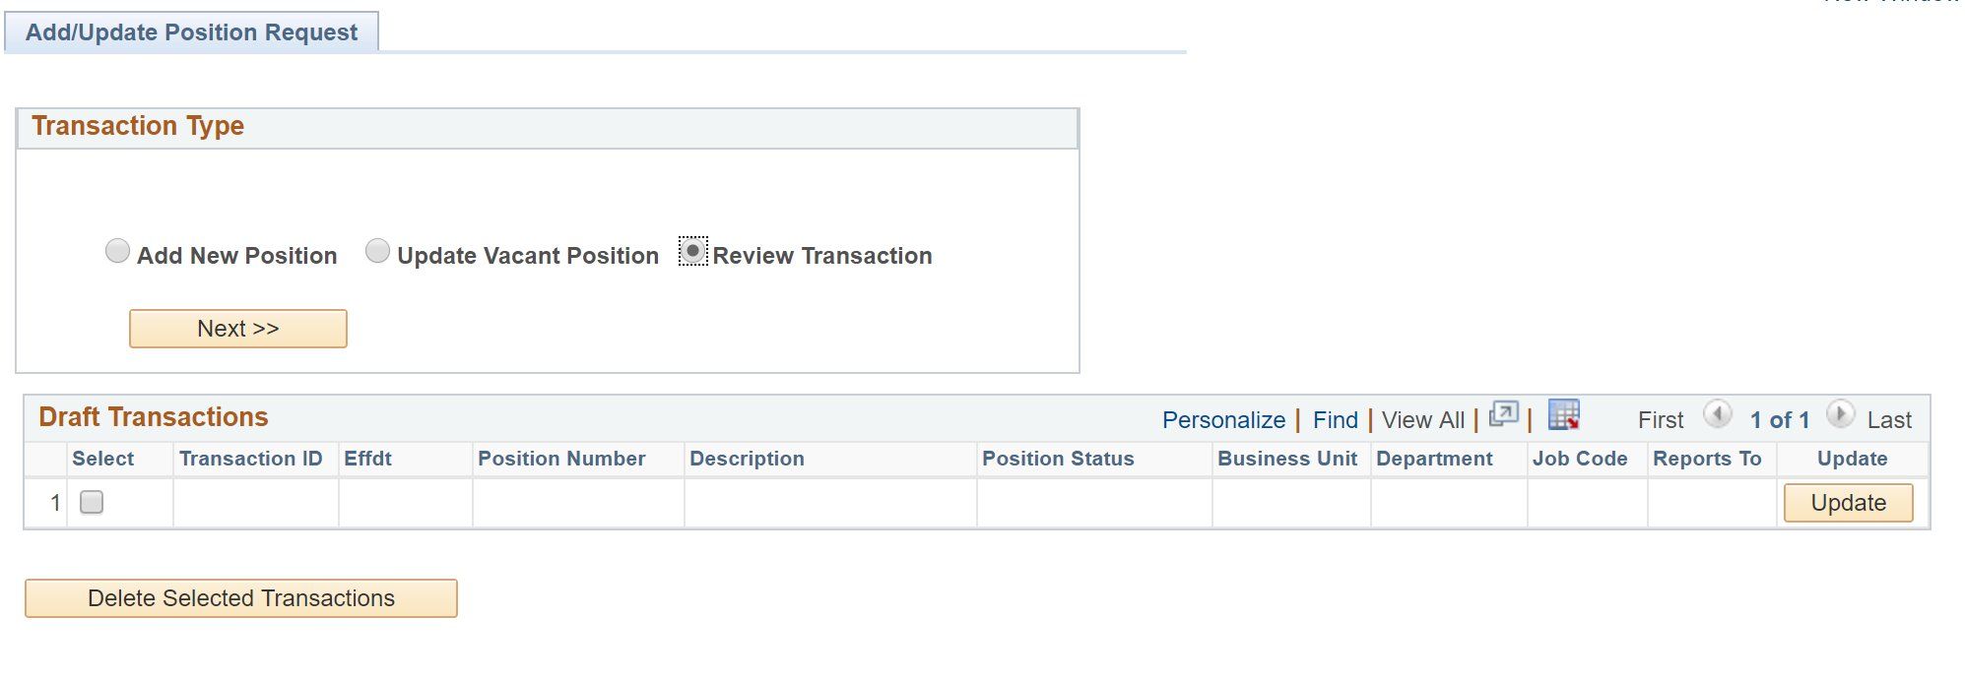
REVIEW POSITION CONTROL TRANSACTIONS
Use the Add/Update Position Request page to review transactions for business units for which you have access.
This is the same page you use for adding a new position, or updating a vacant position.
Click the Review Transaction option, and click Next to begin the steps for viewing an existing position control request.

Slide 49
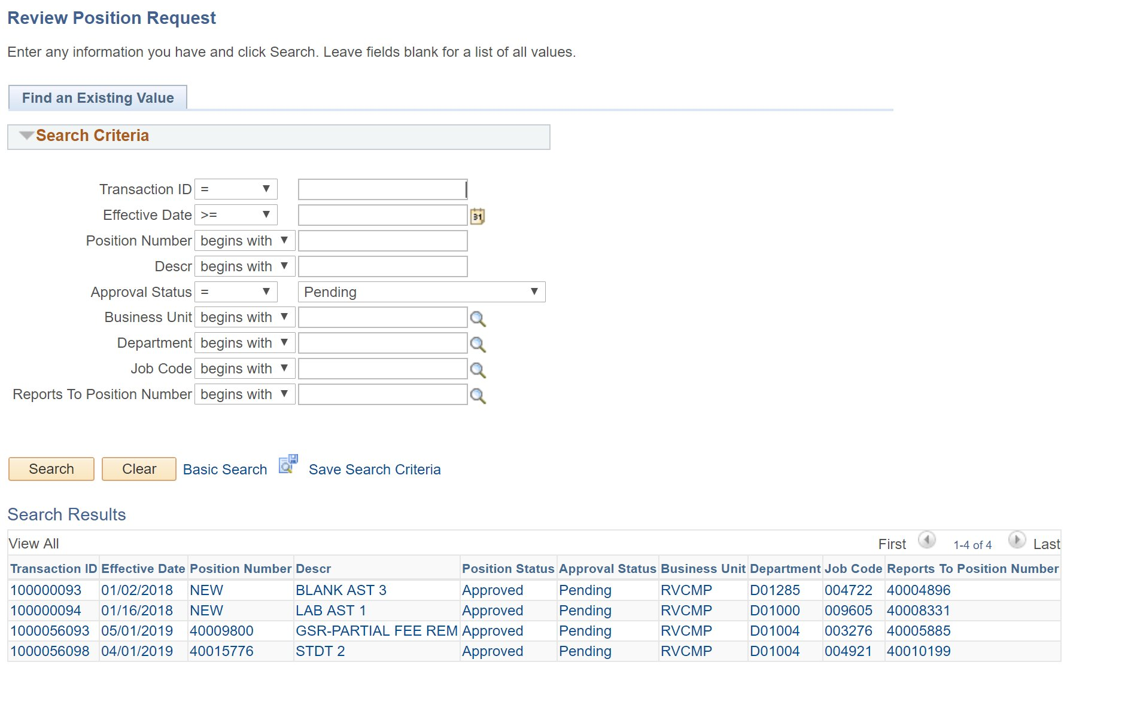
FIND AN EXISTING VALUE PAGE
Use this page to enter known search criteria, to narrow the search to only the position control transaction(s) you want to view.
You have the option to search for requests with any status by leaving the Approval Status field blank, or you can search for requests with one or more specific statuses.
When the search results display more than one transaction, click on the one you want to view.

Slide 50
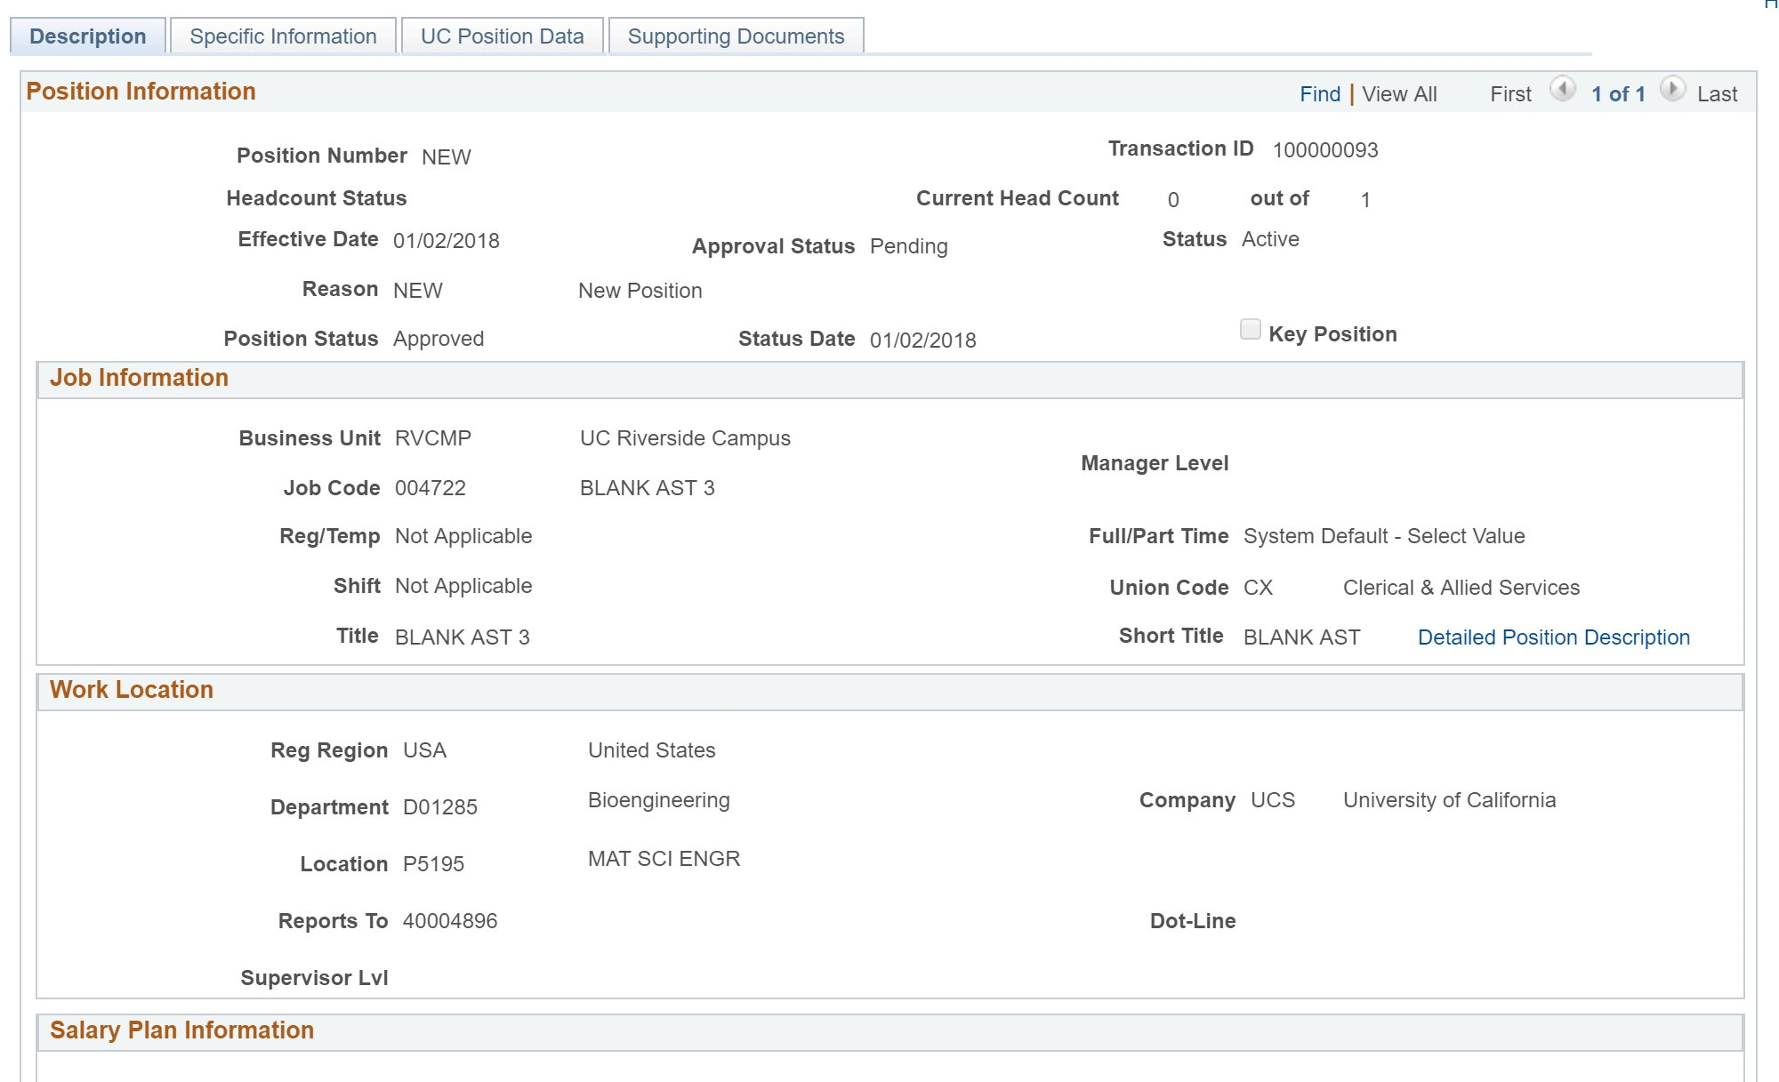
POSITION CONTROL REQUEST COMPONENT

Slide 51
THINGS TO REMEMBER
Position Control Initiators use Position Control Requests to add positions or update vacant positions.
PayPath Initiators update positions that have a single incumbent using the PayPath Actions component.
A vacant position is one that is unfilled on or after the Effective Date you enter on the Find an Existing Value page of the Position Control Request.
Because there is not an incumbent employee, there are fewer downstream effects to updating a vacant position.
Position Control Requests utilize AWE to route transactions locally for approval before being routed to UCPath.

Slide 52
COURSE OBJECTIVES REVIEW
Having completed this course, you should be able to:
Identify features of the Position Management module.
Explain the relationship between position data and job data.
View position information.
Initiate a position control request for a new position.
Initiate a position control request for updates to a vacant position.
Access and view existing position control request transactions.

Slide 53
UPDATING POSITION CONTROL (continued)
Field Name | Definition
Tester Net ID | Test User’s Login Name
Tester Password | Test User’s Password
Position Number | Position Number
Job Code | Choose Any within your Accountability Structure
Department | Choose Any within your Accountability Structure
Report To | Future Employee’s (Supervisor/Manager) Report To
FTE | Position’s FTE Amount (between 0.5-1)
Tester Notes | Tester Notes
Report To | Terminated Employee’s (Supervisor/Manager) Report To
Employee Classification | Terminated Employee’s Employee Classification
FTE | Terminated Employee’s FTE Amount
Tester Notes | Tester Notes
Status | Enter current status of scenario (New, In Progress, etc.)
Transaction ID | Enter Transaction ID after submitting Voluntary Termination Templ.

Slide 54
CHECK YOUR UNDERSTANDING

Slide 55
SharePoint Instructions and Hands on Training

Slide 56
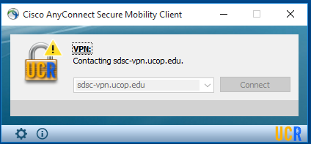
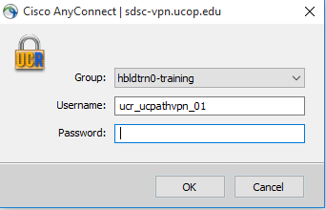
SHAREPOINT LIST INSTRUCTIONS
Open the Cisco AnyConnect client.
Enter the VPN name: sdsc-vpn.ucop.edu
Click Connect.
Select the Group: hbldtrn0-training
Enter one of the following username:
ucr_ucpathvpn_01 Row 1 and Row 2
ucr_ucpathvpn_02 Row 3 and 4
ucr_ucpathvpn_02 Row 5 and 6
The VPN password for the week of 7/8/19 is: ~~9+Game+Rome~~
Once Connected to the VPN:
Go to https://hbldtrn0.ucpath-build.devops.universityofcalifornia.edu/psp/HBLDTRN0/?cmd=login&languageCd=ENG&
Enter the Tester ID\Password provided in the SharePoint Scenarios.

Slide 57
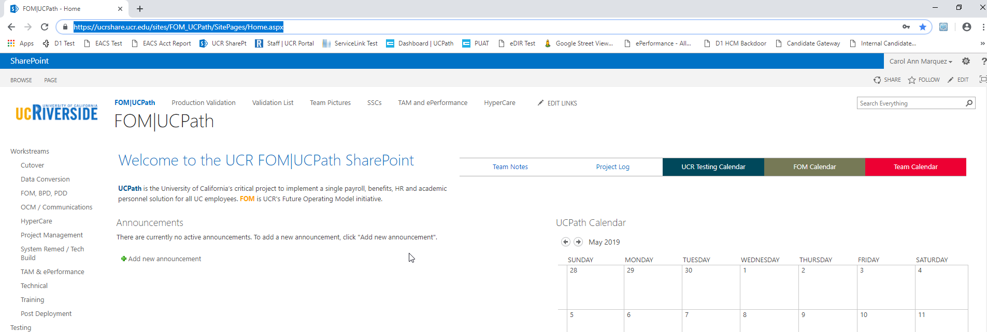
SHAREPOINT LIST INSTRUCTIONS
Testing SharePoint: https://ucrshare.ucr.edu/sites/FOM_UCPath/SitePages/Home.aspx
Preferred browsers are Internet Explorer and Chrome. (Save the link as a favorite)
Select UCPath Transaction Training Scenarios from the left side Quick Menu:

Slide 58
VIEWING LIST OPTIONS
When the list opens, note the tabs at the top of the screen:

Slide 59
VIEWING LIST OPTIONS (part 2)
By selecting ‘List’ you can filter the view on the process you are transacting. The default view is All Transactions. Select a specific transaction type to view the list containing only those transactions:

Slide 60
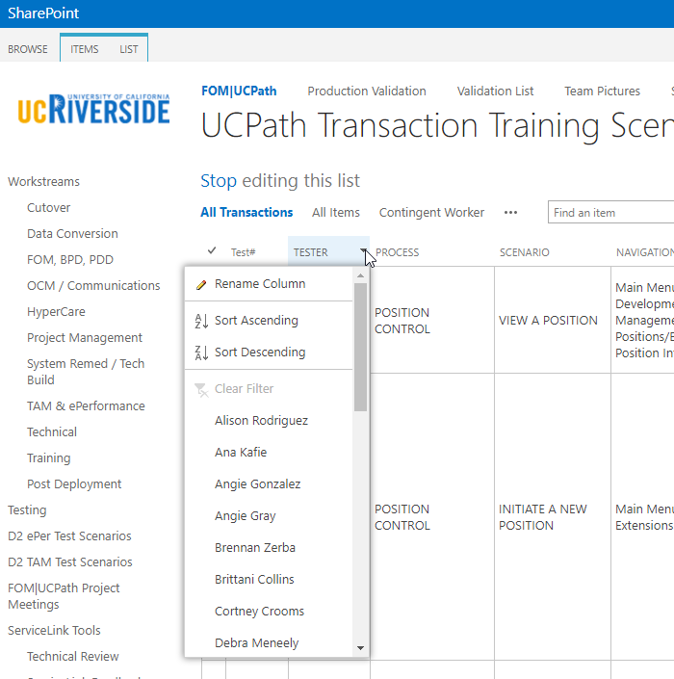
UPDATING AND EDITING A SHAREPOINT LIST
Many functions of a SharePoint list are similar to MS Excel, except that it is in a central location, and can be accessed / updated by multiple people at the same time.
Use the list headers to filter and sort. Only you will see these temporary changes.
By selecting your name in the drop-down, you will have easy access to only your transactions. This is especially helpful if your name appears several pages into the list.

Slide 61
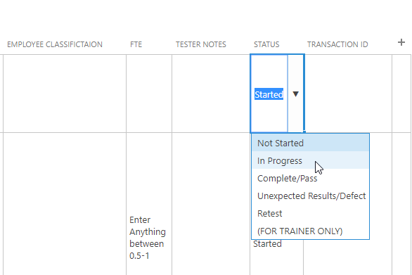
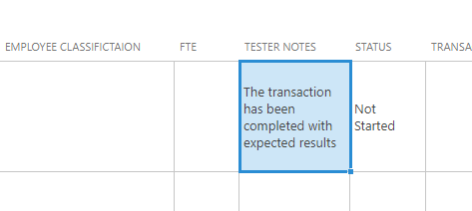
UPDATING AND EDITING A SHAREPOINT LIST (part 2)
You can update your test by editing directly by clicking into the cell. Some cells are controlled by a drop-down choice, others are free-form. To save your change, click in another cell.

Slide 62
Appendix

Slide 63
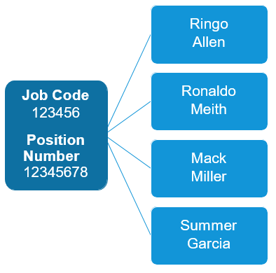
MULTI-HEADCOUNT POSITIONS
Definition Attributes Possible Uses
Jobs with the same attributes can be grouped into one position, rather than creating a unique position for every job. | Business Unit, Dept., Location Job Code, Union Code, Employee Relations Code, Special Training Code Reports To, Personnel Program FTE, Salary Plan, Grade, FAU | Per Diem, Recreation Program Instructors Limited and Students TAs, Readers, Tutors Emeriti (WOS), Summer Session Instructors, UNEX Instructors

Slide 64
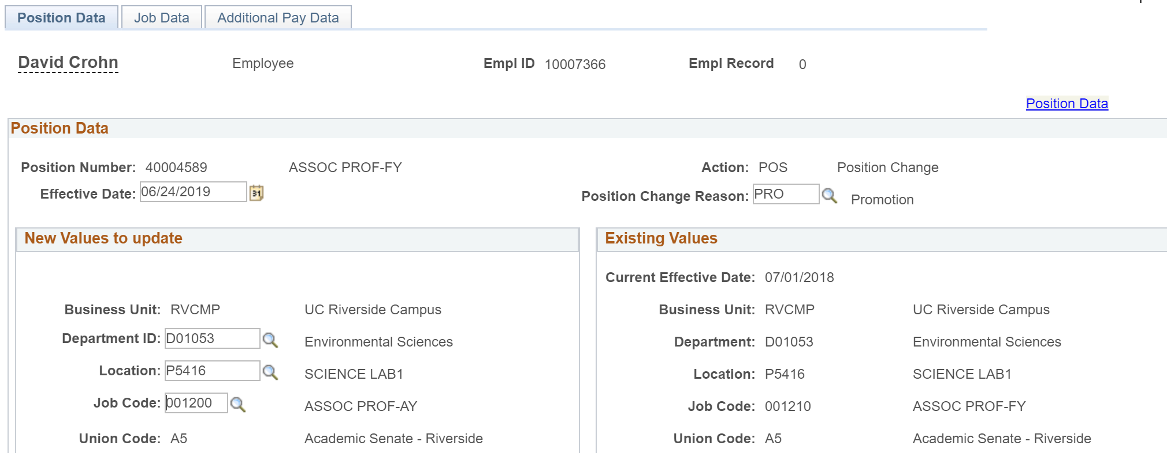
POSITION DATA AND PAYPATH TRANSACTIONS
Location PayPath Initiators use the PayPath Actions component to update position data and/or job data. Position changes made in PayPath Actions automatically update the employee's job data to ensure they remain in sync.

Slide 65
POSITION MANAGEMENT ROLES
Partner or designee
Act as brokers of HR/AP/Payroll services and primary point of contact for managers and unit level leadership
Transactional Unit
Shared Services
Responsible for executing transactional activities related to position updates
Planning & Budget Office
Provide subject matter expertise in technical/complex areas (e.g., classification, salary grade/step)
Identify and communicate need for new position or updates to existing positions
Responsible for AWE for new position requests and position updates
Central Office
Provides policy guidance and oversight
Provide guidance on establishing positions from budget perspective
Creating new positions within
Represent the needs of the department(s)

Slide 66
POSITIONS: WHO DOES WHAT AND WHERE
Role | Role: Position Control Initiator | Role: Position Initiator | Role: UCPath Center WFA Production
Who | Department / Unit | SSC | UCPath WFA
Where | Position Control Request | Position Management (Add/Update Position Info) | Position Management (Add/Update/ Correct Position Info)
What | Used to request a new position and to request an update to vacant positions. This method initiates AWE. | Used to add and update data including multi-headcount positions. This method does not initiate AWE. | Used to app, update and correct position data. This method does not initiate AWE.
* PayPath Initiator will be address in later course.

Slide 67
Your Feedback Please
http://bit.ly/ucpathpilottraining

